Slide 1
Notes:
Presenter: Opening Slide

Slide 2
Teacher information session Changes to the nationally assessed languages at continuers level
OFFICIAL
for teaching at:
Stage 1 in 2024
Stage 2 in 2025
Dutch
Romanian
Yiddish
Armenian
Bengali
Bosnian
Polish
Karen
Tamil
Serbian
Persian
Punjabi
Swedish
Filipino
Portuguese
Macedonian
Croatian
Russian
Turkish
Sinhala
Chin Hakha
Nepali
Hungarian
Karen
Hindi
Auslan

Slide 3
Acknowledgement of Country
OFFICIAL

Slide 4
Online meetings – housekeeping
Please keep your speaker on mute.

Slide 5
Agenda
OFFICIAL
1.30 pm | Welcome
 | Future directions of the SACE
 | Proposed subject improvements for 2025
 | The new CCAFL framework for Stage 2 - Stage 2 exam 2025
2.30 pm | Finish

Slide 6
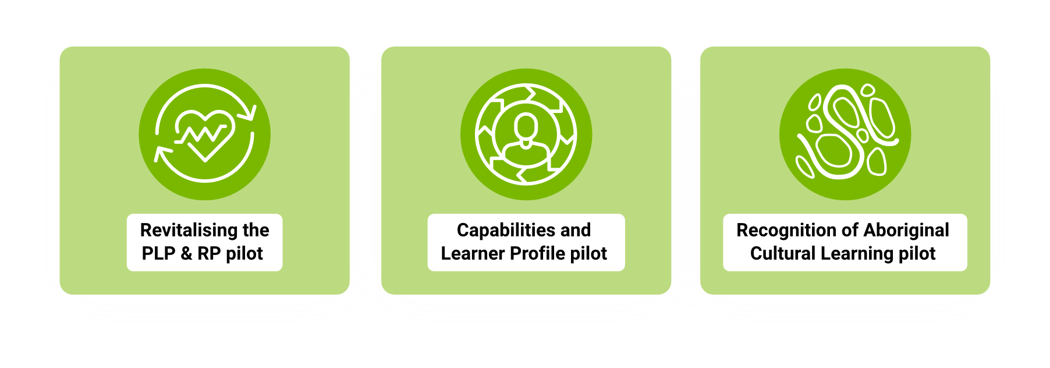
Future directions
Using ‘thrive’ to reconceptualise curriculum, pedagogy, assessment, quality assurance, recognition and certification
Notes:
​
​

Slide 7
Future Directions. A qualification for a changing world
Subject Renewal
Enabling deeper, real-world learning, disciplinary knowledge, and embedded capabilities.
Recognition
Quality Assurance
Building an enhanced model that extends trust, provides better feedback and builds teacher capacity.
Designing a way to fairly and formally recognise more of what young people know and can do

Slide 8
Passport to Thrive
https://www.sace.sa.edu.au/about/what-we-do/strategic-plan

Slide 9
Subject improvements
Overarching principles
flexibility | for teachers to make local decisions based on the needs of their cohort
space | for student agency, authentic learning and development of capabilities
clarity | to remove inconsistencies or ambiguities
consistency | within and across subjects
opportunities | for students to present their learning in varied and novel ways
manageability | for students and teachers and do not require significant change to programming or extensive professional learning

Slide 10
Ideas for subject improvements from 2025 From 8-10 assessments to 8 assessments and change to weightings overall
Current |  | Proposed
AT1: Folio |  | AT1: Folio
Students undertake THREE TO FIVE assessments for the folio | 50% | Students undertake THREE assessments for the folio | 40%
AT2: In-depth Study |  | AT2: In-depth Study
There are three assessments for the in-depth study | 20% | There are three assessments for the in-depth study | 30%
a written response to the topic in [Language] (maximum of 600 characters/500 words) |  | a written or multimodal response to the topic in [Language] (max of 600 characters/500 words or the equivalent in multimodal form)

Slide 11
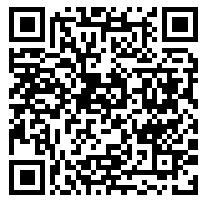
Feedback on ideas for subject improvements in 2025
https://sacethrive.typeform.com/to/ZgChA5JQ

Slide 12
New CCAFL framework – a reminder
CCAFL is a national arrangement where:
all agencies across Australia share a curriculum and assessment model for 27 small enrolment languages.
The new framework:
is embedded in each state’s curriculum – we share content and exam
2024 (Stage 1) and 2025 (Stage 2).

Slide 13
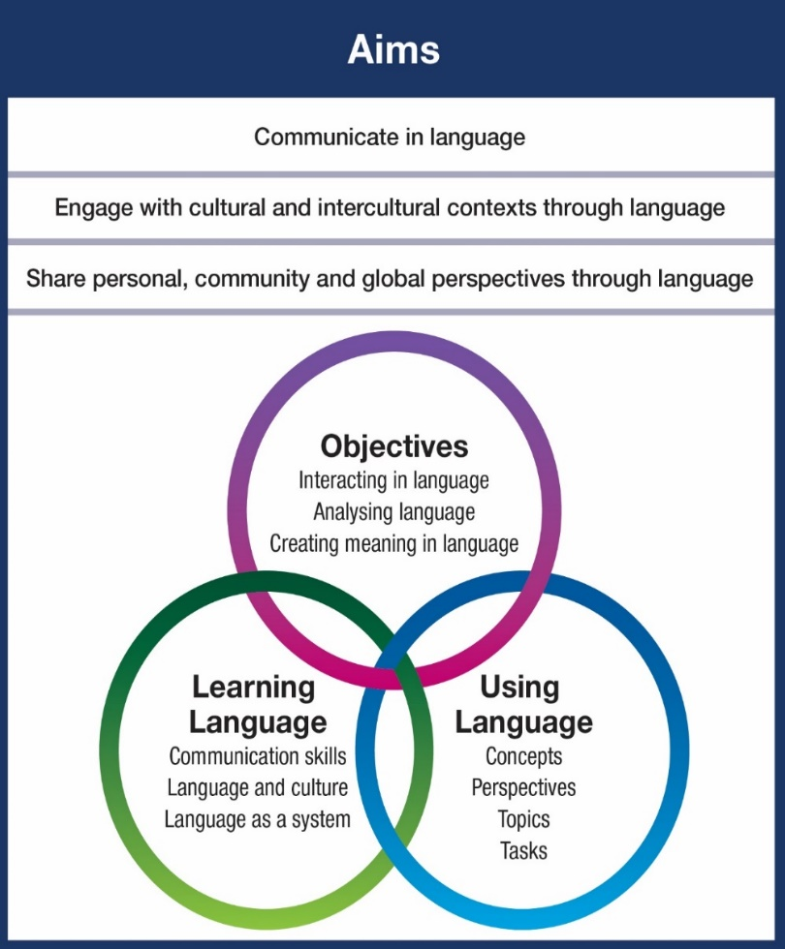
New CCAFL framework
The new framework:
introduces new concepts, topics and perspectives
allows these to be explored within the Australian context.

Slide 14
What’s new in the subject outline?
NO CHANGE | MINOR CHANGE | NEW
Subject description | Learning requirements | content
Assessment design criteria | Capabilities | Stage 2 external assessment (oral and written exam)
Performance standards | School assessment (new concepts, topics, perspectives) | Grammar, dictionaries, subtopics – new examples

Slide 15
Stage 2 assessment types (for teaching in 2025)
Stage 2
Assessment Type 1: Folio | The assessments should specify the concept and perspective.
Assessment Type 2: In-depth Study | The assessments should specify the concept and perspective
Assessment Type 3: Oral exam | The assessment will relate to the CCAFL concepts and perspectives and there will be changes to the structure according to specifications of host state.
Assessment Type 3: Examination | CHANGES TO STRUCTURE
NO change to assessment type titles Concepts, topics, and perspectives are new (replacing the current themes and topics) Assessment design criteria and specifications remain the SAME Some changes to structure of the oral exam

Slide 16
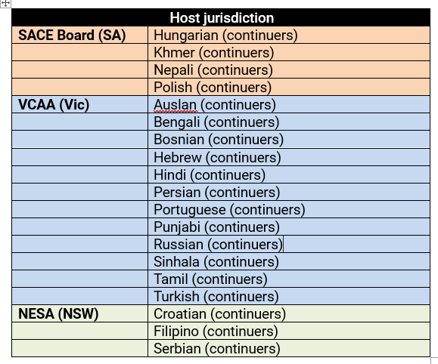
Changes to oral exam
CCAFL arrangements mean that;
All students sit same written exam
States set own oral exam specifications

Slide 17
NSW hosted languages – Filipino, Croatian, Serbian
Time allowed: Approximately 10 minutes
The oral exam will consist of a discussion guided by the examiner.
The student will respond to questions on 2-3 prescribed topics, one of which will be chosen by the student.
Students will be required to present and substantiate opinions and ideas from personal, community and global perspectives.
More training and information to come as it is made available from NESA

Slide 18
Prescribed topics - Filipino
Prescribed topics - Serbian
Identity
Inclusivity, diversity and belonging
Living in Australia
Legacy
Innovation
Filipino-speaking culture
Responsibility
Society
Work
Sustainability
Sustaining language and culture
Global trends
Identity
Inclusivity, diversity and belonging
Relationships and human interactions
Legacy
Innovation
History and traditions
Responsibility
Society
Youth
Sustainability
Sustaining language and culture
Global trends

Slide 19
Specifications to be confirmed VIC – Bengali, Bosnian, Hebrew, Hindi, Tamil, Portuguese, Punjabi, Russian, Persian, Sinhala, Turkish SACE Khmer, Nepali, Polish, Hungarian
VIC and SA hosted languages

Slide 20
Assessment Type 3: Written examination 2025
Current exam (2.5 hours) |  | NEW exam (130 minutes)
Section 1: Listening and responding Part A - Questions 1–3 3 texts in language with answers in English (15 marks) Part B - Questions 4–6 3 texts in language with answers in language (15 marks) |  | Section 1: Responding to texts Question 1 - Text 1: One listening text in [language] and responding in English (7 marks) Question 2 - Text 2: One listening text in [language] and responding in language (8 marks) Question 3 - Reading and listening in [language] and responding in English (15 marks) Text 3A: one reading text in [language] Text 3B: one listening text in [language]
Section 2: Reading and responding Part A - Questions 7–8 2 texts in language with answers in English (10 marks) Part B - Question 9 (15 marks) One text in language Response in language approx,. 150 words
Section 3: Writing in Language One of Questions 10–12 (20 marks) Original text to be written in language Response approx. 250 words
Total marks 75
Section 2: Creating texts
Question 4 - Reading and responding in [language] (15 marks)
Text 4: one reading text in [language]
Response approx. 150 words
Students choose one of the following
Question 5 or Question 6 (20 marks)
Writing in [language]
Response approx. 250 words
Total marks 65

Slide 21
Current exam (2.5 hours) |  | NEW exam (2 hours)
Listening texts total approx. 8 minutes. The total length of the three reading texts will be approx. 550 words. |  | Listening texts total approx. 4 ½–5 minutes. The total length of the two reading texts will be approx. 450 words. There will be one or two visual texts in this examination which may appear in any of Questions 3, 4, 5 or 6.
Assessing skills and knowledge more efficiently
Recognition of visual texts

Slide 22
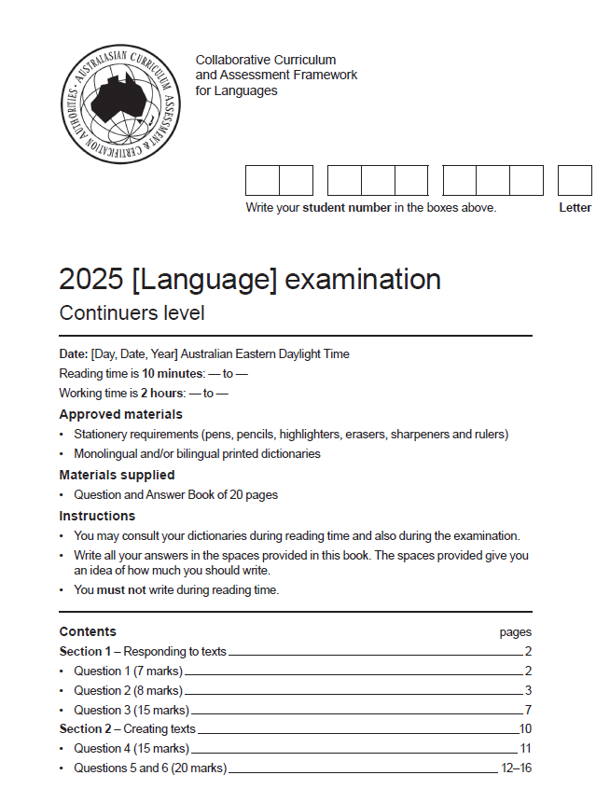
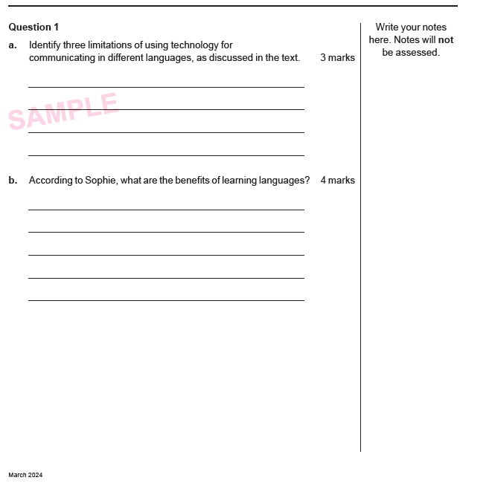
Section 1: Responding to Texts

Slide 23
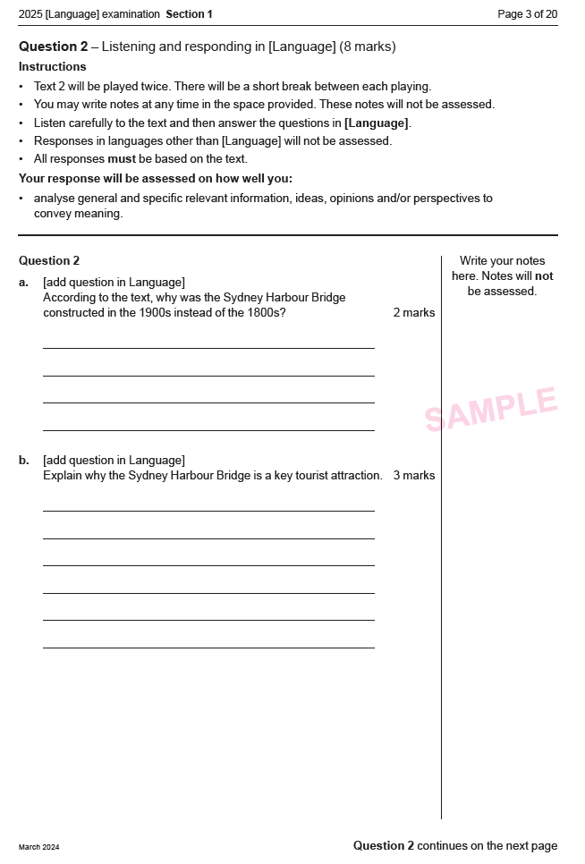

Slide 24
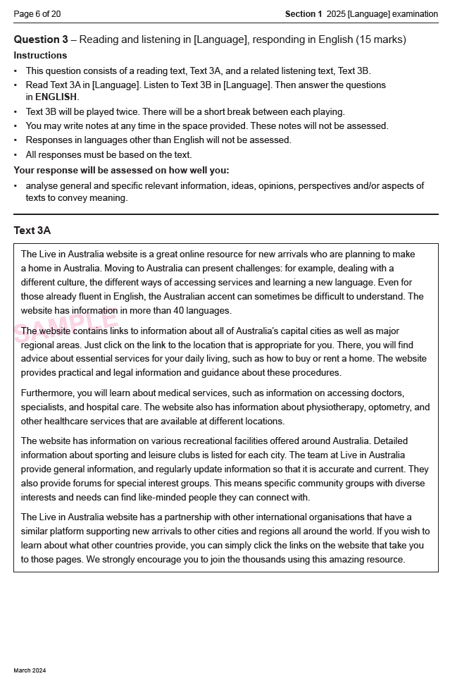
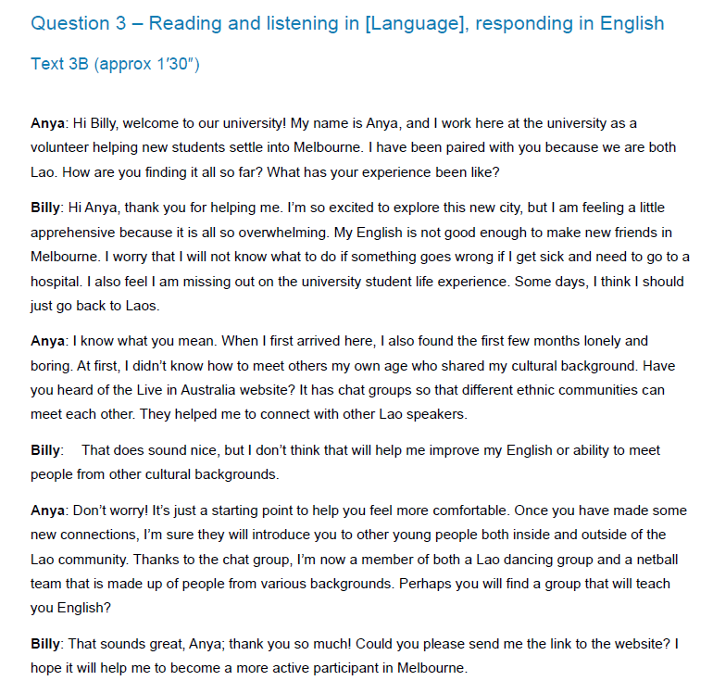

Slide 25
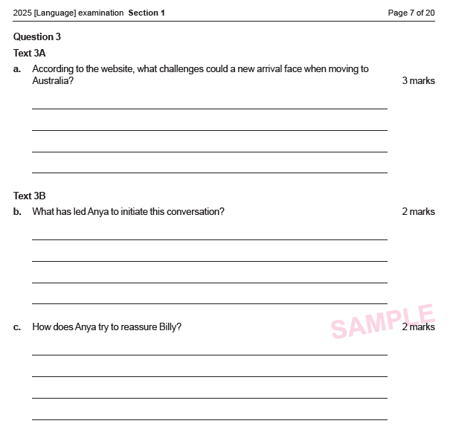

Slide 26
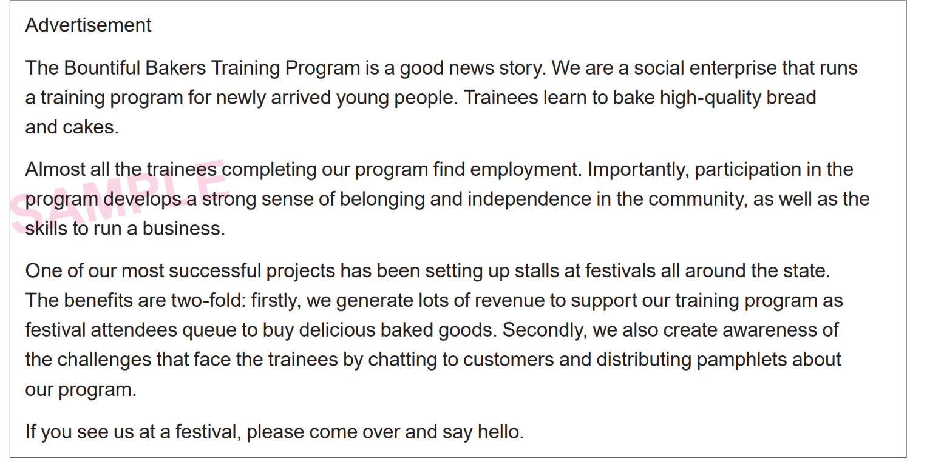
Section 2: Creating Texts

Slide 27
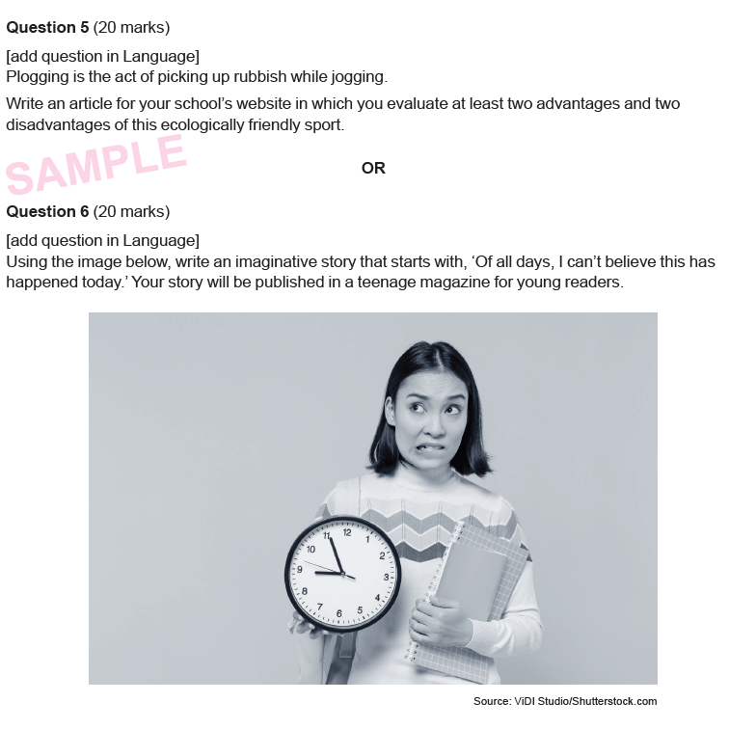

Slide 28
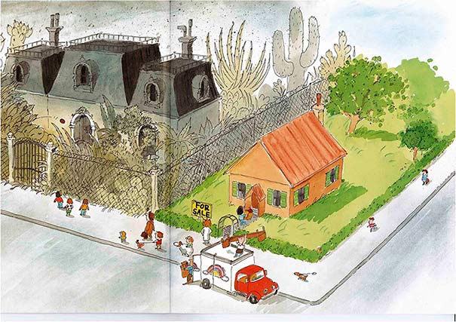
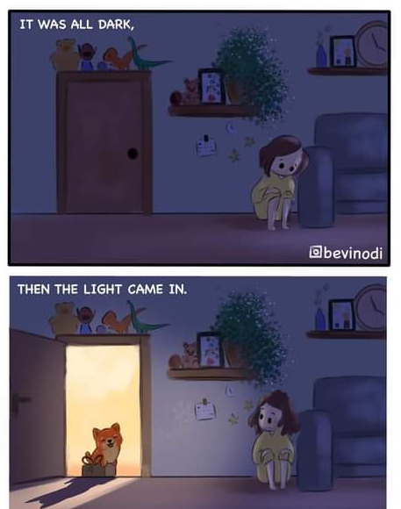
Visual texts
1 or 2 visual texts in any of q 3,4,5, or 6

Slide 29
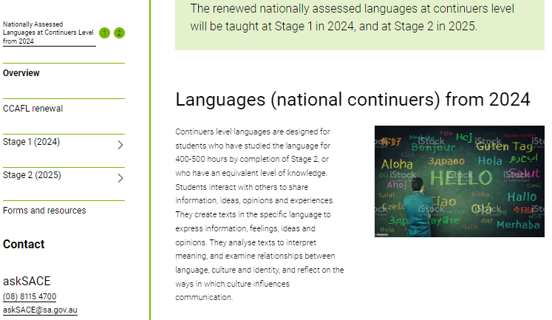
New minisite
https://www.sace.sa.edu.au/web/nationally-assessed-languages-at-continuers-level-from-2024/overview

Slide 30
QUESTION TIME Thank you for your support Best wishes for the year ahead
Karen Collins and Sally Letcher
English & Languages Faculty
Email to SaceEnglishAndLanguages@sa.gov.au

