Slide 1
Subject Renewal Key drivers

Slide 2
Through our work with pilot schools over the last four years, the key drivers below have emerged as the most impactful. We have used the following characterisations of these drivers to support teachers’ awareness and early understanding of their intent.
As we work more closely with Subject Renewal Groups, these key drivers will continue to be better understood and defined as they emerge in the renewed subjects.

Slide 3
Deep Authentic Learning
Students discuss and apply learning from familiar and unfamiliar situations across a range of meaningful and relevant real-world situations
Student Agency
Students are proactive in the co-creation of their learning pathway and influence how they undertake, demonstrate and action their learning.
Natural Evidence of Learning
NEoL captures the diverse authentic forms of students’ demonstration of learning and achievement, better reflecting what students know and can do.
Metacognition
Students understand and evaluate their thinking to regulate the way they learn.
SACE Capabilities
Are complex competencies: a mixture of elements including attitudes, skills, values, knowledge and beliefs that are developed directly and indirectly through learning and assessment design. The capabilities valued by the SACE Board include: Collective engagement, Personal enterprise, Principled action, Quality thinking and Self-motivated learning.
Notes:
Each subject has its own unique history and identity, but we are committed to developing new curriculum that:
- connect the learning to real life relevance and experiences
- has space for student agency
- to look for opportunities to broaden the range of evidence that students can provide
- allows for students understand how they learn and regulate their learning
- allows for students to develop their capabilities

Slide 4
What is deep authentic learning?

Slide 5
Deep Authentic Learning
Deep learning
Authentic learning
Discuss, apply, and transfer knowledge across different situations and contexts
Real-life or real-world contexts, knowledge gained can be applied to solve real-world problems
Notes:
One of the key drivers is deep authentic learning.
Deep authentic learning is twofold:
Deep Learning: This includes the unique, deep learning that occurs in each subject. Students show their thorough understanding of a subject to the point where you can confidently discuss, apply, and transfer that knowledge across different situations and contexts, both familiar and unfamiliar.
Authentic Learning: Links the learning that occurs in the subject and throughout their schooling with real-life or real-world contexts, ensuring that the knowledge gained can be applied to solve real-world problems. It is meaningful and relevant to the student’s interests.
Deep authentic learning involves maintaining the integrity of content knowledge while providing opportunities for students to experience and apply their learning in real-world contexts. This can be on a local, national, or global scale.
This approach ensures that students gain depth in discipline knowledge, while understanding the application of their studies in the real world. We understand this occurs throughout our classrooms currently, in many different forms, and seek to ensure this is valued throughout the process of subject renewal.

Slide 6
Extend the focus on meaningful content while maintaining the deep richness of the subject area.
Strengthen student engagement in real life learning
Create space for deep authentic learning
Deep Authentic Learning
Notes:
Throughout subject renewal, we will find space to connect the learning in our SACE subjects to real life relevance and experiences.
Along the roadmap of subject renewal, we will be considering how we can create room for more deep authentic learning, so students focus more deeply on the things that really matter to them.
It’s about creating space, strengthening student engagement in real life learning and extending the focus on meaningful content while maintaining the deep richness of the subject area.
Deep authentic learning is about creating an educational environment where students are not just passively receiving information but becoming active participants in their learning journey. By involving students in projects that require critical thinking, problem-solving, and collaboration, educators can help students see the value and application of their knowledge beyond the classroom.
This not only deepens their understanding of the subject matter but also prepares them for future challenges by equipping them with practical skills and a more insightful appreciation for the discipline.
A consideration for Subject Renewal is ‘how will we intentionally makes space in your subject for deep authentic learning?’

Slide 7
Deep Authentic Learning
What is it?
Students discuss and apply learning from familiar and unfamiliar situations across a range of meaningful and relevant real-world situations.
Criteria (dimensions)
Engaged in real world learning contexts
Solving real world problems
Deep understanding transferred to other learning
Personally meaningful
Favours depth over breadth

Slide 8
What is student agency?

Slide 9
Student Agency
More than just a choice of topic
More than just a choice in mode of presenting their work
“Student Agency is rooted in the belief that students have the ability and the will to influence positively their own lives and the world around them. Student agency is defined as the capacity to set a goal, reflect and act responsibly to effect change“
(OECD 2030)
“It is about acting rather than being acted upon; shaping rather than being shaped; and making responsible decisions and choices rather than accepting those determined by others”
(OECD 2030)
“Having agency means participating in active learning rather than passive learning and trying to work things out for yourself. It's also being willing to experiment, learn, fail, and then try again.”
(SACE Strategic Plan 2020-2023)
Notes:
Another key driver of subject renewal is Student Agency
When we consider the concept of agency, at the foundation it may look like simply giving choice to the student. This often looks like students having the opportunity to select what topic they do, or how they may present their learning.
Throughout our piloting of EIF and AIF, we drew from the OECD’s definition of agency, that students have the ability to influence their own lives positively and can make their own responsible decisions. That was also shaped by our own strategic plan that encouraged experimentation and failure as part of the learning process.
While EIF and AIF have been pioneering this space, we want to be able to offer opportunities for student agency throughout the SACE.

Slide 10
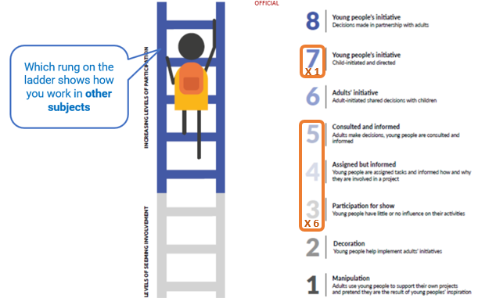
Student Agency
Student agency is about students having opportunities to co-create their learning pathway and influence how they demonstrate and action their learning.
Notes:
Affordances for student agency partners with deep authentic learning. It places importance on content knowledge and directed learning while still allowing for students to understand that there is a time and place for them to experiment with the application of content through making decisions about the direction and scope of their own learning.
Through the work we have been doing with schools, we know there is some amazing practice out there where students are active drivers of their learning. But what we hear from teachers is that this gets constrained at senior secondary – not because of pedagogical practice, but that it’s our curriculum that leads to a teacher-driven student experience.
Student agency is not an all or nothing binary, it is on a continuum. We saw a good example of this when we were conducting evaluation for AIF. We asked a small student focus group how they viewed their other SACE subjects as seen on the OECD ‘Agency Ladder’. These students said they often felt their agency moved between having little to no influence over their learning to adult led where students are consulted and informed, but ultimately decisions around their learning were made by others. There was very little indication from these students that they had or understood where there were opportunities to move towards full agency in the classroom with the current curriculum.
Developing agency in the classroom gives students the understanding that the level at which individuals take action will vary, and it gives them the skills to be productive in the many varying environments they will find themselves in both during and post school.
Student agency is about opportunities for students to direct, manage, and drive their own learning across the curriculum, allowing them to learn in contexts that they choose, that are relevant to them, and to use their own interests, passions, and desires to both further explore and evidence their learning.

Slide 11
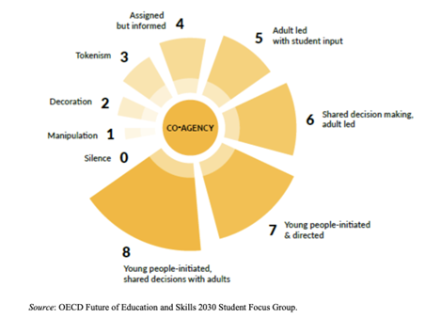
Student Agency
Developing capacity to initiate and progress learning
Making decisions in partnership with teachers
Teacher as co-agent in learning
Notes:
Not all students come to school with a strong sense of agency. They have been shaped by their individual histories and social and cultural experiences. And for some their demonstration of agency is through their behaviour choices, and they do not know how, or find it difficult to see, the value in learning. For many students it is a process to move through stages of agency to develop the skills to be confident and independent learners.
The sun model of co-agency provides a visual representation of how students may progress from no or very limited agency in the classroom to being the directors of their own learning paths.
One of the key considerations in subject renewal is having curriculum that provides for the continuum of agency within the context of a wide range of different subjects. It is not a one size fits all. This will look different in different learning areas.
We want students to be able to participate and create change in their future world, and to do this they need to be confident to take considered risks and understand the possibility of their own power to effect change for themselves and others. We want them to move into their post school life knowing how important it is to have control over their knowledge, understanding and actions. Regardless of the subjects they take, we want our students to leave school having built their social and cultural capital through a strong and well understood sense of their own agency and the impact that they can have, and the experiences students will have at school, and in your subject can be their starting point.
We will consider how we can design a subject outline that intentionally promotes student agency.

Slide 12
Student agency
What is it?
Students are proactive in the co-creation of their learning pathway and influence how they undertake, demonstrate and action their learning.
Criteria (dimensions)
Positive influence on own life
Taking action
Working things out for yourself
Experimenting & learning from failure
Responsible decisions and choices made with adults

Slide 13
What is natural evidence of learning?
Notes:
What we have learnt and seen from the SACE pilots, EIF, AIF, Capabilities and Learner Profile, and Recognition of Aboriginal Cultural Knowledge and Learning is the impact of Natural Evidence of Learning as a valued and valid assessment of student evidence.

Slide 14
Natural Evidence of Learning
Authentic and varied
Supporting students' strengths and choice
Curated for self
Broadening the evidence of learning
Notes:
Natural Evidence of Learning can be focused through some of the key concepts
1. Authentic and varied – Where learning is diverse and can be influenced by numerous factors, including the learner’s context, interests, and the nature of the learning itself. This variability underscores the richness and adaptability of the learning process.
2. Supporting students’ strengths and choice – incorporating student choice into learning environments helps align educational activities with individual interests and strengths, making the evidence of learning more representative of each student’s unique journey and abilities.
3. By curating evidence of learning for yourself, you not only document and reflect on your own progress but also create a personalized record that can be useful.
It helps in recognizing your own development and can be valuable for personal growth and lifelong learning.
4. Broadening the evidence of learning is embracing a wider range of evidence allowing for a more comprehensive view of student’s learning and abilities, accommodating different learning styles and strengths.

Slide 15
Valued and valid assessment evidence
Teacher Professional observation and judgement
Confidence and reassurance in the value and validity
Capture the range of learning
Document progress
Notes:
If we can now consider the role of the curriculum and assessment conditions in the subject outline and how teachers can reinforce the value and validity of Natural Evidence of Learning.
The collection of natural evidence of learning is seen as a dynamic and flexible approach for teachers to make more accurate professional judgments of student learning, providing a fuller picture and helping to create a more valued and valid assessment.
Teacher Professional observation and judgement – observing students in action is just as valuable and valid as the more formal artefacts students produce (essays, reports, tests) —whether through discussions, group work, or individual tasks— students can provide a clearer picture of their understanding and thought processes
Confidence and reassurance in the value and validity – renewed subjects should provide confidence and reassurance in the value and validity of the varied and broad natural evidence students are developing and providing. We have seen this done successfully in the EIF and AIF subject outlines
Capture the range of learning – As natural evidence of learning can be varied, indirect and informal , teachers’ observations help capture this broad spectrum of learning activities, giving a more comprehensive view of student progress
Document progress - Observations can be documented by the teacher and used to track student progress over time.

Slide 16
Natural Evidence of Learning
Some possible suggestions
Video or voice recordings
Social media correspondence
Chat with grandma
Peer conversations
Visual journal
Create comic
Body language within conversations
Notes:
On the slide are some possible suggestions as to how a student may show some natural evidence of their learning whilst learning a new language.
You can see through these suggestions that the student is able to show evidence in various formats that allows them to show their learning progression. The end result should be that students have the ability and space to gather Natural Evidence of their learning and it be recognised through their learning journey.
Subject renewal will consider how to incorporate natural evidence of learning and what assessment types lend themselves to these different forms of evidence.

Slide 17
Natural evidence of learning (NEoL)
What is it?
NEoL captures the diverse authentic forms of students’ demonstration of learning and achievement, better reflecting what students know and can do.
Criteria (dimensions)
Diverse
Authentic
Naturally emerges from learning process
Shows progress

Slide 18
What is metacognition?

Slide 19
Metacognition
Greek
Word
μετά
Latin
Word
Cognitio
Beyond = On top of =
= Knowledge
= Thinking
Going beyond “What have I learned” and asking “How did I learn it?”
Notes:
During the learning process, you are using a range of thinking skills, and you are making decisions about what and how you might learn, retain or demonstrate new knowledge.
Metacognition is a core thinking skill that can have significant impact on the success that students have in their growth in and beyond the classroom.
There’s a range of ways to understand ‘Metacognition’ – it is commonly described as “thinking about thinking”. It can be defined as “awareness or analysis of one’s own thinking”. When it comes to students, and the learning they engage in, it is about them understanding the way they think, knowing how they think, and applying that to either enhance the way they think, or to achieve a goal.
In order to be equipped with the lifelong skills students need to flourish in the world beyond, we need students to move beyond asking “What have I learned?” and asking “How did I learn it?”

Slide 20
Metacognition and self-regulation
Self-Regulation
Cognition: Task performance strategies, rehearsal and decisions
Metacognition: Strategies to control and regulate cognition, the reason why we do an action
Motivation: Task related beliefs, interest and emotional reaction/ behaviours
(Dinsmore et.al., 2008)
Notes:
When we start unpacking the details and nuances about metacognition, we can understand it as being key components of Self Regulation, which supports students in setting goals, managing time, staying motivated and adjusting strategies as needed. In this way,
Cognition is what is required to complete the task. The actual doing of the tasks
Metacognition forms the strategies that control and regulate your cognition; the things that regulate your performance of the task. It is sometimes the reason why you would do an action.
Motivation is also relevant, and is made up of the interest, beliefs and emotional response to a task.
This kind of understanding is we want our students to have about themselves, so that they are able to judge if how they’re learning is effective, and be able to decide for themselves, how they can navigate and improve.

Slide 21
Metacognition
Metacognition relates to students purposefully monitoring and directing their own learning, whilst engaging in regular reflection and feedback from others.
Notes:
Its not enough for students just to merely think about their thinking, they need to do it for a purpose.
It’s a developing capability for students to think about their own thinking during the learning process, but also to evaluate and decide what is effective, and build their skills in how they judge what is an effective learning process.

Slide 22
Benefits of developing metacognitive thinking
“Post-school, our students are required “to be largely independent, self-regulated learners, an assumed capability many students are ill-prepared for”
(Nugent et al, 2019)
Students can evaluate their processes to identify how to be more effective, not just evaluate the output of what they are doing.
Students can draw on their knowledge and awareness of thinking processes and modify these while they are engaged in a task.
Students can shift their way of working to motivate themselves to progress a task
Students can develop a range of strategies and relevant help-seeking behaviours that will support them in their across all their SACE subjects, and forward into their lives.
Notes:
What the research generally says, that once students leave school, we require them to be “largely independent, self-regulated learners” which is “an assumed capability that many of our students are ill-prepared for”.
Some of our students leave school with these skills – think about the student who has faced and overcome a challenge, self-reflected and matured, or shown immense personal growth and development. However, how many students have explicitly had the opportunity to develop and master these skills, from a trusted guide or expert, like a teacher?
Metacognition is a very strong predictor of learning success, and forms part of the toolkit students take with them from high school out into the world.
So our aim is to develop these skills for all students so they can work to identify and evaluate what works for their learning, and then apply this to a range of subjects.

Slide 23
Metacognition
What is it?
Students understand and evaluate their thinking to regulate the way they learn.
Criteria (dimensions)
Understanding how I learn
Evaluating thinking processes
Regulating/modifying thinking processes

Slide 24
What are SACE capabilities?

Slide 25
Capabilities are complex competencies: a mixture of attitudes, skills, values, knowledge, and beliefs that are continuously developed throughout a person’s life.
Notes:
People often refer to capabilities as ‘soft skills’ but they are more than that.
Capabilities are complex competencies - not rated on a scale, but on levels of progression. They demonstrate the typical level of competence of a student.
Capabilities are not cognitive skills; such as literacy, numeracy and digital literacy. They cannot not be assessed in a ‘test’, but rather evidenced through knowing a student well across a range of contexts.

Slide 26
Notes:
The goal of the SACE is to provide every learner with the opportunity to develop their capabilities as well as deep discipline knowledge. As a key pillar of the strategic plan, we believe that by placing a focus on the intentional development of capabilities, we will equip students with the language, skills and knowledge they need to open doors to future pathways and possibilities while encouraging curiosity, lifelong learning, being responsible members of society, and being connected to people and communities.

Slide 27
SACE Capabilities in pilot
Collective Engagement
I can be inclusive of ideas, people and perspectives to generate purposeful outcomes.
Personal Enterprise
I can demonstrate initiative, pursue opportunities, produce outcomes of value and ‘get things done’.
Principled Action
I can be responsible for my actions and consider the impact I have. I can learn from my own experiences and the experiences of others and ‘do the right thing’.
Quality Thinking
I am curious about the world around me and use a range of thinking strategies to shape my understanding.
Saturn is the only planet with rings in the entire Solar System
Self-Motivated Learning
I can embrace challenges as opportunities and persevere and be active in my own learning.
Notes:
These are the SACE capabilities in pilot.
The words in bold are the ‘drivers’ that reflect the essence of the capabilities.
These capabilities encompass knowledge skills, behaviours, and dispositions to assist young people to live and work.

Slide 28
Capabilities are made up of elements
Adapting
Being considerate and caring
Being creative
Being organised
Being reflective
Demonstrating initiative
Demonstrating perseverance
Demonstrating respect
Developing informed opinions
Embracing diversity
Forming relationships
Inquiring
Making contributions
Taking opportunities
Being curious
Being responsible
Comprehending
Engaging in dialogue
Engaging with feedback
Reasoning
Using tools
Notes:
The capabilities are broken down into elements. They are the ‘building blocks’ of the capabilities. Multiple ‘blocks’ may appear across multiple capabilities, however the types of behaviours a student might demonstrate will depend on the context or environment they are in.
Our capabilities in pilot are built from these elements, and it is the combination of elements that helps teachers and students to understand the essence of the capabilities.
It is these observable behaviours and skills that industry see as important and valued in the world of work.

Slide 29
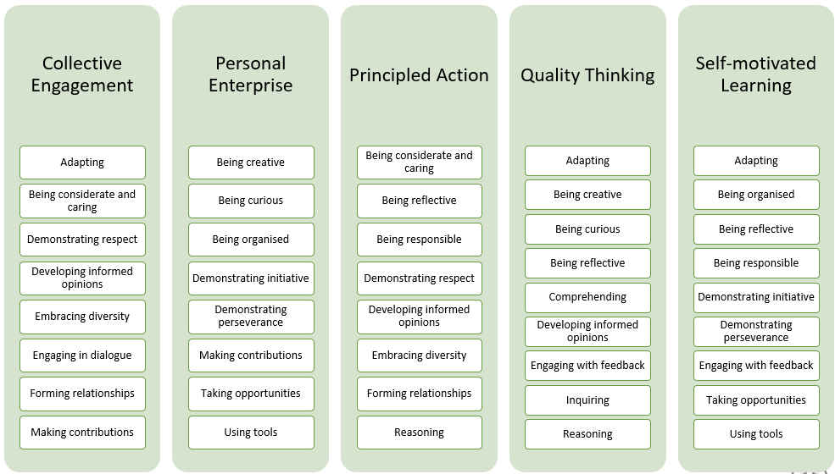
Elements grouped into capabilities
Notes:
This is how we have grouped the elements within each capability for our current pilot.
From a subject point-of-view, we need to make space in the curriculum for every student to have the opportunity to develop their capabilities. It doesn’t mean that every subject develops every single element and subsequently every single capability, its that the development of elements and capabilities relevant to the context of the subject are brought back to the forefront and are a core part of the students’ SACE learning journey. Across all of their subjects and other school experiences, they will develop these in different ways.

Slide 30
Capability development in the SACE
We want to think of and use this as a developmental tool that:
provides all young people with the opportunity to develop their capabilities,
allows them to be successful in their post-school pathways,
helps them to navigate the complex challenges of life beyond school.
“It is vital that young people understand their strengths and are able to identify what makes them unique and explore possible future pathways” (Learning Beyond Limits, 2023).
Notes:
The Capabilities and Learner Profile project is committed to recognising and showcasing more of what young people know and can do beyond just subject grades.
We want to personalise the SACE learning program for each individual student’s chosen pathway and allow the SACE certificate to recognize and value the learning that students do both inside and outside of the classroom.
We want to put students at the centre of decision making and support them to think about their strengths and the capabilities they have both in school and in their everyday lives.
We have been exploring what this work will mean for students and what value it will have in helping students with their chosen pathway. And really, where we see the value in this work, is in opening doors for students to future pathways and future possibilities. If students can recognise their unique strengths and have the language to be able to talk about them, this will help signal what they would like to do, where they would like to go, and what goals they might have. We want to give students the language to talk about what they are truly capable of.

Slide 31
How are capabilities developed?
Capabilities are developed across all aspects of the student’s school experience, as well as in activities or environments outside of school.
Opportunities for development and demonstration of capabilities should be provided to students across all aspects of a learning program, and changes to curriculum, assessment, and learning design are essential for this to happen.
Notes:
Opportunities for development and demonstration of capabilities should be provided to students across all aspects of a learning program, and changes to curriculum, assessment, and learning design are essential for this to happen.

Slide 32
Elements
Adapting
Being considerate and caring
Being creative
Being curious
Being organised
Being reflective
Being responsible
Comprehending
Demonstrating initiative
Demonstrating perseverance
Demonstrating respect
Developing informed opinions
Embracing diversity
Engaging in dialogue
Engaging with feedback
Forming relationships
Inquiring
Making contributions
Reasoning
Taking opportunities
Using tools
SACE Capabilities
What are they?
SACE Capabilities are complex competencies: a mixture of elements including attitudes, skills, values, knowledge, and beliefs that are developed directly and indirectly through learning and assessment design. The capabilities valued by the SACE Board include: Collective engagement, Personal enterprise, Principled action, Quality thinking and Self-motivated learning.

