Slide 1

The theme of love
♡
Sace number: XXXXX
Ref: A744834

Slide 2
Ancient Greek concepts of love -
The Ancient Greeks had many different concepts of love most of which are demonstrated through the women in ‘The Odyssey’. For the ancient Greeks, 'love' was categorized into distinct words, each representing a different kind of infatuation, rather than generalizing all facets of 'love' into a single word.

Slide 3
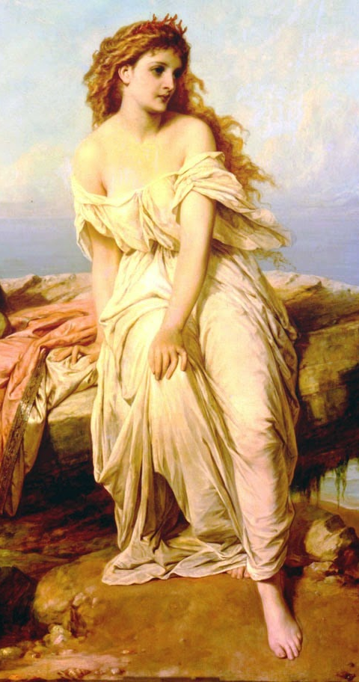
Mania - Obsessive Love
Stalking behaviours, co-dependency, extreme jealousy, and violence are all symptoms of Mania. Love is thought to help those with low self-esteem, and Mania sufferers are desperate to keep the sense of self-value that their desired partner provides.

Slide 4
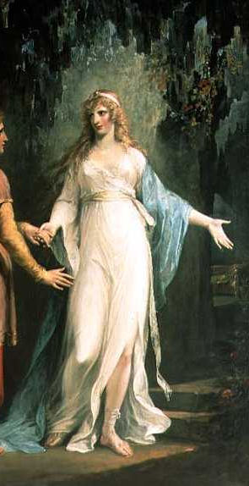
Calypso -
Calypso could be seen as a representation of mania as her infatuation for Odysseus results in him being held captive on her island for 7 years with the end goal of making him her immortal husband. She was desperate for Odysseus to return her feelings and was willing to give anything for him as a result.
Odysseus has no emotional connection to Calypso whatsoever and although he may share a sexual relationship with her, ‘At nights its true he had to sleep with her in the vaulted cavern, cold lover, ardent lady’. To put in simpler terms, Odysseus is more than reluctant in the matter and does so as if to appease her.

Slide 5
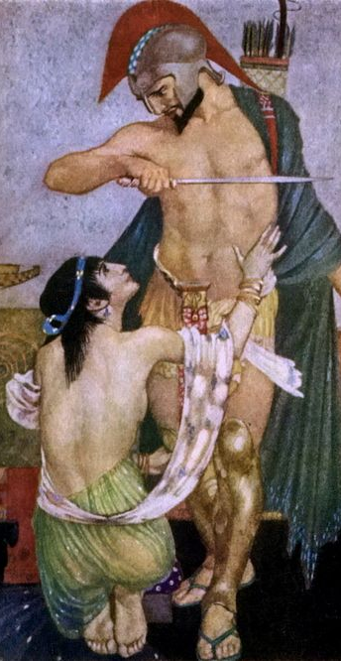
Ludus - Playful Love
Ludus is playful or uncommitted love. It can involve activities such as teasing and dancing, or more overt flirting, seducing, and conjugating. The focus is on fun, and sometimes on conquest, with no strings attached.

Slide 6
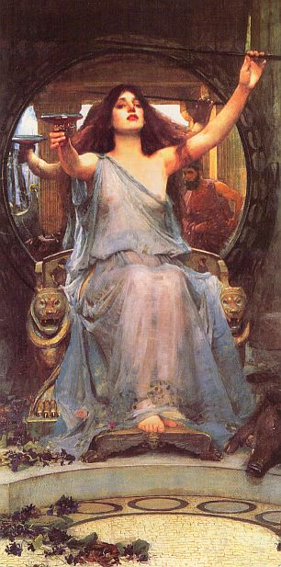
Circe -
A physical manifestation of ludus, Circe has no interest in an emotional attachment with Odysseus rather a sexual relationship. She has no interest in courting, ‘but now put up your sword and come with me to my bed, so that in making love we may learn to trust one another’) Her disinterest in emotional attachment is a stark contrast to the relationship he shares with his wife, and when it is time for Odysseus to leave he does not find it difficult, and neither does she. The ‘love’ that Circe and Odysseus share is hollow, shallow and two dimensional, as there is nothing connecting the characters deeply, nothing worth fighting for, resulting in a short lived relationship.

Slide 7
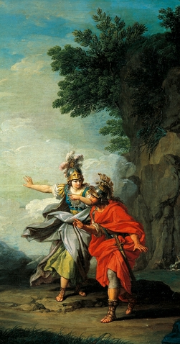
Philia - Affectionate Love
Philia is an affectionate and tender platonic love, most commonly translated into ‘friendship’. Philia is the most general kind of love and was most often talked about in the context of shared goodwill.

Slide 8
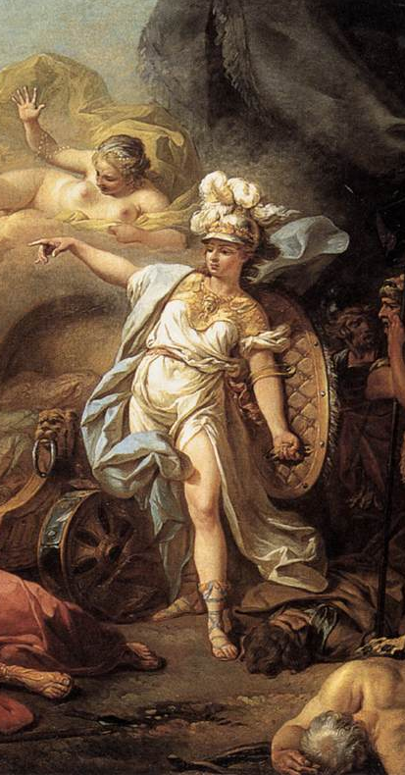
Athene -
The relationship that Odysseus and Athene Share is quite complex, it is obvious that Athene cares for Odysseus, but not in the way that the other characters in ‘The Odyssey’ do .Athene admires Odysseus as she is able to see herself in him, the traits that make him a fierce warrior are those she is able to recognise in herself. To an extent it could be argued that Athene is in love with Odysseus however, platonically. Athene looks out for Odysseus and is with him every step of the way, Athene could be seen as a representation of ‘Philia’ as her unfailing love for Odysseus is similar to the bond of a mother and son, she guides him through many hardships and acts as a friend and close ally to him at times. It is Athene that is responsible for Odysseus’ return to Ithaca , ‘It is for Odysseus that my heart is wrung, the wise and unlucky Odysseus, who has been parted so long from all his friends’, and it is with this simple statement that the journey of Odysseus begins.

Slide 9
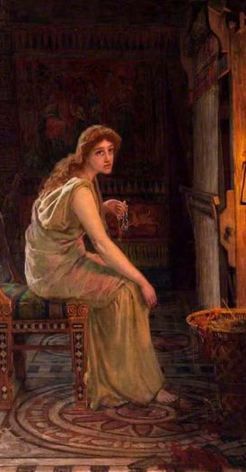
Pragma - Enduring Love
Pragma is a kind of practical love founded on reason or duty and one’s longer-term interests. Sexual attraction takes a back seat in favour of personal qualities and compatibilities, shared goals. Patience, tolerance, and compromise are essential elements of pragma

Slide 10
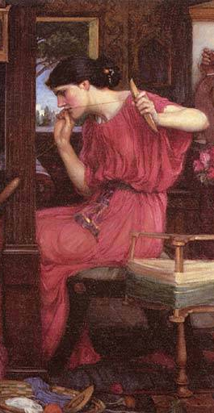
Penelope -
Odysseus’ love for his wife, is mirrored through Penelope’s faith that Odysseus will one day return home, despite the fact that he has been away for twenty years. Penelope has endured many hardships during the absence of her husband, and she has done all that is possible to keep herself from re-marrying. ‘on her loom in her house she set up a great web and began weaving a large and delicate piece of work… so day by day she used to weave at the great web but every night had torches set beside it and undid the work.’ It is through this cunning ploy that Penelope was able to buy herself some time for Odysseus to return home.
Homer is demonstrating through the character of Penelope that despite the circumstances her love for her husband is unconditional and unwavering. Penelope is an example of ‘Pragma’ as she possesses the fundamental qualities of this type of love. Patience, tolerance, compromise and sacrifice.

Slide 11
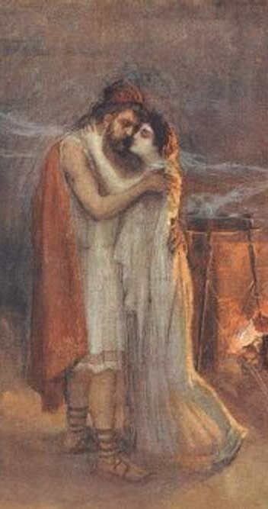
Agape - Selfless Love
Agape is the deep and unconditional love felt by a parent for a child, or the love in a long-established marriage.

Slide 12
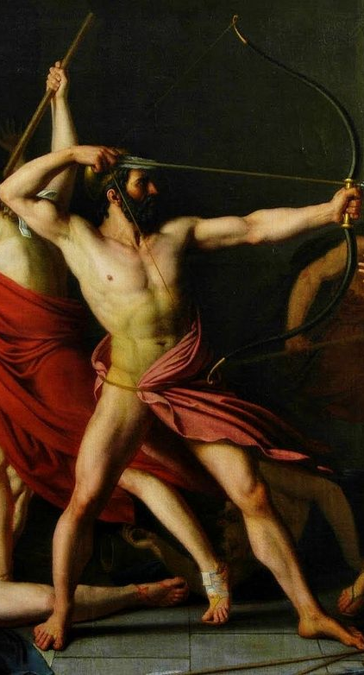
Odysseus -
There are many points throughout ‘The Odyssey’ that the readers may find themselves questioning Odysseus’ love for his wife as he seems at times, less than committed to her. Despite the fact that Odysseus may have sexual relationships with other women, his emotional attachment remains with his wife Penelope. Odysseus is driven by the love for his wife and child to return home, pursuing through many hardships. The love that Odysseus has for his wife closely resembles ‘agape’.
This connection is evident most whilst he is trapped on the island with Calypso, “She found him sitting on the shore. His eyes were wet from weeping as they always were. Life with its sweetness was ebbing away in the tears he shed for his lost home.”

Slide 13
What is Homer trying to say about love?
The love that Penelope and Odysseus share is unconditional and it is through this demonstration of unconditional love that Homer creates a stark contrast to the other concepts of love that manifest through the characters of, Calypso, and Circe. It could be argued that Homer is trying to prove that the perfect concept of love, is the love that Odysseus and Penelope share, as despite the circumstances surrounding these characters they are destined to return to each other, and it is this love for Penelope that drives the story

