Slide 1
SACE Leaders Forum
March 6, 2017

Slide 5
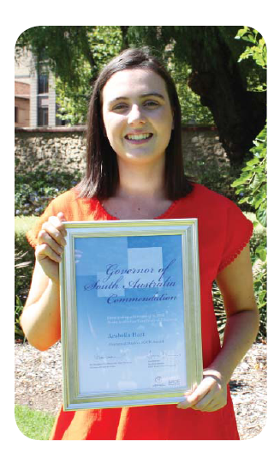

Slide 7
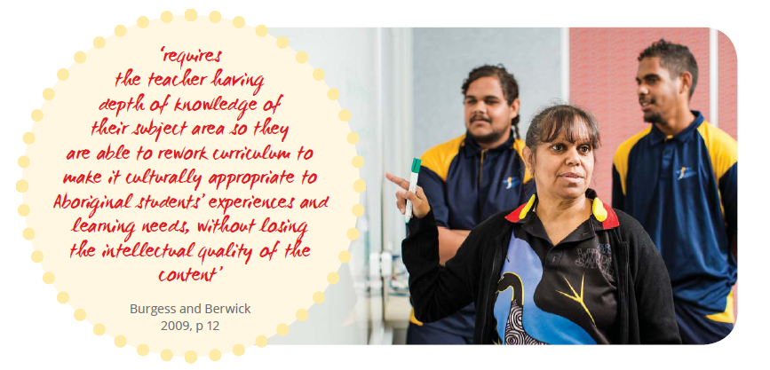

Slide 10
SACE Aboriginal Education Strategy - Governance
Steering Committee
Working Group
Cross sectorial representation
University Deans of Indigenous Educations
Department of Sate Development
a high representation of Aboriginal people
Strengths-based approach

Slide 11
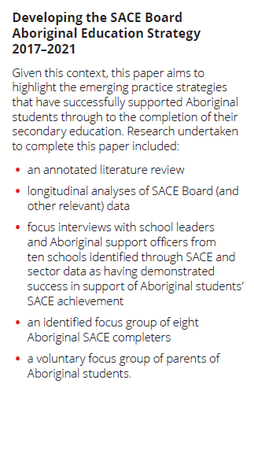

Slide 12
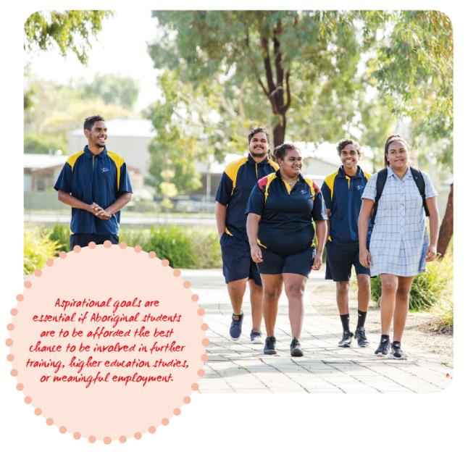

Slide 13
SCE Aboriginal Education Strategy – Spirit of the strategy

Slide 14
Aboriginal SACE Potential Completers 2011-2016

Slide 15
Aboriginal SACE completers 2011-2016

Slide 16
Aboriginal SACE Completion Rate Compared to the Total Cohort 2011-2016

Slide 17
Near Misses 2013

Slide 18
Near Misses 2014

Slide 19
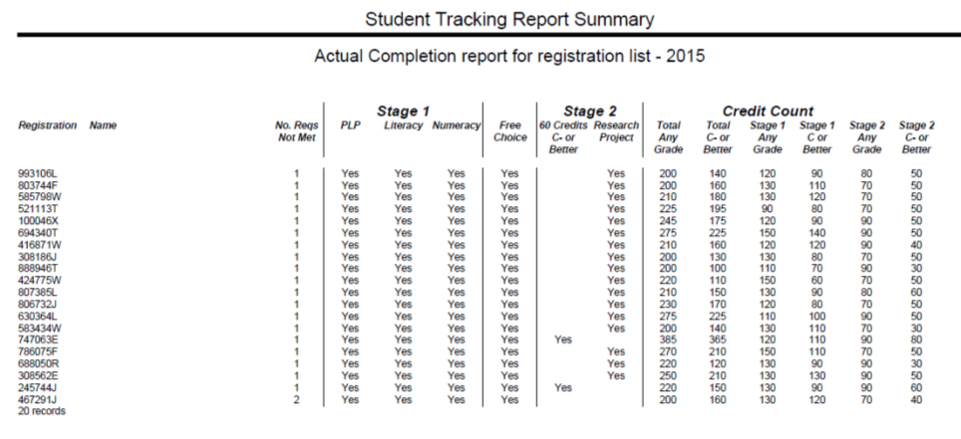
Near Misses 2015

Slide 20
Near Misses 2016
No. Reqs. Not Met | PLP | Literacy | Numeracy | Free Choice | Research Project | 60 Credits C- or Better | Stage 1 Any Grade | Stage 1 C or Better | Stage 2 Any Grade | Stage 2 C- or Better | Stage 1 or 2 Total Credit Count (Any Grade) | Stage 1 or 2 Total Credit Count (C or better)
1 | Yes | Yes | Yes | Yes | Yes |  | 130 | 120 | 90 | 50 | 220 | 170
1 | Yes | Yes | Yes | Yes | Yes |  | 140 | 130 | 80 | 20 | 220 | 150
1 | Yes | Yes | Yes | Yes | Yes |  | 165 | 85 | 70 | 30 | 235 | 115
1 | Yes | Yes | Yes | Yes | Yes |  | 130 | 110 | 70 | 50 | 200 | 160
1 | Yes | Yes | Yes | Yes | Yes |  | 140 | 100 | 90 | 50 | 230 | 150
1 | Yes | Yes | Yes | Yes | Yes |  | 150 | 150 | 100 | 50 | 250 | 210
1 | Yes | Yes | Yes | Yes | Yes |  | 110 | 90 | 90 | 50 | 200 | 140
1 | Yes | Yes | Yes | Yes | Yes |  | 130 | 110 | 70 | 50 | 200 | 160
1 | Yes | Yes | Yes | Yes | Yes |  | 145 | 125 | 60 | 40 | 205 | 165
1 | Yes | Yes | Yes | Yes | Yes |  | 165 | 105 | 90 | 30 | 255 | 135
1 | Yes | Yes |  | Yes | Yes | Yes | 140 | 100 | 80 | 80 | 220 | 180
1 | Yes | Yes | Yes | Yes | Yes |  | 150 | 100 | 70 | 50 | 220 | 150
1 | Yes | Yes | Yes | Yes | Yes |  | 140 | 120 | 90 | 50 | 230 | 170
1 | Yes | Yes |  | Yes | Yes | Yes | 145 | 125 | 145 | 125 | 290 | 250
1 | Yes | Yes | Yes | Yes |  | Yes | 305 | 295 | 90 | 80 | 395 | 375
1 | Yes | Yes | Yes | Yes |  | Yes | 110 | 90 | 140 | 110 | 250 | 200
1 | Yes | Yes | Yes | Yes | Yes |  | 185 | 105 | 80 | 50 | 265 | 155
1 | Yes | Yes | Yes | Yes | Yes |  | 185 | 175 | 110 | 50 | 295 | 225
1 | Yes | Yes | Yes | Yes | Yes |  | 110 | 70 | 90 | 50 | 200 | 120

Slide 21
Near Miss – Student 1
2MCN20 D+ AT1=C- AT2= D Exam = D
2BIG20 E+ AT1 = E AT2= E+ Exam = D-

Slide 22
Near Miss – Student 2
2MDS20 D AT1= C- AT2= C- Exam N
2CME20 E+ AT1= E+ AT2= E+ Exam E+
2PHY 20 E- AT1 =did not submit AT2= E Exam E+

Slide 23
Near Miss – Student 3
2BIG20 AT1=C AT2=D EX=D
2LEG20 AT1=D+ AT2=B- EX=E

Slide 24
Aboriginal SACE Completers receiving an ATAR 2011-2016

Slide 25
Number of 2016 Aboriginal SACE Completers who also completed a VET Certificate
VET Certificate – by AQF Level | Number of Students
Total Certificate I | 8
Total Certificate II | 15
Total Certificate III | 106
Total Certificate IV | 2
Total | 131

Slide 26
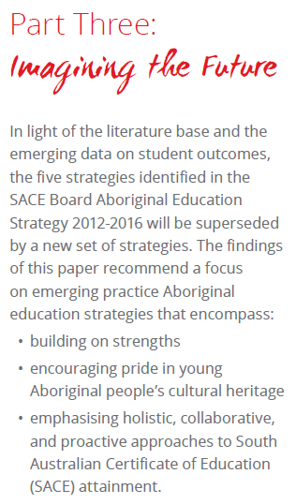

Slide 27
Trends in number of SA Aboriginal students studying at least one Stage 1 or Stage 2 Subject
 | Number of Stage 1 Students |  |  |  | Number of Stage 2 Students
 | 2013 | 2014 | 2015 | 2016 | 2013 | 2014 | 2015 | 2016
SA Country | 542 | 583 | 621 | 702 | 153 | 149 | 174 | 201
SA Metro | 780 | 815 | 848 | 830 | 261 | 303 | 294 | 327
Total | 1322 | 1398 | 1469 | 1532 | 414 | 423 | 468 | 529
Notes:
Data Caveat
Stage 1
Remember this could be year 10 & 11 students in these numbers
Stage 2
Remember at Stage 2 these numbers could include students who are in year 11 doing a Stage 2 subject plus year 12 students.

Slide 28
Strategic Priorities 2017-2021
EMPOWERMENT: Identity and Belonging
RESPECT: Strong Commitment and High Expectations Relationships
LEADERSHIP: People and Culture
CAPACITY BUILDING: Culturally Responsive Curriculum and Assessment
ACHIEVEMENT: Excellence, Aspiration and Merit
TRANSPARENCY: Data analysis and Evaluation

Slide 29
SACE Leaders Forum
March 6, 2017

Slide 30
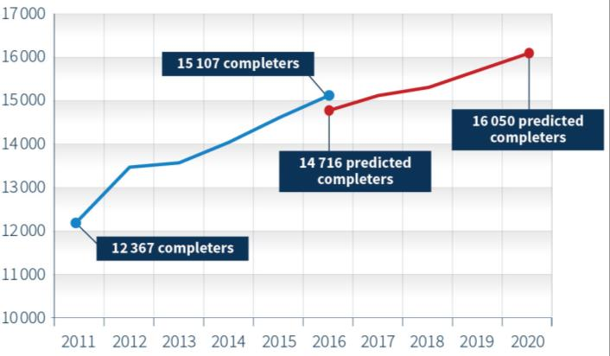
Highlights
SACE completion: Number of students in South Australia completing the SACE [2011–2016]
Predicted [2016–2020]
Notes:
2016 = 15,107 completers – 96.6% completion rate

Slide 31
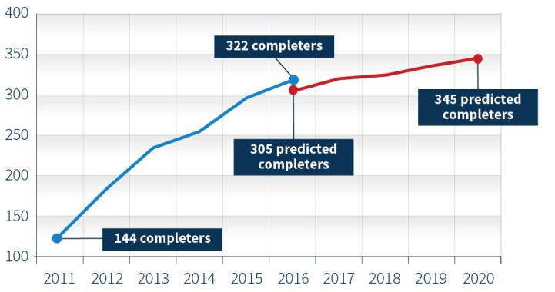
Highlights
Aboriginal Education Strategy: Number of Aboriginal students
in South Australia completing the SACE [2011–2016]
Predicted [2016–2020]
Notes:
2016 = 322 Aboriginal Completers, 93.9% completion rate

Slide 32
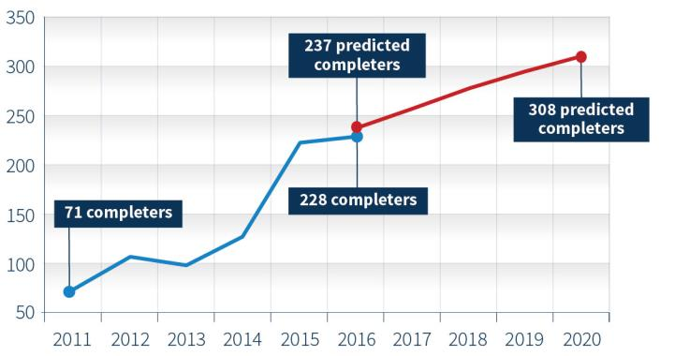
Highlights
Modified Subjects: Number of students completing the SACE with at least one modified subject at Stage 1 or Stage 2 [2011–2016]
Predicted
[2016–2020]
Notes:
2016 = 228 completers

Slide 33
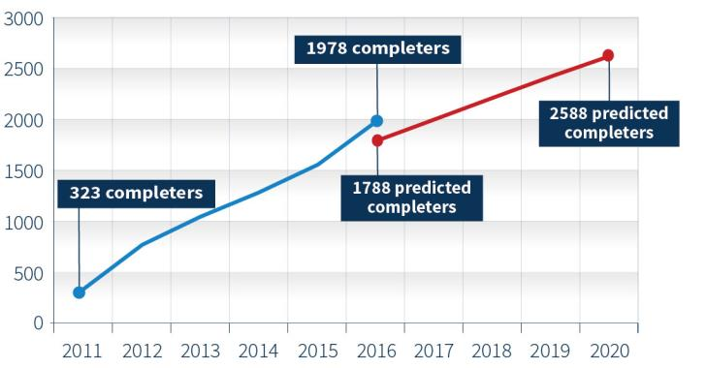
Highlights
Vocational education and training: Number of South Australian students who completed the SACE as well as a VET Certificate III [2011–2016]
Predicted
[2016–2020]
Notes:
2016 = 1978 completers

Slide 34
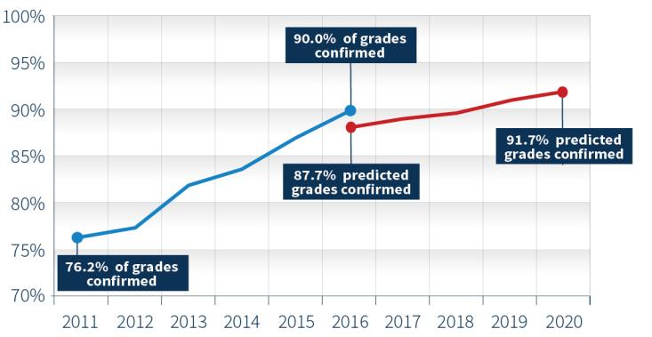
Highlights
Moderation outcomes:
Proportion of South Australian Stage 2 school assessment component grades confirmed at moderation [2011–2016]
Predicted
[2016–2020]

Slide 35
SACE Board Strategic Plan 2016-2020

Slide 36
We need to ensure that the ways SACE assessments are administered, submitted, assessed and quality assured,
recognise the way that students use technology
to demonstrate their learning.

Slide 37
Submission of Materials
Bypass

Slide 38
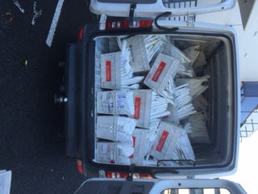

Slide 39
How much time do teachers spend preparing evidence for moderation and marking?
Less than 1 hour | 8%
1-2 hours | 21%
3-6 hours | 30%
1 day | 16%
More than 1 day | 24%

Slide 40
School Assessment Materials
 | Format
 | students develop | students submit | Teacher submits
All electronic | 20% | 17% | 6%
Mostly electronic but some paper | 36% | 24% | 7%
Some electronic but mostly paper | 25% | 26% | 24%
All paper | 19% | 33% | 63%

Slide 41
Journey to online submission, online moderation and online marking
More subjects. Further consultation providing some solutions to online submission barriers
Towards 2020
More subjects. Subjects selected on the basis that students’ evidence of learning is ‘mostly’ developed in electronic formats
2018
Subjects selected on the basis that students’ evidence of learning is developed in electronic formats
2017

Slide 42
Subjects commencing the online transition in 2017
School Assessment | External Assessment
Stage 2 Classical Studies Stage 2 English Literary Studies Stage 2 Indonesian (continuers) Stage 2 Media Studies Stage 2 Music Technology Stage 2 Philosophy | Stage 2 Health Stage 2 Media Studies Stage 2 Philosophy Stage 2 Essential English Stage 2 Community Studies

Slide 43
Functionality of Schools Online
Online Submission
Note: This will be linked to a video at a later date

Slide 44
Communication and preparation

Slide 45
Governing principles
Online submission
Online moderation
Online marking

Slide 46
‘The primary responsibility for school assessment and its integrity resides with schools.

Slide 47
Discussion and Reflection
questions
implications
feedback

Slide 48
Considerations
Online Submission of Materials
School Bandwidth
File formats/naming conventions
Features of System
Online Marking and Moderation
Viewing material on screen
Device requirements
Location of Activity – central or any location
Training and Support

Slide 49
‘As professionals, teachers are best placed to make decisions about student’s learning, record their results and select student work for moderation.’

Slide 50
Sample
A-
Notes:
For all Stage 2 subjects, paper and online, teachers will nominate their moderation sample using their Stage 2 results sheets.

Slide 51
Notes:
Continue to transform moderation from a manual to an electronic process

Slide 52
2017 Stage 2 Moderation: Moderation Task
English
2ESH20
Notes:
Mock-up

Slide 53
2017 Stage 2 Moderation: Moderation Task
English
2ESH20
Notes:
Mock-up

Slide 54
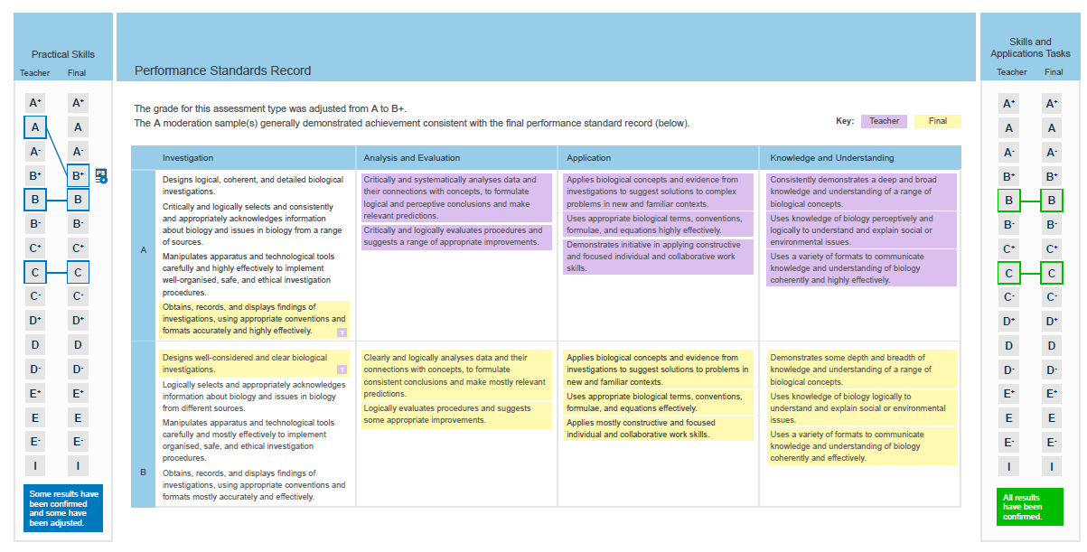
Notes:
Mock-up

Slide 55
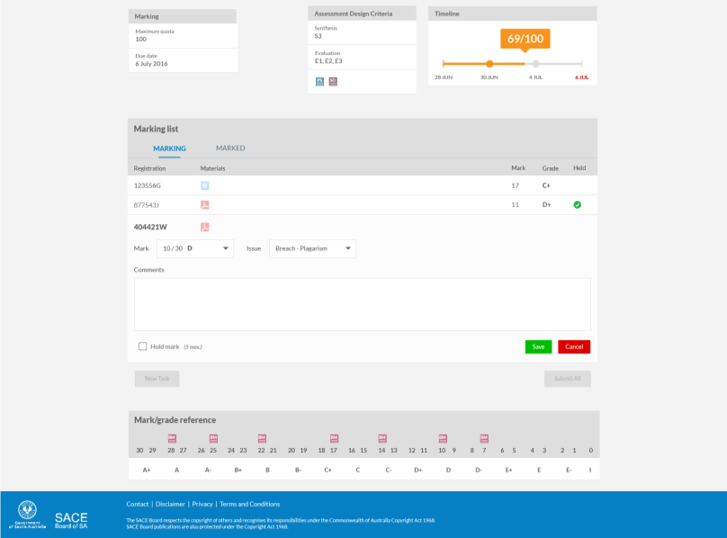
Online Marking
Notes:
Mock-up

Slide 56
Notes:
Mock-up

Slide 57
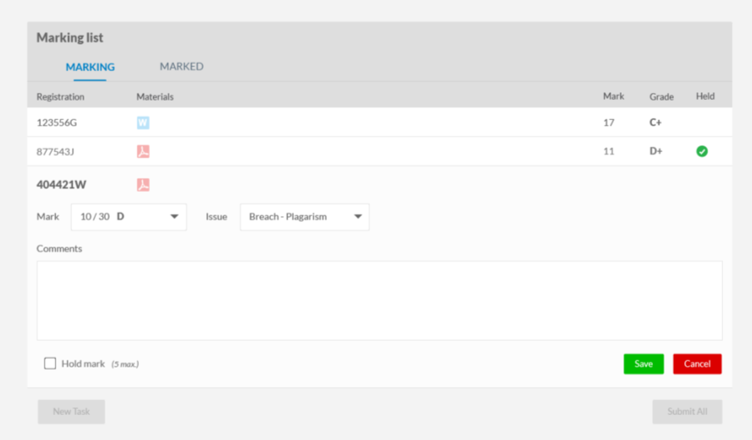
Notes:
Mock-up

Slide 58
Online Learning
Notes:
Mock-up

Slide 59
Notes:
Mock-up

Slide 60
Notes:
Mock-up

Slide 61
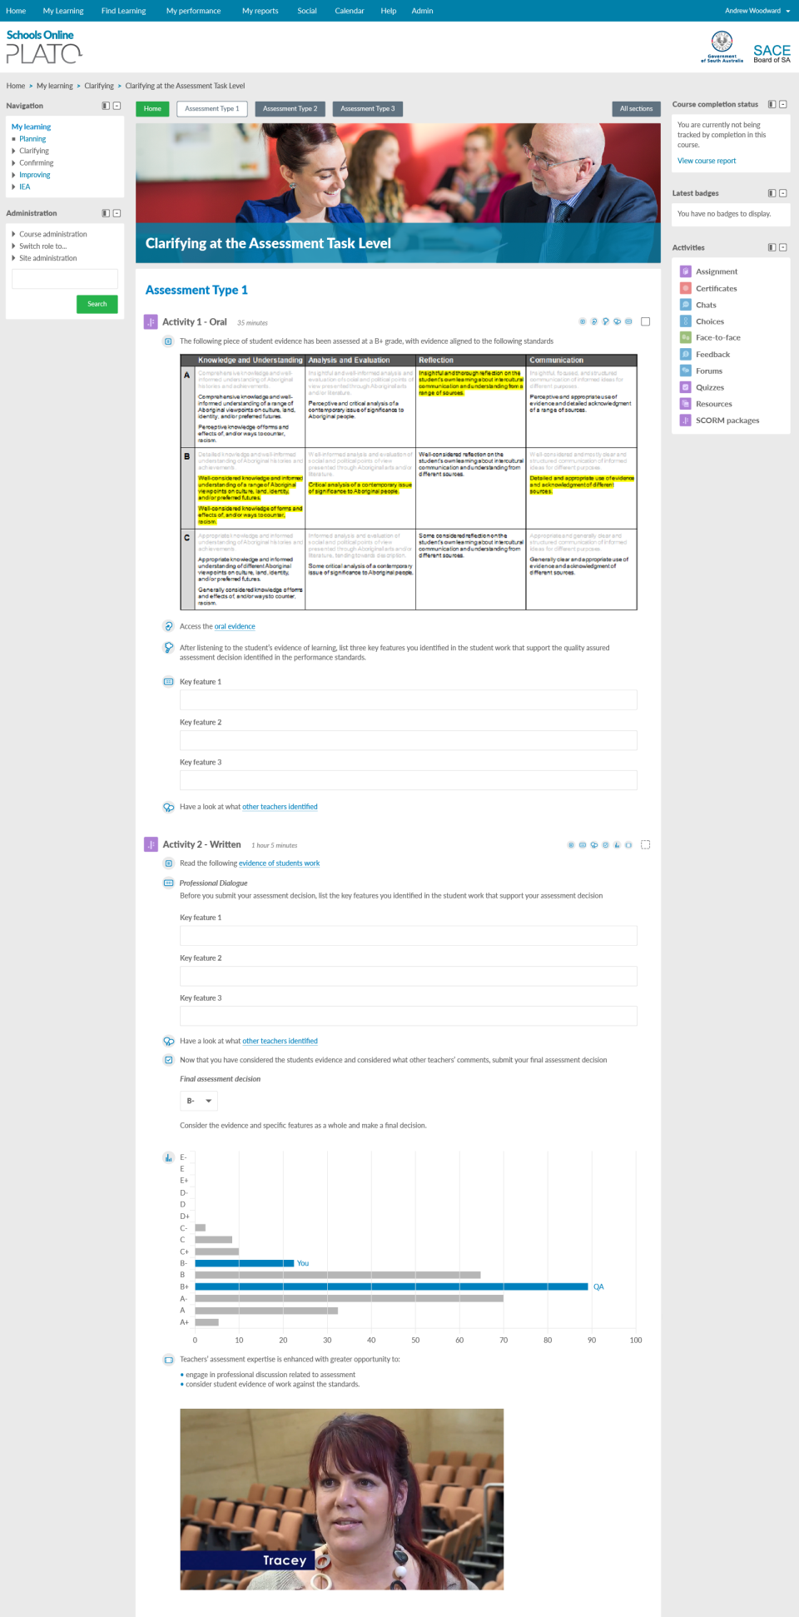
Feedback and reports
Notes:
Mock-up

Slide 62
Online Examinations Enter

Slide 63
Our needs
Design and setting
Management of the exam
Security – delivery and marking
Special provisions
Privacy
High availability and high performance, for high stakes delivery

Slide 64
Discussion and Reflection
questions
implications
feedback

Slide 65
SACE Board Strategic Plan 2016-2020

Slide 66
2014
2016−17
2017−18
2021
16
subjects
Aboriginal Studies
Digital Technologies
Integrated Learning
Music subjects
Physical Education
Scientific Studies
Accounting
Aust. Languages
Aust. & Int. Politics
Bus. & Enterprise
Cross-disc. Studies
Dance
Drama
Economics
Health
Nutrition
Philosophy
Psychology
Society and Culture
30
subjects

Slide 68
Growth in capabilities
Conceptual and contextual learning
Transformative learning
Relevant, engaging learning
Collaborative learning
Quality assessment

Slide 69
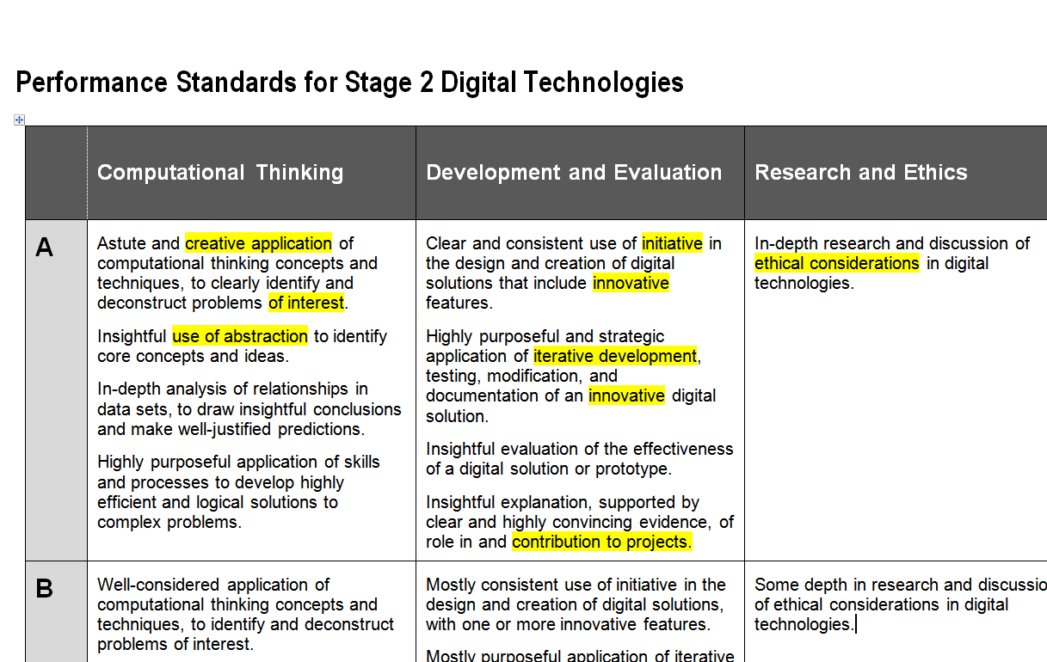

Slide 70
Please visit the following link to view the Creative Arts video
https://www.sace.sa.edu.au/web/creative-arts
Notes:
Creative Arts video

Slide 71
SACE Board Strategic Plan 2016-2020

Slide 73
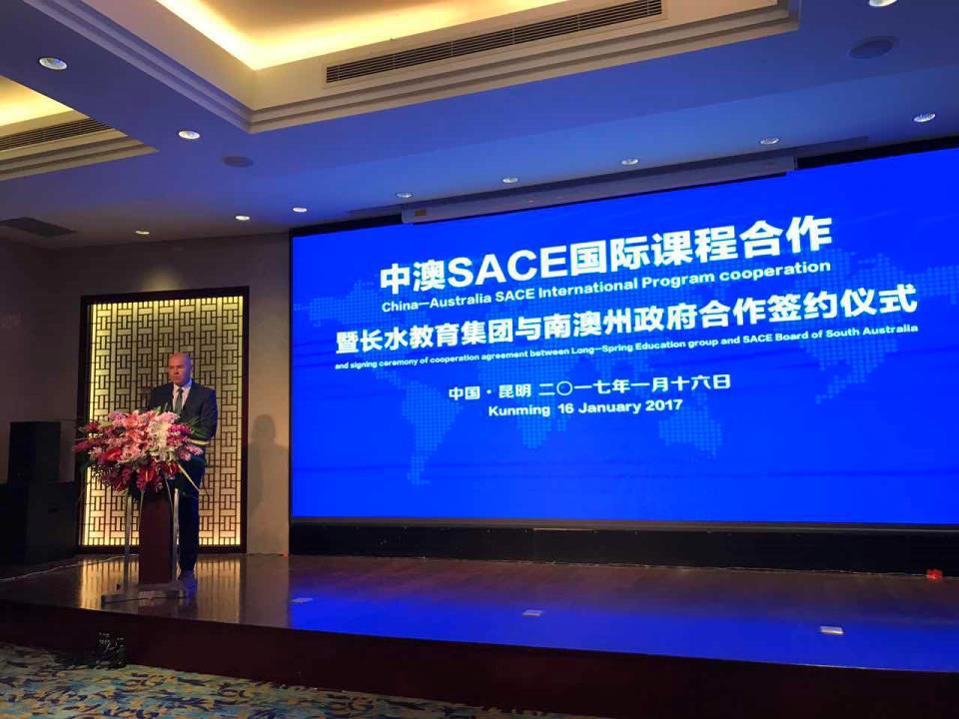

Slide 74
SACE International 2017
 | 2017 | 2018 | 2019 | 2020
Malaysia* | 5 | 5 | 5 | 5
China | 9 | 13 | 16 | 19
Vietnam | 1 |  | 2 | 4
India/Nepal |  |  | 2 | 4
Other, e.g. Vanuatu, Indonesia, Thailand, Philippines |  | 1 | 2 | 3
Total Schools | 15 | 19 | 27 | 35

Slide 75
SACE Board Strategic Plan 2016-2020

Slide 76
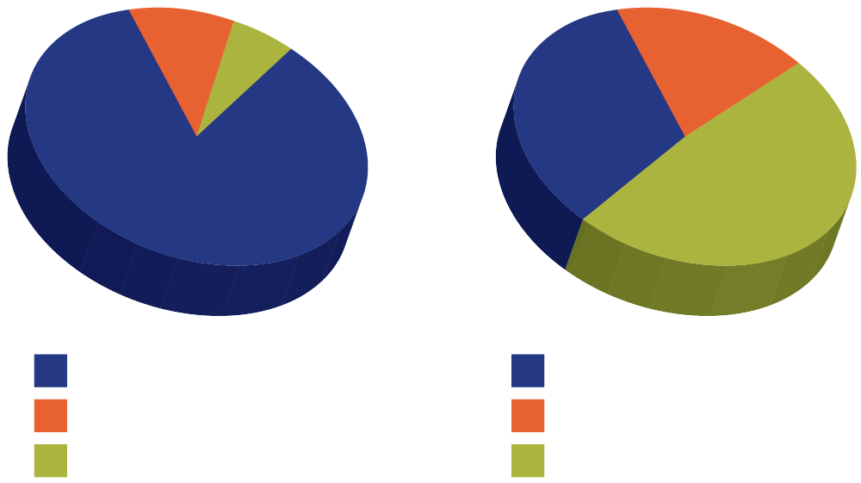
IEA Engagement 2015
Registrations by Participant
Registrations by School
167
15
84
31
1818
75
2069 in total
75 in total

Slide 77
Institute of Educational Assessors
Develop online modules for delivery in 2018.
Publish conference proceedings and an anthology of CEA Case Studies.
Develop a list of SACE Board research priorities.
Offer 2 scholarships toward practitioner action research.
Stage an annual assessment conference.

Slide 78
SAVE THE DATE
IEA 2017 Conference
Friday June 9th
9am – 3:30pm
Education Development Centre
Prof. Gordon Stobart
Emeritus Professor of Education, Institute of Education, University College London
Bookings - www.sace.sa.edu.au/iea

Slide 79
Discussion and Reflection
questions
implications
feedback

Slide 80
SACE Board Strategic Plan 2016-2020

Slide 81
au ∙ thor ∙ i ∙ ty
a: power to influence or command thought, opinion, or behaviour
b: freedom granted by one in authority

Slide 82
How should a 21st century authority relate with its partners?
“what do you want to look like?”

Slide 83
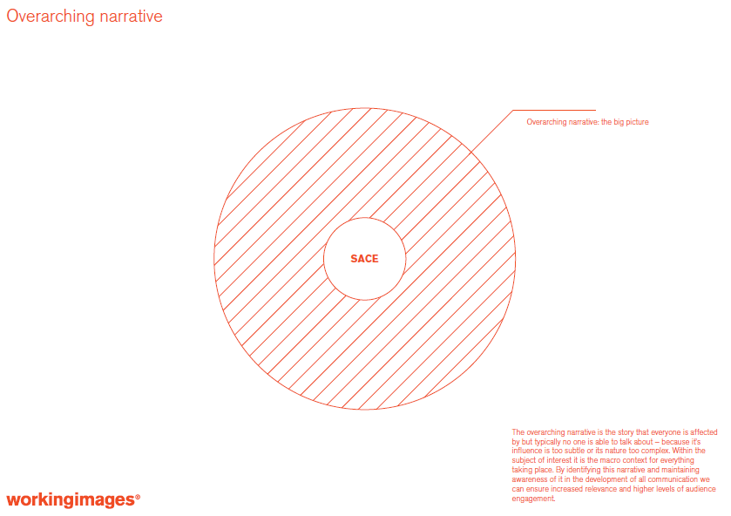

Slide 86
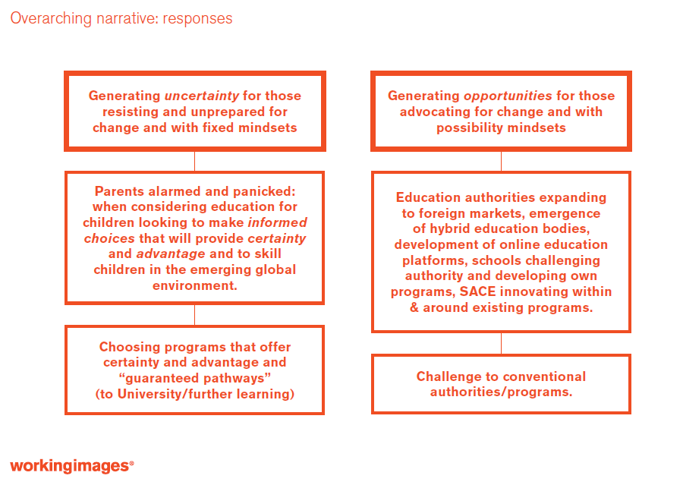

Slide 91
Please visit the following link to view the Irish Junior Cycle communication video
http://www.juniorcycle.ie/Assessment/Orla
Notes:
ORLA Link

Slide 92
Discussion and Reflection
questions
implications
feedback
What is the current SACE ‘narrative’ in your school community?

Slide 93
SACE Leaders Forum
March 6, 2017

