Slide 2
Information Session for New Geography Teachers Rozi Binte Rahmat (SACE Officer for GHY) Joanne Wegener (Lead Practitioner) 23 February 2021 4.00 pm to 5.00 pm

Slide 3
Agenda
Assessment types
Expectations
Q&A
Welcome
The SACE website
Electronic examinations

Slide 4
Welcome to SACE Website
sace.sa.edu.au

Slide 5
Teaching the SACE

Slide 6
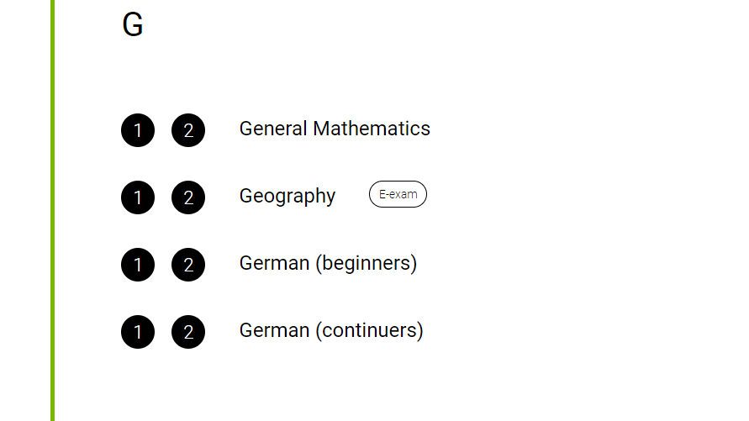
Teaching Geography

Slide 7
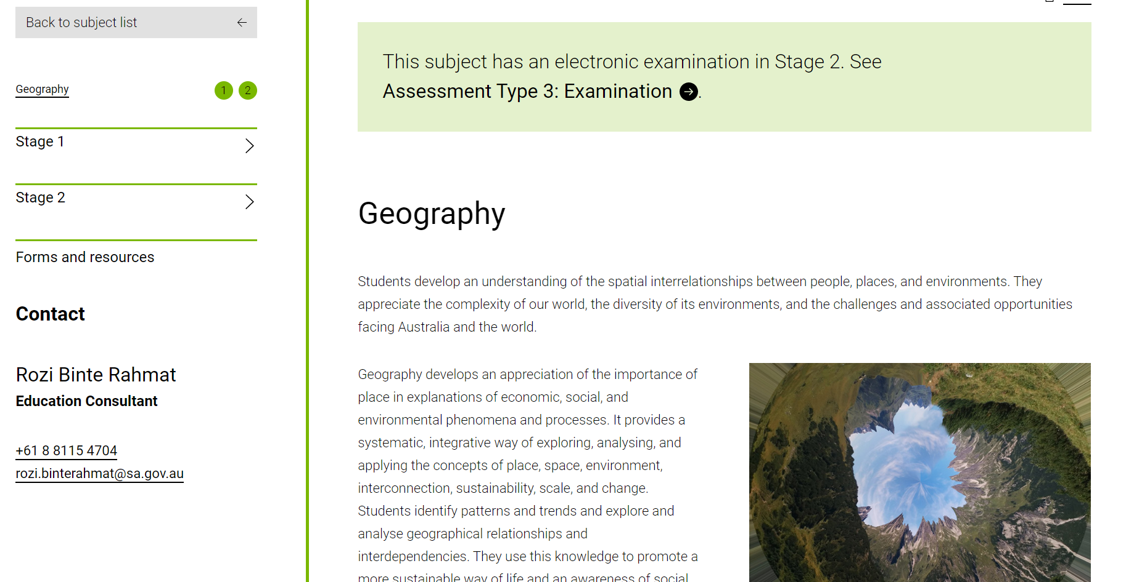
Teaching Geography

Slide 8
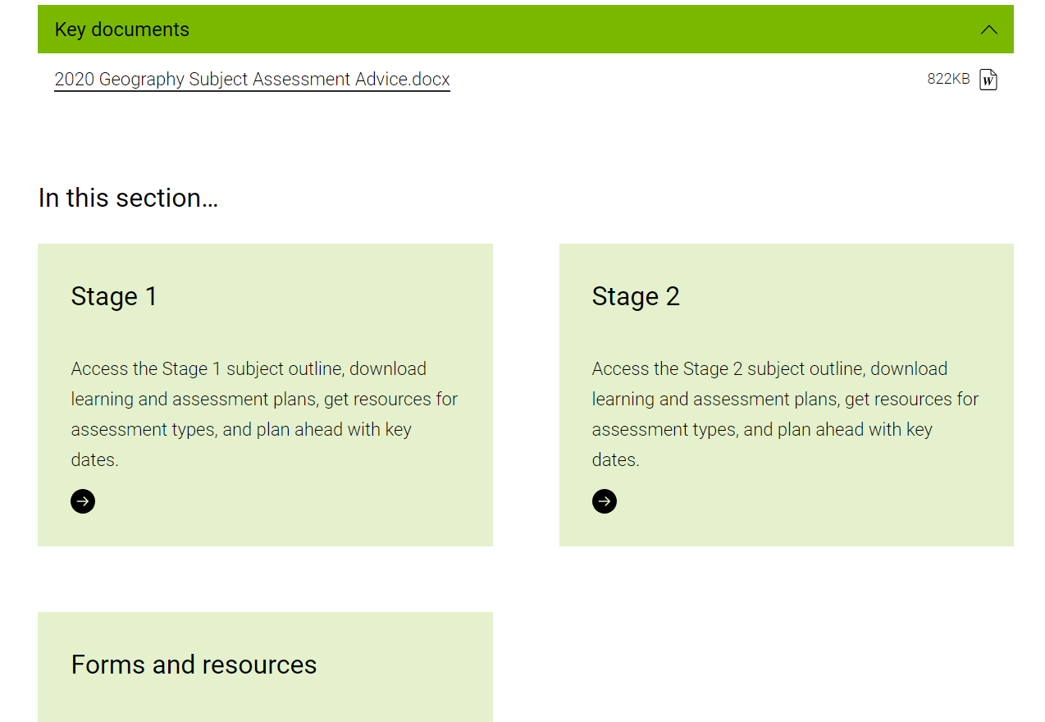
Teaching Geography

Slide 9
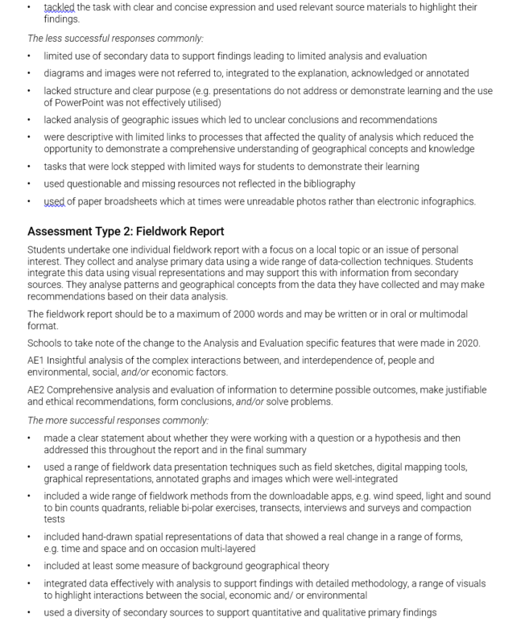
Teaching Geography

Slide 10
Teaching Geography Stage 1

Slide 11
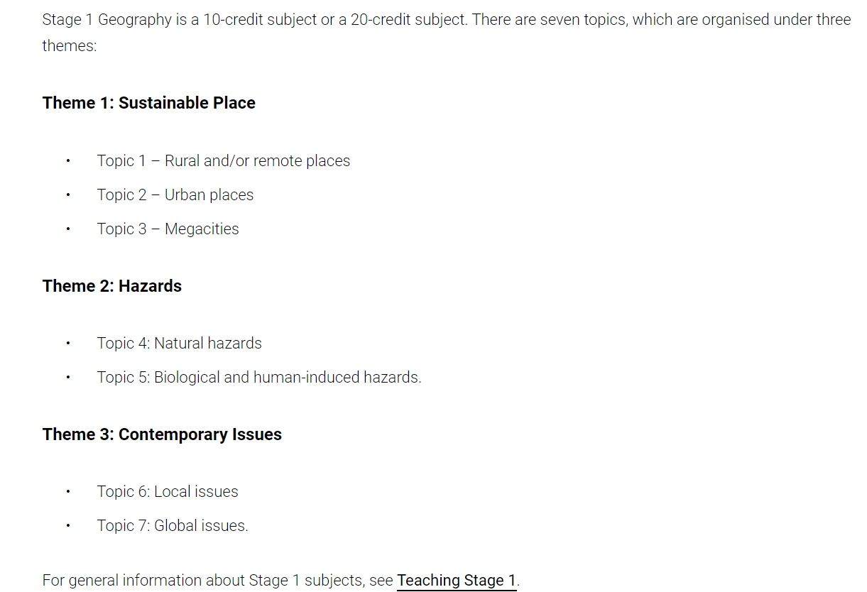
Teaching Geography Stage 1

Slide 12
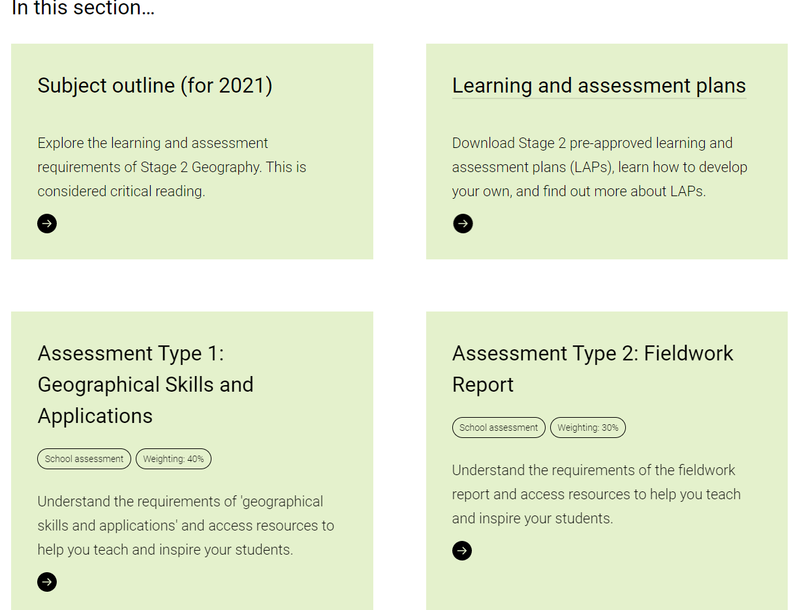
Teaching Geography Stage 2
Subject Outline
Samples of LAPs
Samples of AT1 and AT2 tasks

Slide 13
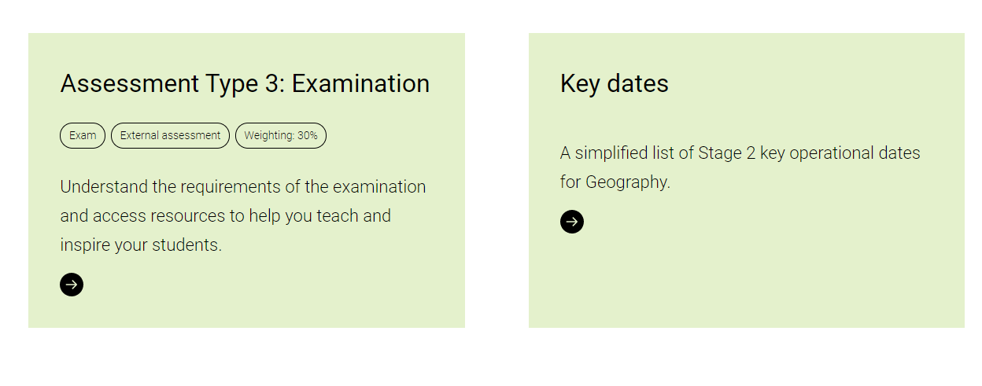
Teaching Geography Stage 2
Electronic Examination for Geography since 2020

Slide 14
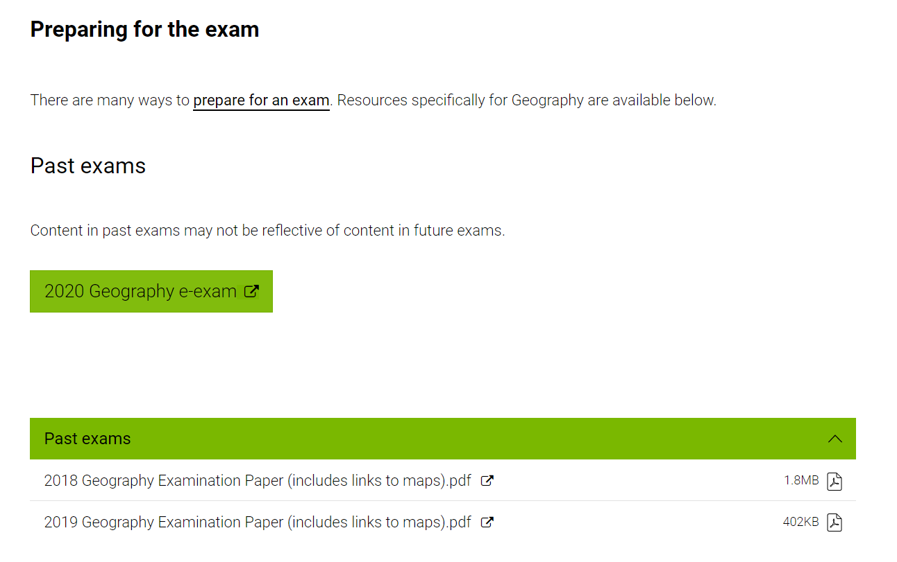
Teaching Geography Stage 2

Slide 15
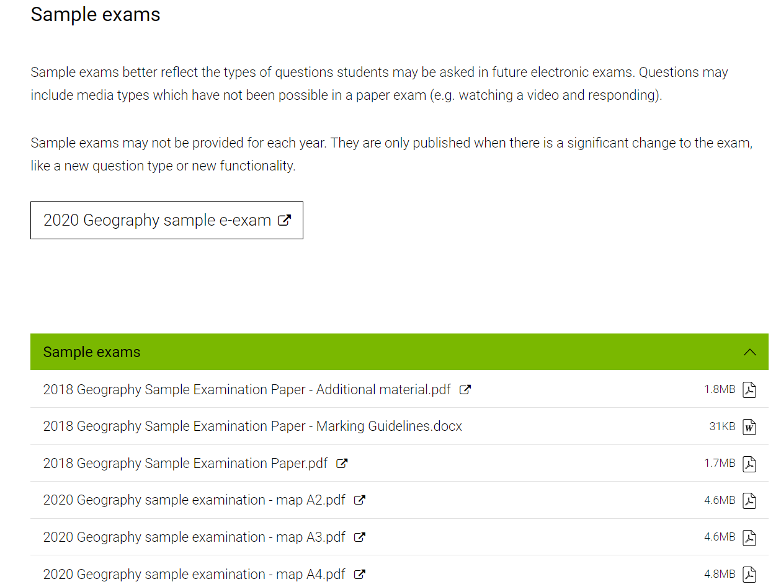
Teaching Geography Stage 2

Slide 16
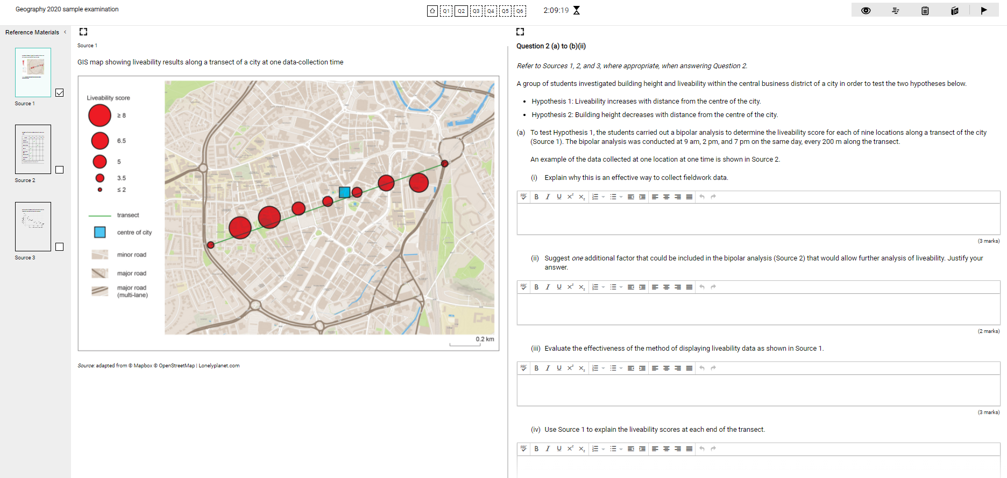
Teaching Geography Stage 2
Sources
still waiting
for copyright approval

Slide 17
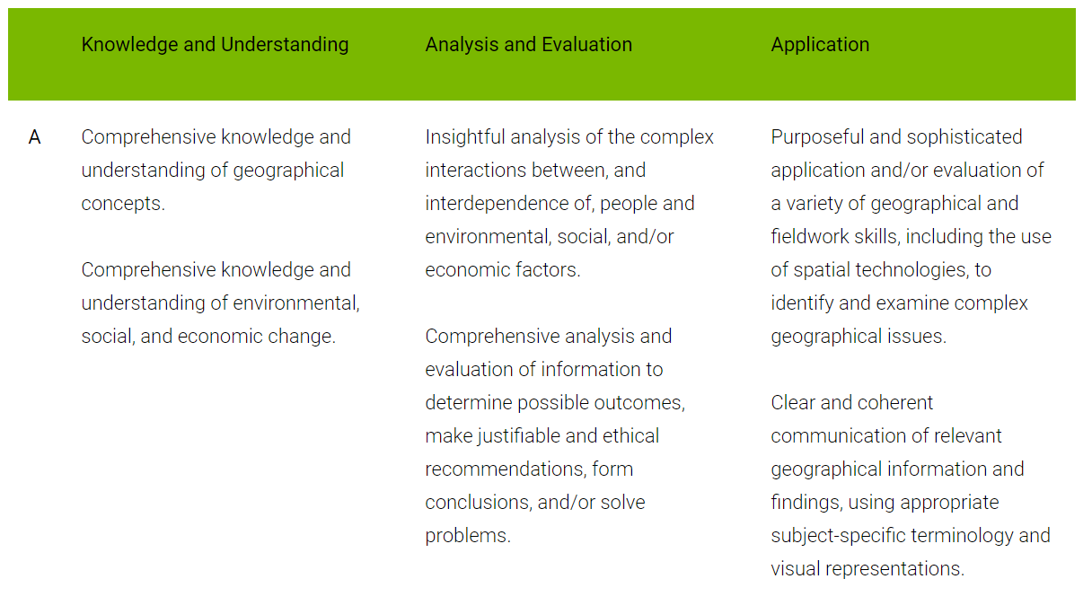
Teaching Geography Stage 2
AE1
AE2
AP1

Slide 18
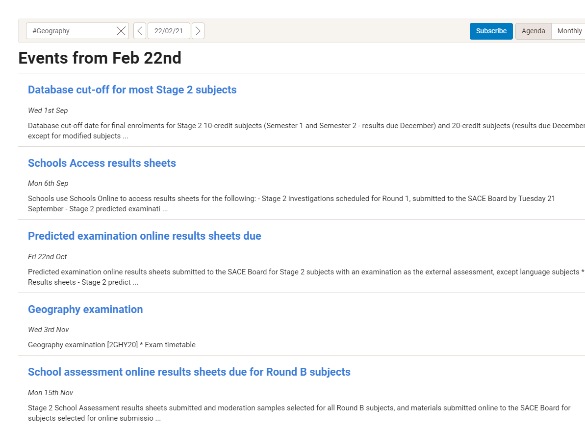
Teaching Geography Stage 2
Examination date
Uploading moderation tasks
Window/ Familiarisation period

Slide 19
Teaching Geography Stage 2

Slide 20
Teaching Geography Stage 2
Coming up soon.

Slide 21
Joanne Wegener Senior Years Learning Leader Concordia College
Introducing the Lead Practitioner

