Slide 1
Stage 2 Scientific Studies – Assessment Type 2 Collaborative Inquiry (20%)
This recorded presentation has a maximum limit of 5 minutes. With changes made Subject Outline for 2023, this task should feature:
a description of what the inquiry was about
an evaluation of the effectiveness of collaboration and its impact on results/outcomes
This task has been adapted from a 2022 submission so this sample is indicative of the evidence we would expect to see featured in 2023.

Slide 2
SummAry of design
The aim of this investigation was to explore the effect of crowd presence and external noise on free throw shooting accuracy in basketball.
Independent variable: no crowd with noise cancelling headphones, neutral crowd, negative crowd and positive crowd.
Dependent variable: free throw shooting accuracy (%).
Hypothesis: it is predicted that participants would have a higher shooting accuracy (%) if they were wearing noise cancelling headphones with no crowd.

Slide 3
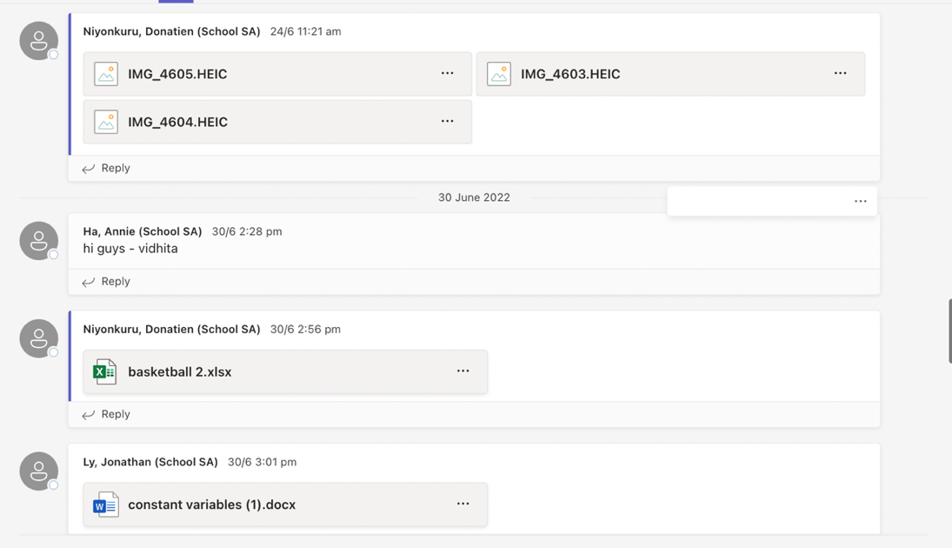
Evaluation of effectiveness of collaboration
IAE5: Discussion about how well the group members worked together, the distribution of tasks, and allocated due dates to keep people accountable.
Some additional evidence of evaluating collaboration appears in the journal which can contribute to the assessment if IAE5. In 2023 the focus of this section is on evaluating the collaborative skills used across all aspects of the task as listed in the subject outline (e.g. identifying a problem, deconstructing the problem etc.). Providing examples of collaboration linked to the listed aspects of the task in the subject outline with evaluation of the success of the collab activities and the impact on the results/outcomes.
Communicating between each other and discussing different range of ideas
Communication
this is an image showing how our group communicated which was done communicating via Microsoft teams. Microsoft teams was one of the most important sources of communication as it allowed us to share and distribute or different ideas, in order to resolve any conflict or confusion. It was also used to update any missing participants who weren’t present on the day.
Deadlines were set to keep group members accountable and keep track of task completed.
Using internet sources to communicate when not at school

