Slide 1
New to teaching GENERAL MATHEMATICS
MARCH 2021

Slide 2
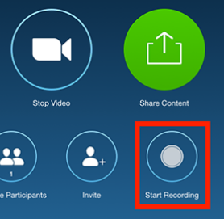
Zoom meeting requests
Please keep your speaker on mute.
Please use the chat tool to ask specific questions that you would like addressed during the teleconference.

Slide 3
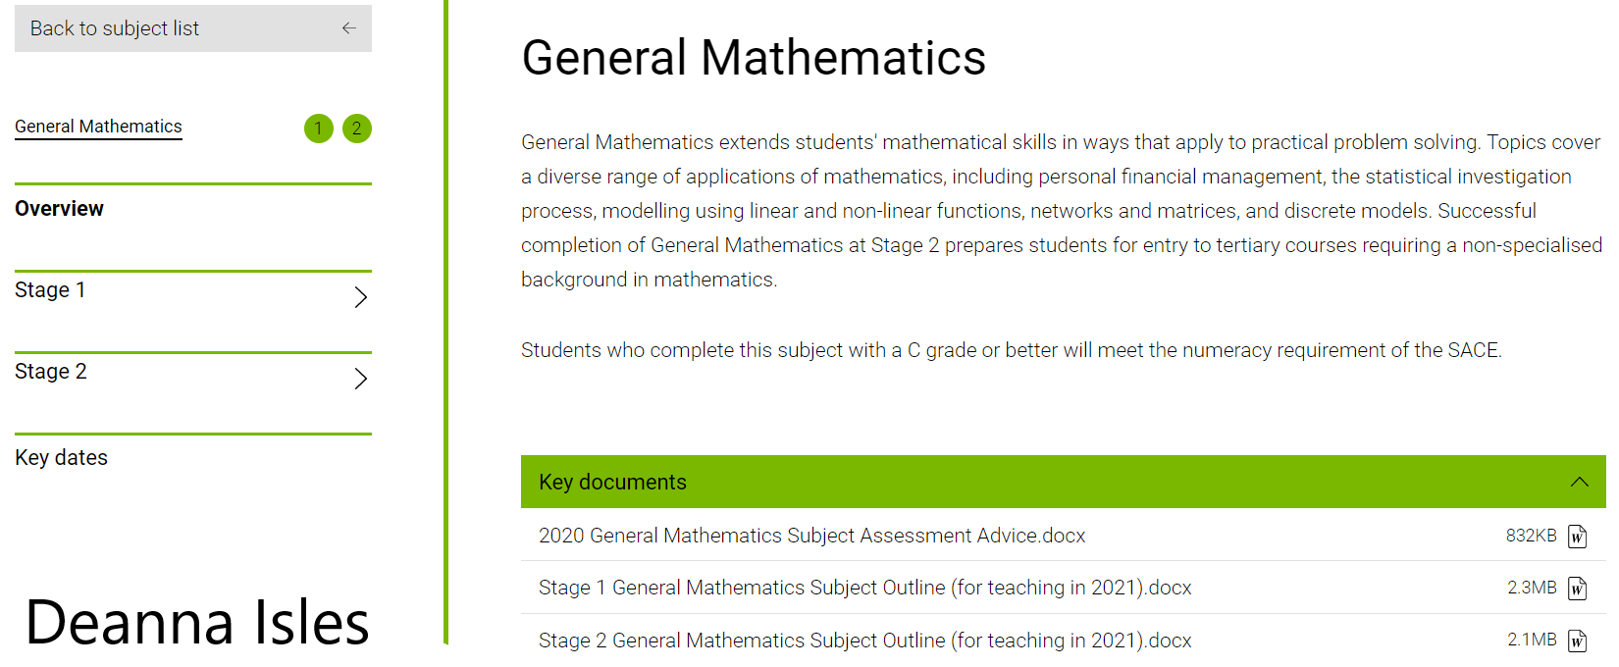
Key sources of support – Subject webpage

Slide 4
Current subject outline
The most important tool for teaching General Mathematics

Slide 5
Stage 2 General Mathematics consists of
Five topics fully described
Topic 1: Modelling with linear relationships
Topic 2: Modelling with matrices
Topic 3: Statistical models
Topic 4: Financial models
Topic 5: Discrete models
Students study five topics from the list of six.
Topic 6: Open topic
All students must study Topics 3, 4, and 5.

Slide 6
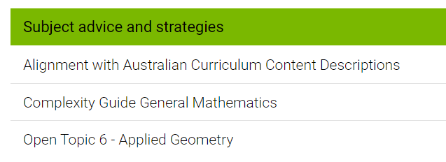
Open topic
Where the Option topic is used, it must replace:
Topic 2:Modelling with Matrices
Flexibility for teachers to design programs to meet the needs and interests of their students
Relevant to local context
Comparable standard to other topics in the subject outline
Open topic examples
Applied Geometry
Share Investments

Slide 7
Evidence of learning
EIGHT ASSESSMENTS
five skills and applications tasks
two folio tasks
one examination.
School assessment (70%)
Assessment Type 1: Skills and Applications Tasks (40%)
Assessment Type 2: Mathematical Investigations (30%)
External assessment (30%)
Assessment Type 3: Examination (30%)

Slide 8
Assessment Type 1: Skills and Applications Tasks (40%)
This set of assessments:
Must include ONE skills and applications task from each of the NON-examined topics.
Students complete five skills and applications tasks.
Skills and applications tasks must be completed under the direct supervision of the teacher.
The equivalent of one skills and applications task must be undertaken without a calculator or notes.
In the remaining skills and applications tasks:
electronic technology as per approved calculator guidelines
up to one A4 sheet of handwritten notes (on one side only)

Slide 9
Assessment Type 2: Mathematical Investigations (30%)
Two Mathematical Investigations:
The evidence for each investigation, excluding bibliography and appendices if used, must be a maximum of twelve A4 pages if written, or the equivalent in multimodal form.
Students complete two tasks
The maximum page limits are for single-sided A4 pages with minimum font size 10.
Page reduction, such as two A4 pages reduced to fit on one A4 page, is not acceptable.
Conclusions, interpretations and/or arguments that are required for the assessment must be presented in the folio task, and not in an appendix. Appendices are used only to support the folio task, and do not form part of the assessment decision.

Slide 10
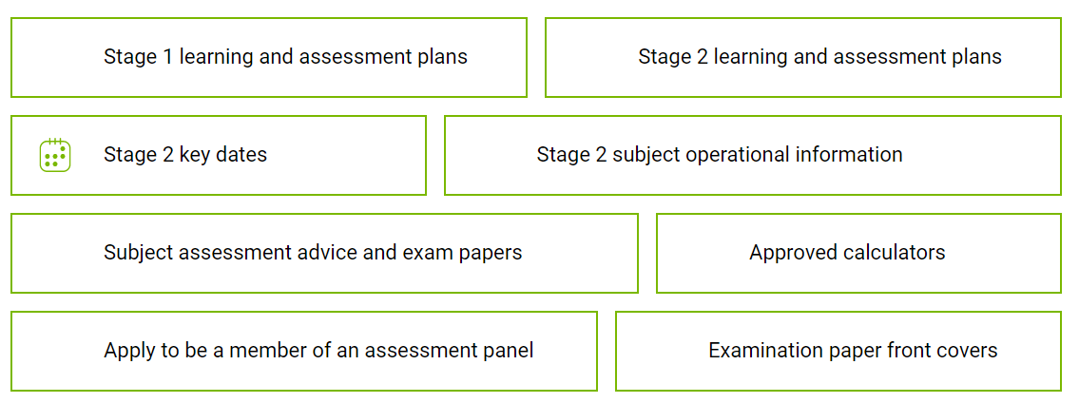
Range of different resources accessible

Slide 11
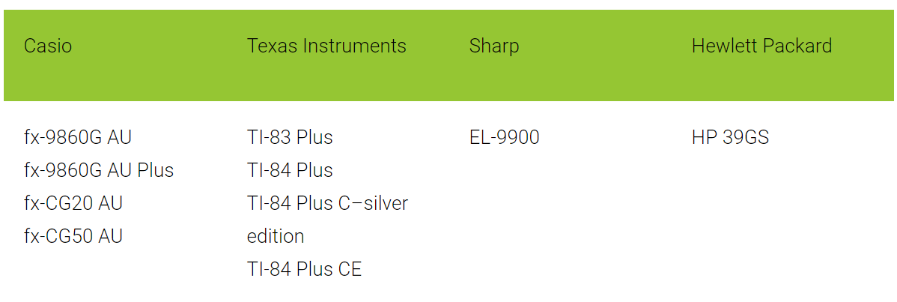
Approved scientific calculators
Any scientific calculator, except those with an external memory source (USB jack or SD card slot), may be used.
All students are required to clear the memory of their scientific calculators.
General conditions for the use of approved calculators
Students must provide their own calculators or be allocated a calculator by the SACE coordinator.
For mathematics subjects, students may bring into the examination room:
two approved graphics calculators
OR
one scientific calculator and one approved graphics calculator.

Slide 12
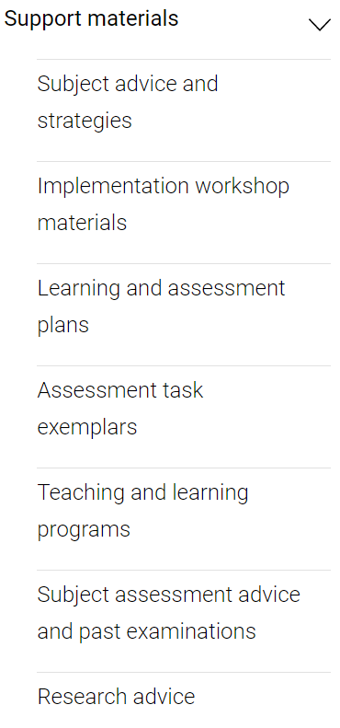
General Mathematics

Slide 13
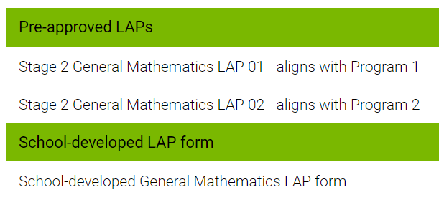
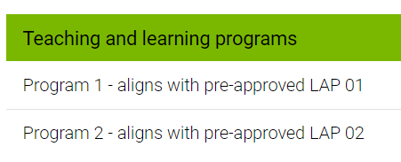
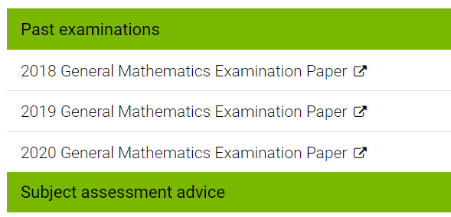
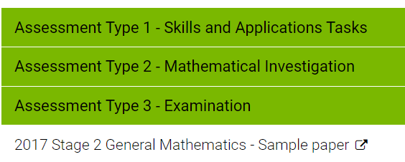

Slide 14
Complexity Guide General Mathematics

Slide 15
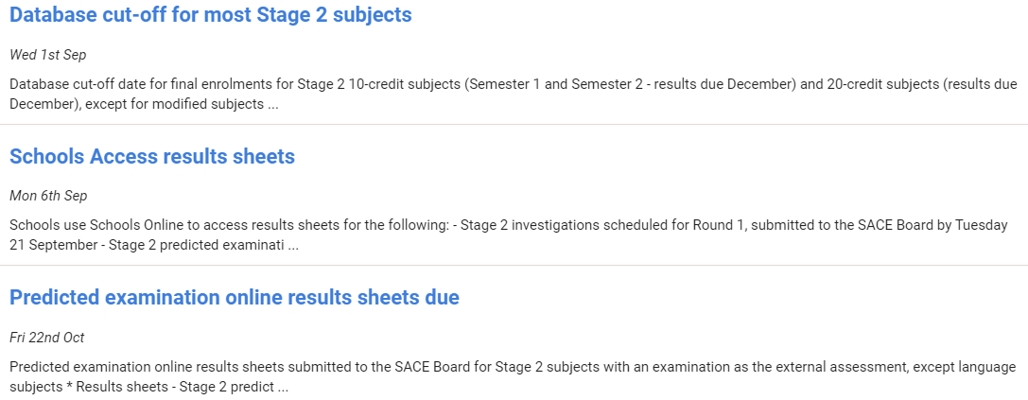
IMPORTANT DATES

Slide 16
IMPORTANT DATES

Slide 17
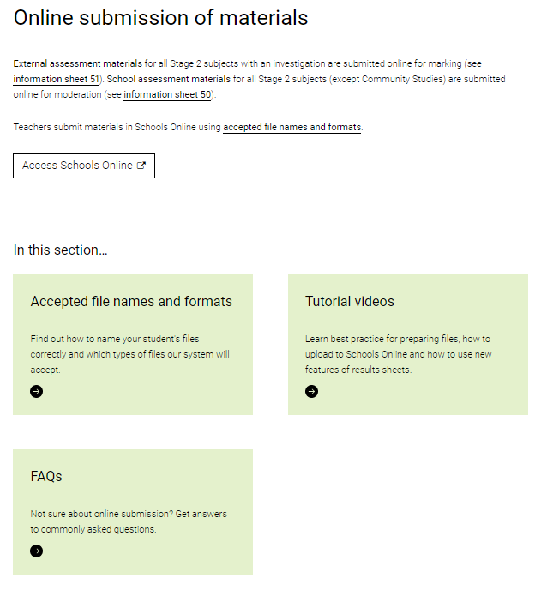
MODERATION School Assessment

Slide 18
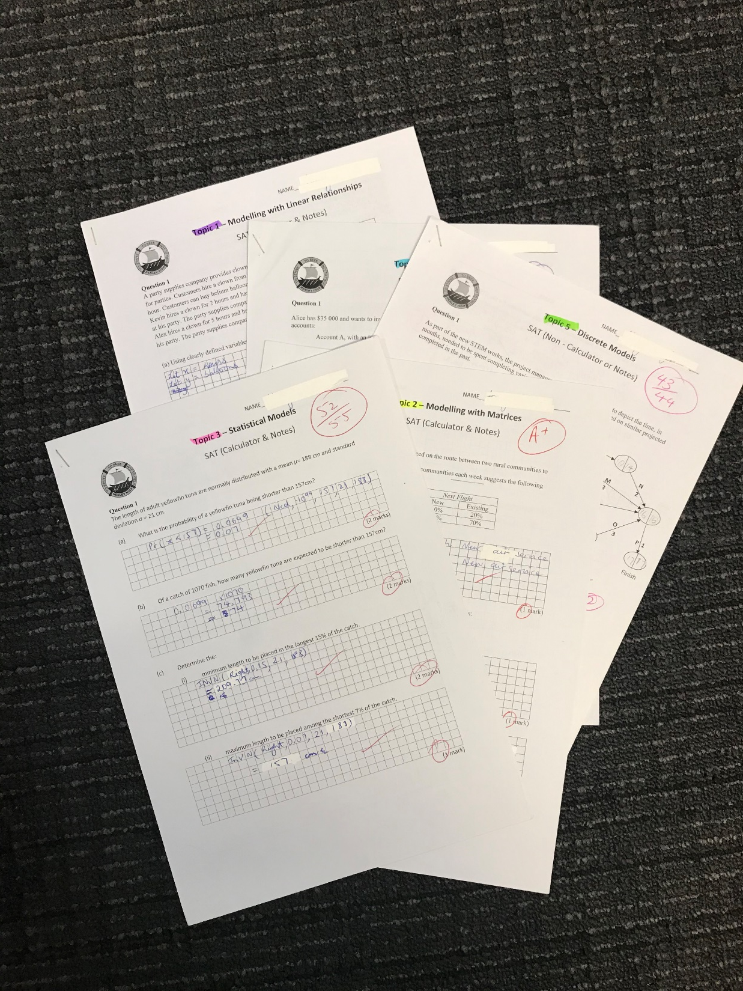
=1
Multiple individual documents are not required to be scanned and uploaded separately for any assessment type for a student in the sample
Notes:
The set of SAT responses for each individual student in the sample can be scanned as one single document.
Where there are multiple investigations, they can also be scanned as a single document.

Slide 19
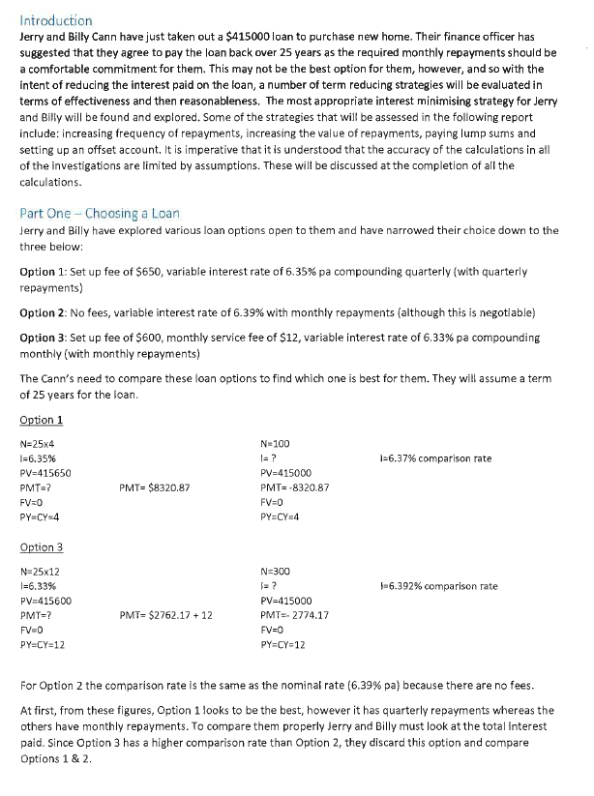
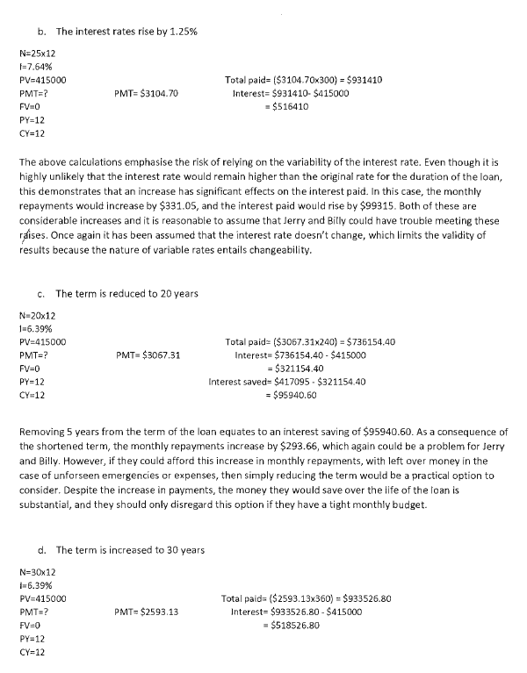
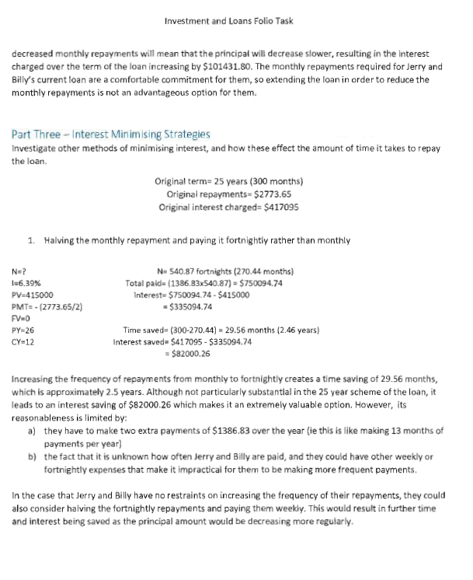
Moderation is a process of confirmation
The correctness of mathematical computations is a key indicator for the moderator to confirm standards indicated by the teacher against the performance standards.
All materials submitted for moderation must have clear evidence of the level of correctness of all mathematical computations carried out by the student.
All mathematical calculations
must be marked
Notes:
Where there are multiple investigations, they can also be scanned as a single document.

Slide 20
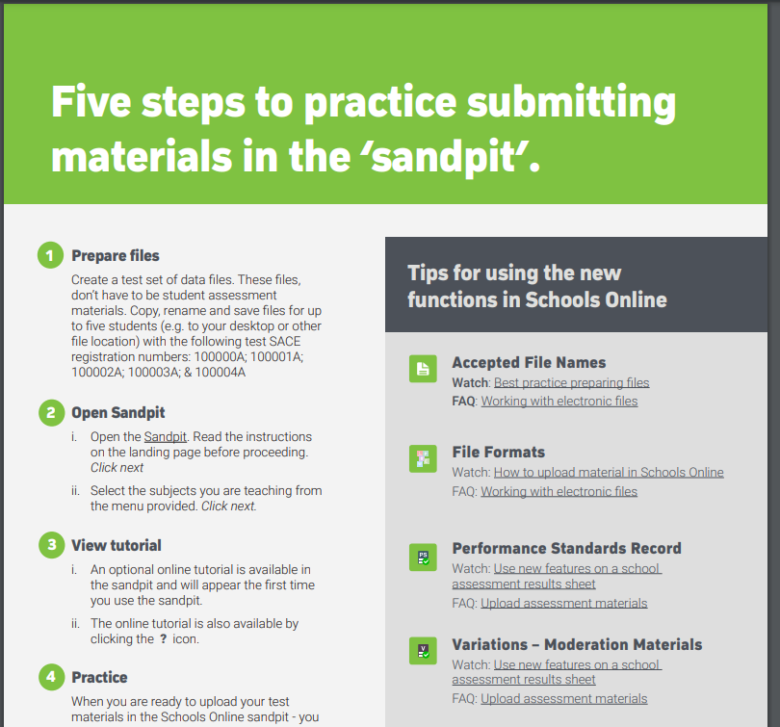

Slide 21
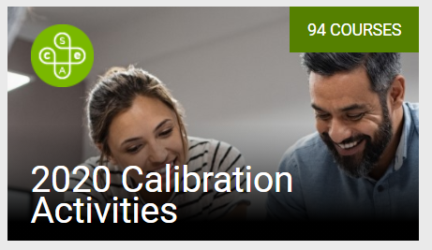
PLATO

Slide 23
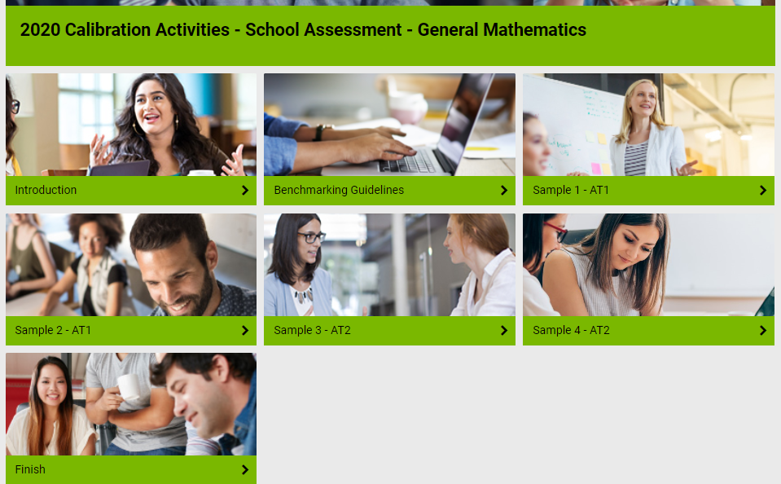

Slide 24
Tips from a
Lead Practitioner

