Slide 1
New to teaching SPECIALIST MATHEMATICS
MARCH 2021

Slide 2
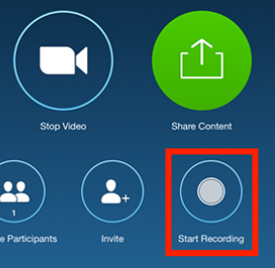
Zoom meeting requests
Please keep your speaker on mute.
Please use the chat tool to ask specific questions that you would like addressed during the teleconference.

Slide 3
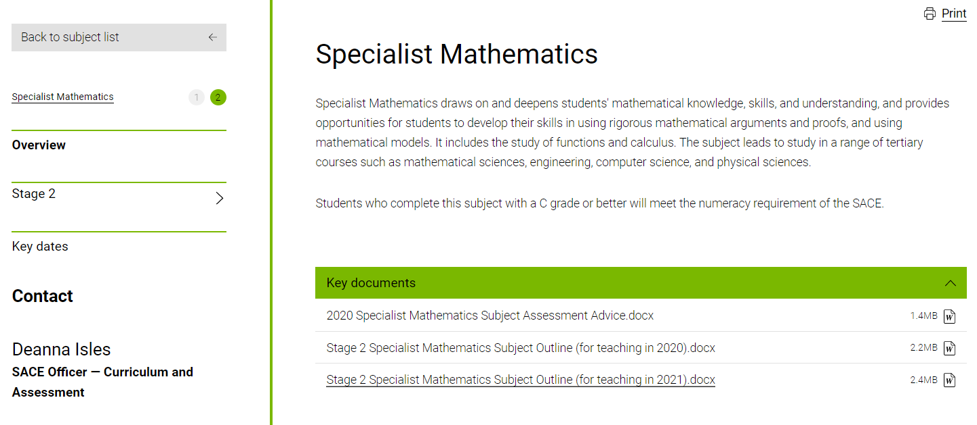
Key sources of support – Subject webpage

Slide 4

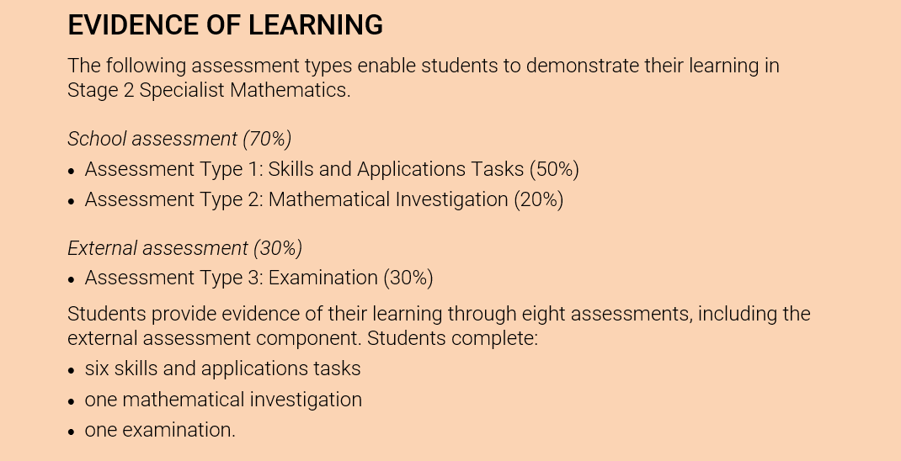
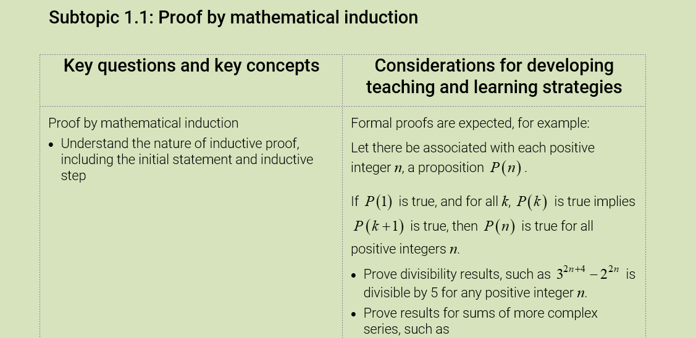
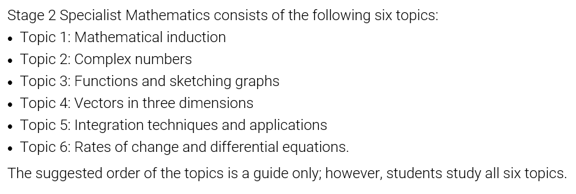
Current subject outline
The most important tool for teaching Specialist Mathematics

Slide 5
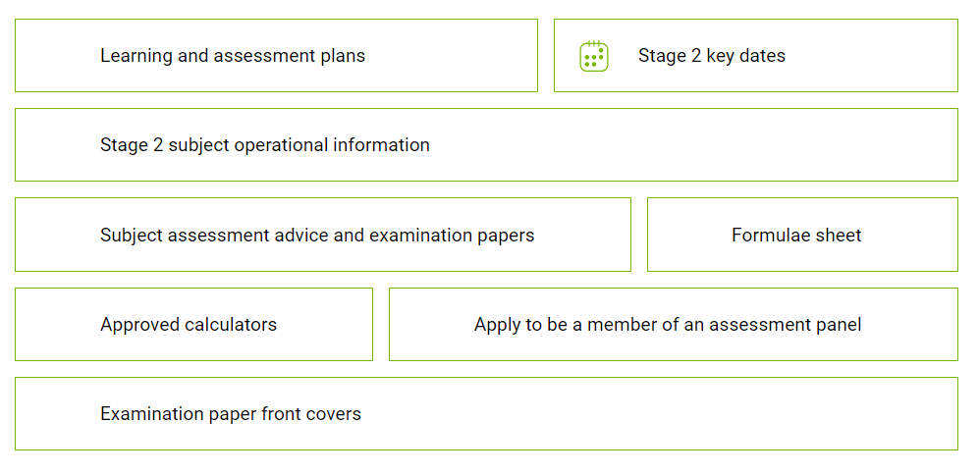
Range of different resources accessible

Slide 6

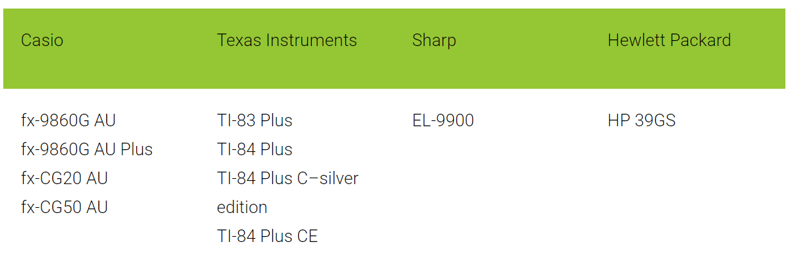
Approved scientific calculators
Any scientific calculator, except those with an external memory source (USB jack or SD card slot), may be used.
All students are required to clear the memory of their scientific calculators.
General conditions for the use of approved calculators
Students must provide their own calculators or be allocated a calculator by the SACE coordinator.
For mathematics subjects, students may bring into the examination room:
two approved graphics calculators
OR
one scientific calculator and one approved graphics calculator.

Slide 7
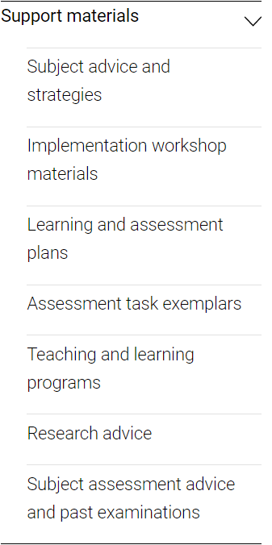
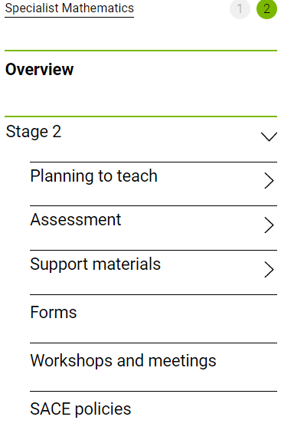

Slide 8
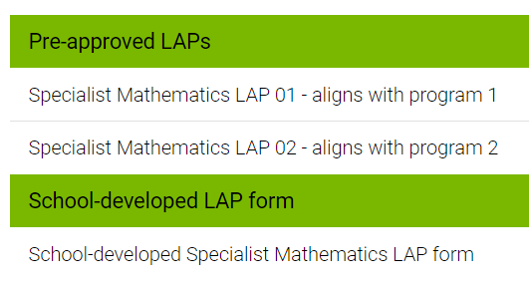
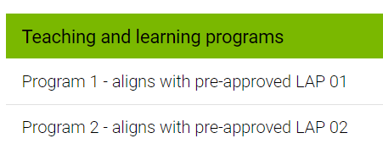
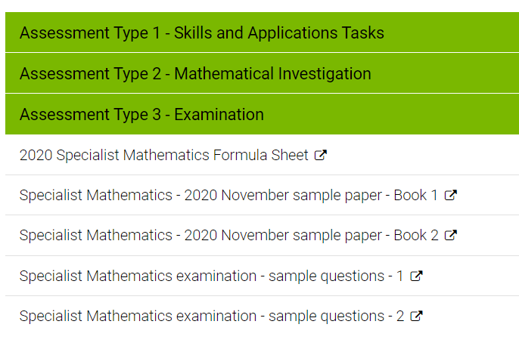
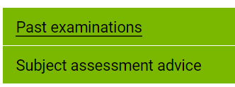
Assessment task exemplars
Subject assessment advice
and past examinations

Slide 9

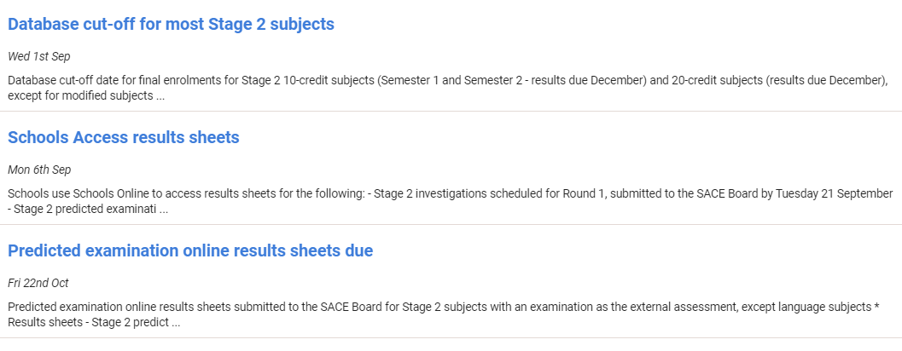
IMPORTANT DATES

Slide 10
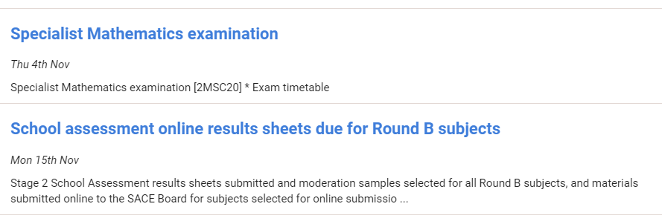
IMPORTANT DATES

Slide 11
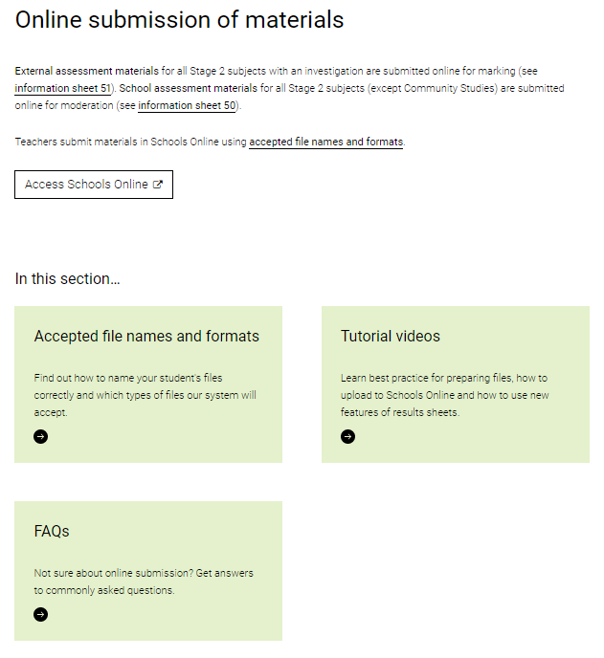

MODERATION
School Assessment

Slide 12
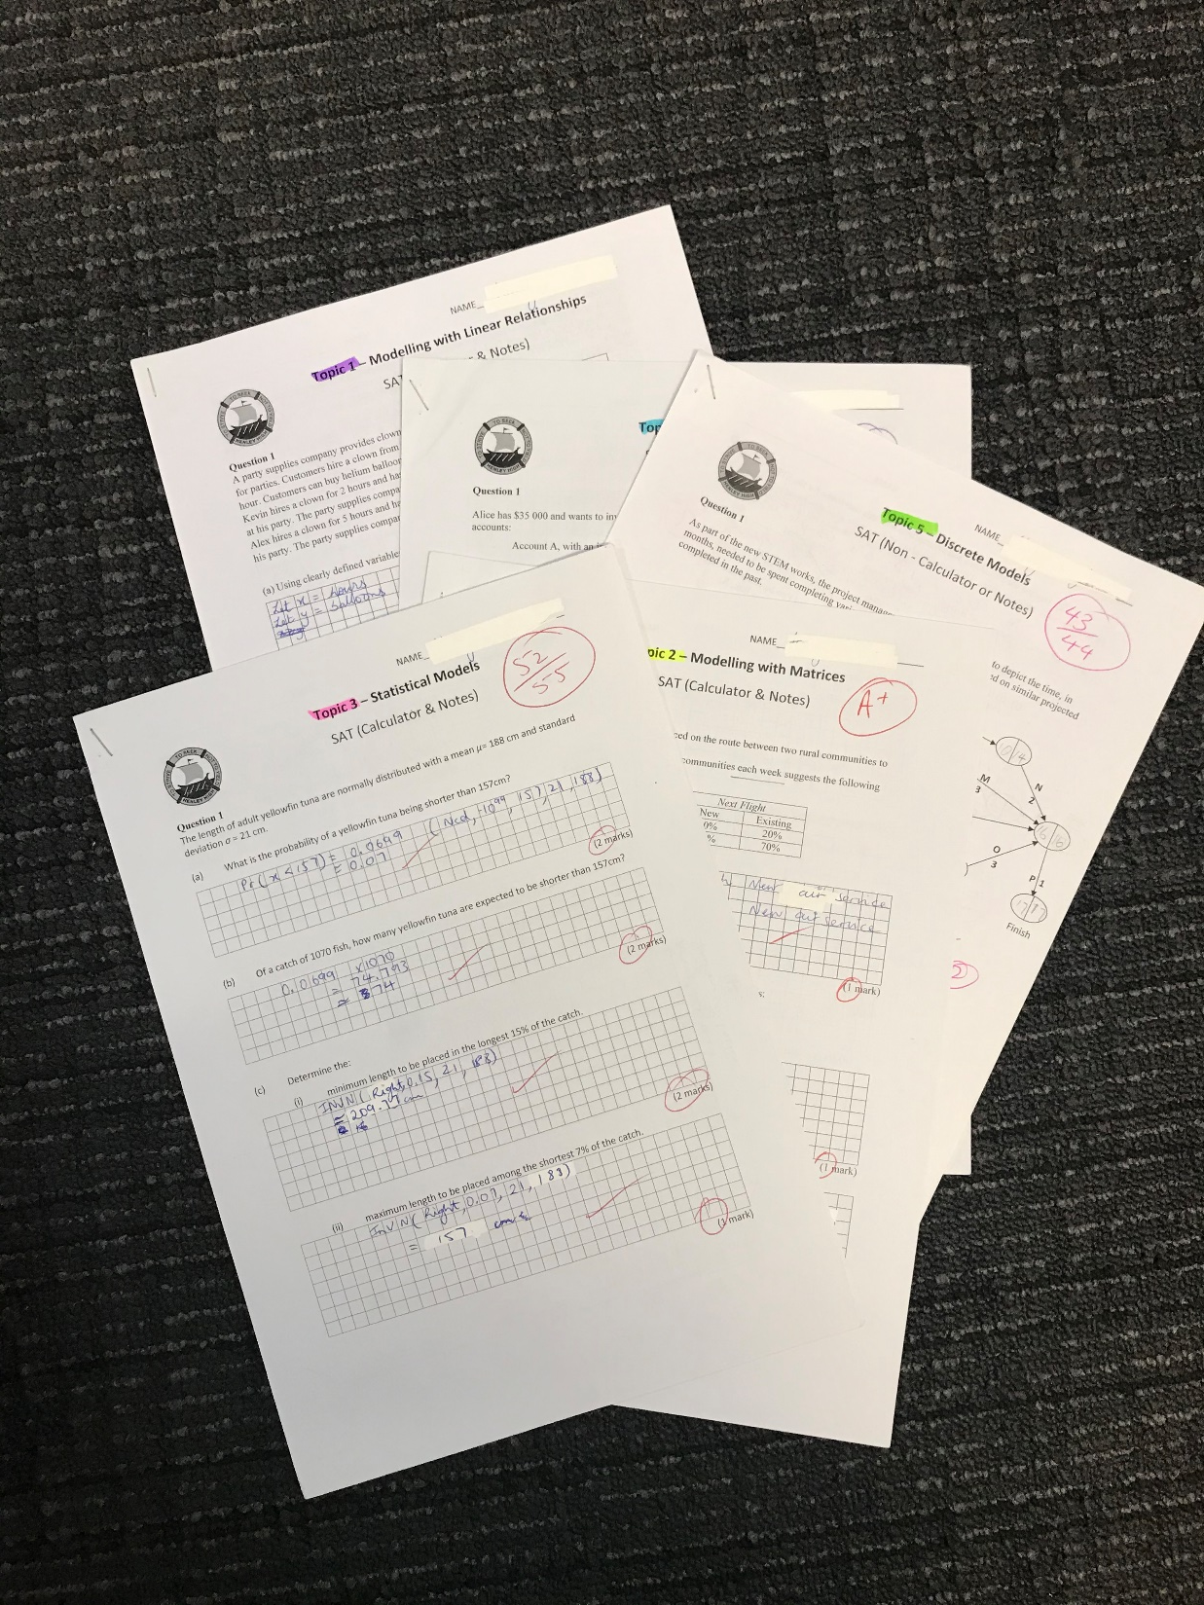
=1
Multiple individual documents are not required to be scanned and uploaded separately for any assessment type for a student in the sample
Notes:
The set of SAT responses for each individual student in the sample can be scanned as one single document.
Where there are multiple investigations, they can also be scanned as a single document.

Slide 13
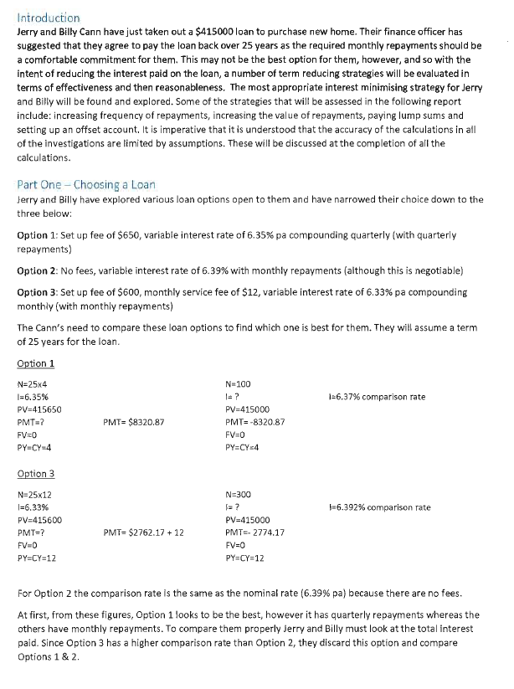
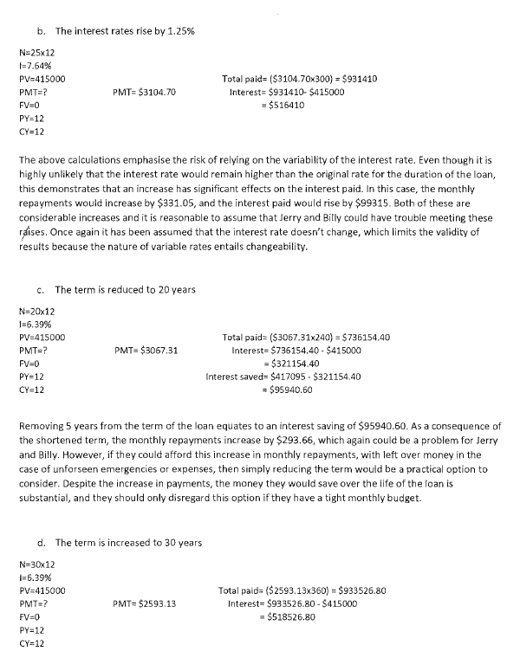
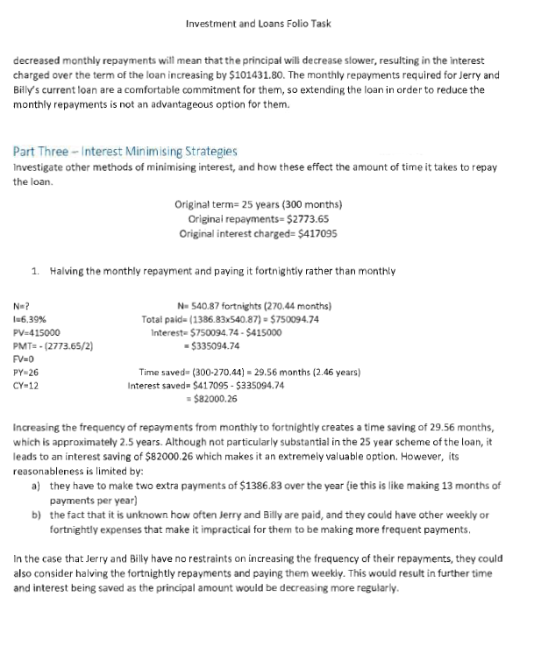
Moderation is a process of confirmation
The correctness of mathematical computations is a key indicator for the moderator to confirm standards indicated by the teacher against the performance standards.
All materials submitted for moderation must have clear evidence of the level of correctness of all mathematical computations carried out by the student.
All mathematical calculations
must be marked
Notes:
Where there are multiple investigations, they can also be scanned as a single document.

Slide 14
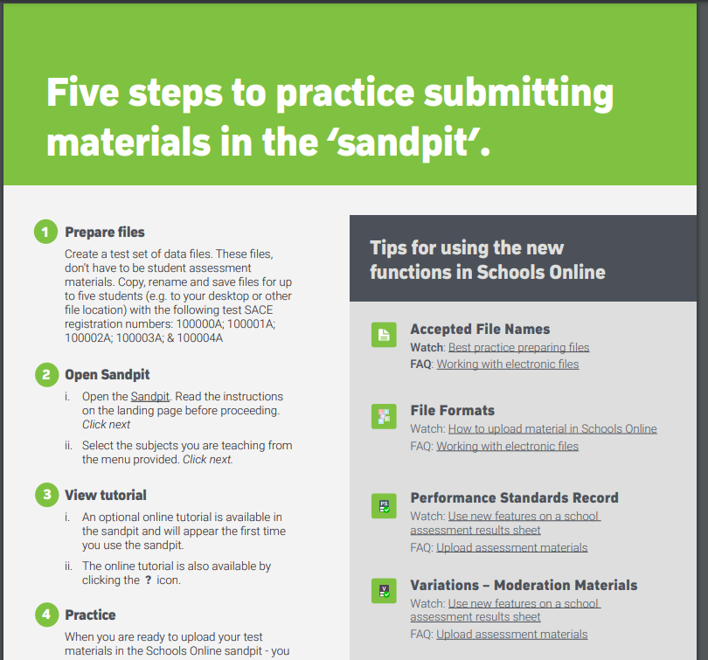

Slide 15

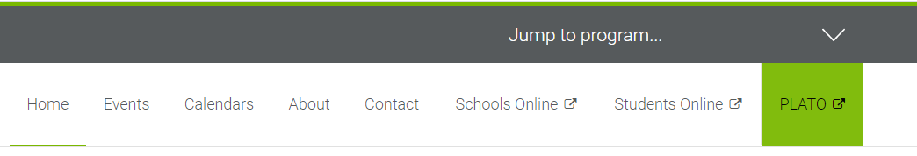
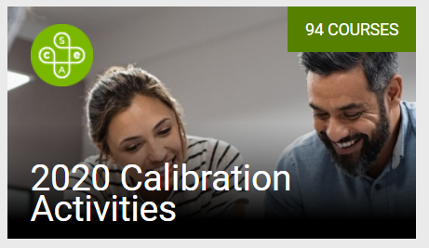
PLATO

Slide 16
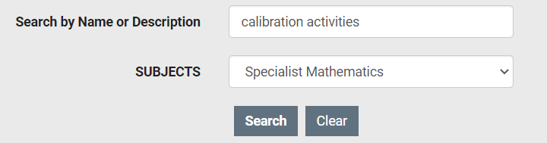
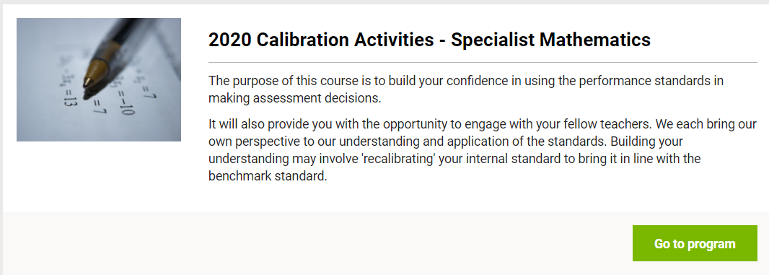

Slide 17


Slide 18

Tips from a
Lead Practitioner

Slide 19
INDUCTION
No need for Σ or Π notation – in fact so many mistakes made when students use this in the LHS P(k+1) step.
Start by stating what P(n) is, if not already given in that format.
Provide part (b) style – exam style (e.g. Q.5 2019 book 1).
Sums, products, divisibility, matrices, trigonometry.
Matrices – good to get conjecture and proof done here in a SAT. Can be asked in exam.
Trigonometry style – may need hints for identity required.
Marking: one mark for statement of P(n) at the beginning with the statement at the end. If the statement at the end is there with no, or incorrect, maths between then no mark.

Slide 20
Complex Numbers and Polynomials
Making good use of graphics calculator when working from Cartesian form to polar form and vice versa (e.g. 2019 Q7 (a)(i) and (ii), Q14 (b)(i))
DeMoivre’s theorem focus (e.g. 2019 Q 14 (b)(ii), (c)(i))
Linking polynomials with roots of complex equations. e.g. Conjugate pairs to a quadratic factor.
Graphing sets –Use supplementary material here: past exam material, extra in Haese. (eg 2019 Q14 (a)(i), (ii))
Ensuring scales are clearly indicated in these Argand Diagrams. (e.g. 2019 Q7 (b))
Triangle Inequality in context of using vectors to represent complex numbers.
Drawing solutions on Argand Diagram, connecting geometry and properties of shapes (e.g. Rhombus, parallelogram). Past exam papers. (e.g. 2019 Q7 (b)-(c) (iii), Q14 (c)(ii)(1)(2))
Using points or vectors to represent solutions but ensure ‘length’ is indicated, and
position reasonably for given angle.
Remainder and factor theorem - past exam questions. Use calculator for solving
simultaneously if required. (eg. 2019 Q 9)

Slide 21
Functions and Graph sketching
Composition of functions and consideration of domains and ranges in this context
and for inverse functions.
Observe behaviour near asymptotes graphically. (e.g. 2019 Q4). May be oblique asymptotes.
Consider modulus graphs – use calculator e.g. |Y1| on CASIO.
Calculator use – be savvy ensure in parametric form that pitch for parameter t is set appropriately.
Be careful that if the calculator has been used to draw parametric
curve then if later an integral is required it must be changed back to “Y=”.
Inverse functions – make sure to link to calculus later (e.g. implicit differentiation) (e.g. 2019 Q13)
o 1-1 is all that is required to consider when asked if a relation has an inverse
o Examiner comments regarding the negative or positive square root when
finding the derivative e.g. if 𝑦 = arcsin𝑥 and ∴ 𝑥 = sin𝑦 … finding the derivative …
Can introduce partial fractions here & revisit in integration. (e.g. 2019 Q1(a) and (b)).

Slide 22
Vectors and Vector Proof
Vector form of the equation of the plane not required. Only the Cartesian form.
Notation - very important to use correct notation so that errors in ‘algebra’ are
avoided. Understanding that 𝒃・𝒃 = |𝒃|^{𝟐}
Triangle Inequality again in this context.
3x3 systems – show row operations clearly
o Recognise reduced matrix that indicates no solution, infinitely many
solutions, unique solution. (e.g. 2019 Q6)
o Recognise possible graphical representation (given). Recognise system as having parallel or coincident planes.
o Two equations of planes for common line. Row operations on this sort of
system. (e.g. 2019 Q6)
Vector proof – assumed knowledge:
similarity
properties of circles
and tangents.
(e.g. 2019 Q3)
Longer questions and shorter questions (e.g. 2019 Q11)
Angle between planes not required.
Volume of 3D shapes not required.

Slide 23
Integration techniques
Link to functions and graph sketching:
o Substitution – do not need to do Q.10 or Q.11 of Ex 7C.1 of Haese
Inverse Trig Functions
Partial Fractions
Integration by Parts (e.g. 2019 Q13 (d), Q15(a))
  LIATE (log, inverse trig, algebra, trig, exp) for choice of ‘u’.
Calculator use – care when entering, especially trig with powers. Comment
previously re CASIO:
if the calculator gives T instead of an x then change TYPE to Y=
Volumes of solids of revolution – often lead in, such that when the function is
squared it works out nicely. (e.g. 2019 Q15)
Modulus for natural log
Volumes of solids involving two functions (Ex 7F.2 of Haese) NOT in the Subject Outline.
Area between Curves ensure in correct order.
Don’t stay on Methods style of question.

Slide 24
Rates of Change and DEs
Changes to Subject Outline regarding 6.3 and 6.4 to clarify what types of relations may be used.
o Bezier curves not in the course but may be used without the actual
expression “Bezier”, just setting 0 ≤ 𝑡 ≤ 1.
o No need for highest, lowest etc.
Implicit differentiation
o remember to come back to inverse functions here
o may be asked to form Cartesian from parametric, then differentiate.
Parametric curves need to be drawn correctly, not two curves for each of x(t) and y(t).
(e.g. 2019 Q2 (a), Q12 (a))
Solving DEs
and separable DEs
(e.g. 2019 Q8, Q10)
Students do not need to know how to produce their own slope fields. (e.g. 2019 Q8)

Slide 25

Rates of Change and DEs continued
Velocity, speed, arclength
(e.g. 2019 Q12)
Calculator use to find max/min of speed function. Be careful to use the x coordinate
on the calculator (which is really t in this context ) in the position formulae to find
the position of object, not the ‘y’ value of the max/min.
Velocity vectors need direction and length when added to a diagram, often forget length.
Recall that
(e.g. 2019 Q2 (b))
Check carefully if you are using Haese – you do not need to do all of the chapter (8I
and 8J) on DEs.

Slide 26

Exam Preparation
Throughout the previous 7 slides it has been noted where exam style questions are recommended.

Slide 27

Revision Guide tips
  Good for basics initially, but don’t spend too long on the topic sections.
(Some students start at
problem 1 and get bogged
down)
  Recommend not looking at solutions for a hint.

Slide 28
Exam Preparation continued
It is important for students to experience some questions that use techniques
and content from different topics within a question.
  o Past exam papers, revision guide
  o Make up your own
Past tests (SATs)
  o Be aware that the linking of topics may not have been possible in SATs
  o Don’t look at solutions.

Slide 29

Exam Preparation continued
‘what will be left out this year’
Don’t try to
predict
OR
‘what style of Induction question will it be this year’ ………..‘related rates was not in last year so will be this year’….

Slide 30

Further Zoom
session
Setting tests
Mathematical Investigations
Examples of questions

Slide 31


