Slide 1
Community Connections Implementation
(replaces Community Studies B from 2022)

Slide 2
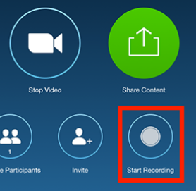
Housekeeping
Please keep your speaker on mute.
Please use the chat tool to ask specific questions that you would like addressed during the teleconference.
Notes:
Mute when not talking. Use ‘hands up’ function, or use the ‘chat’ function to pose questions.

Slide 3
Subject renewal process
Date | Activity
June 2020 | Zoom meeting with teachers requesting volunteers to review and renew CS subjects. (Subject consultants) Identification of key changes needed Conceptual framework presented to the Board
July-Nov 2020 | Tasks allocated Self-managed. Teacher led Draft to critical friends Worked in an online environment
March-April 2021 | Feedback from critical friends considered and incorporated Subject consultants met in person Further refinements Subject consultants to consult with colleagues at their sites Further refinements Advertise Zoom meeting (via Swift)
April 2021 | Send ‘Swift’ communication to all schools/teachers Zoom ‘consultation’ meeting for all CSB teachers/leaders Draft subject outline available for 2 weeks
May 2021 | Gather feedback Further refinements
June 2021 | Draft subject outline presented to the Board for approval
Term 4, 2021 | Implementation activities offered
Term 4, 2021 | New website/support materials provided
Term 1, 2022 | Community Connections taught

Slide 4
What’s changing?
New title: Community Connections.
New field of study (increase to 4): Practical Connections
New titles for the fields of study:
Humanities and Social Sciences Connections
STEM Connections
Practical Connections
Interdisciplinary Connections
New subject website

Slide 5
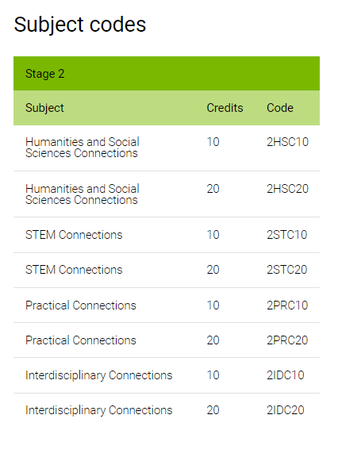

Slide 6
What’s changing?
Learning requirements updated
Assessment design criteria updated
Knowledge and Understanding
Application and Connection
Reflection and Consideration
Increase from 2 assessment types to 3:
School assessment
- Assessment Type 1: Folio (50%)
- Assessment Type 2: Reflection (20%)
External assessment
- Assessment Type 3: Community Application Activity (30%)
Notes:
Assessment Type 1: Folio - will now make up 50% of the learning of building new knowledge, new skills and understandings through a series of tasks.
Assessment Type 3: Community Application Activity - will remain at 30% but it is the connectedness to community to apply new knowledge, skills and understandings, purposefully and in a context where capabilities can be further developed. This now gives students the chance to showcase their work, and acknowledge the considerable work undertaken.
Together this gives an 80% weighting to the learning, skill development, and understanding where this knowledge applies in the community.
Assessment Type 2: Reflection is now reduced to 20% and combines the reflection of the Folio learnings, together with the learning gained as a result of undertaking the Communication Application Activity. This was designed to bring together their overall satisfaction, development of capabilities, and sense of future ventures in relation to their field of interest. The maximum word count has increased to accommodate those students wishing to achieve at the highest level (particularly for the 10 credit option). There is no prescribed minimum.

Slide 7
Learning requirements

Slide 8
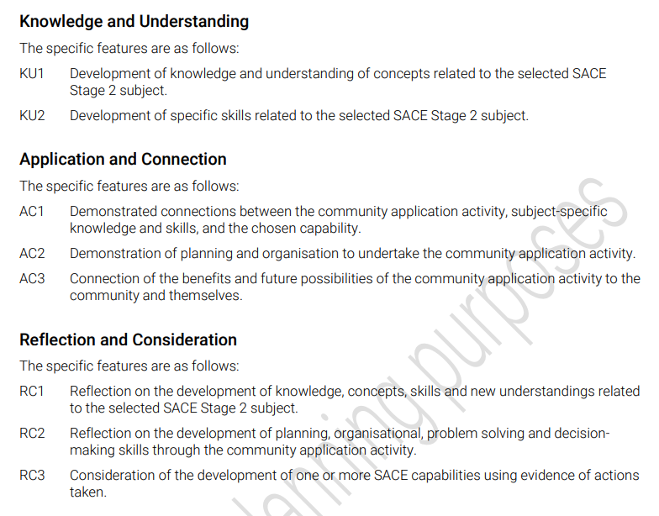
Assessment design criteria

Slide 9
Assessment Type 1: Folio (50%)
Reduction in the number of tasks for a 20-credit
- 10-credit (at least 2 tasks)
- 20-credit (change to ‘at least’ 4 tasks)
Students collect evidence that shows specific learning requirements from the selected Stage 2 subject, and addresses their development of:
knowledge and concepts related to the selected SACE Stage 2 subject
specific skills related to the SACE Stage 2 subject
ADC: Knowledge and Understanding

Slide 10
Assessment Type 2: Reflection (20%)
10-credit = up to 750 words – 5 minutes – equivalent in multimodal
20-credit = up to 1500 words – 9 minutes – equivalent in multimodal
Students:
reflect on the development of knowledge, concepts, skills and new understandings related to the selected Stage 2 subject
reflect on the development of their planning, organisational, problem-solving and decision-making skills through their CAA
consider the development of their selected SACE capability using evidence of actions taken.
ADC: Reflection and Consideration

Slide 11
Assessment Type 3: Community Application Activity (30%)
Opportunity for students to provide evidence of (showcase) and reflect on their community application activity.
- 10-credit – 750 words – 5 mins – equivalent in multimodal
- 20-credit – 1500 words – 9 mins – equivalent in multimodal
Students provide evidence of:
connections between their CAA and subject-specific knowledge and skills, and their chosen capability
planning, organisation, and development of strategies to undertake the CAA
connecting benefits and future possibilities of the CAA to the community and to themselves
ADC: Application and Connection (AC1, AC2, AC3)

Slide 12
Operational information
Moderation
Learning and assessment plans are not required as each assessment type has specific assessment design criteria that will need to be met.
Folio tasks:
A rubric of the assessment decision for each of the four folio tasks should be uploaded with the student work. Reflection task:
A rubric of the overall assessment decision for the reflection task.

Slide 13
Preclusions
Students may elect to enrol in both 10 and 20-credit subjects under the same field of study; however, the courses must remain significantly different to each other.
Where there is both a 10 and a 20-credit subject, using the same subject code these are precluded against each other. For example, 2HSC10 – Humanities and Social Sciences Connections and 2HSC20 – Humanities and Social Sciences Connections are a precluded combination.

Slide 14
Preclusions
Subject |  | Precluded
2HSC10 – Humanities and Social Sciences Connections 2HSC20 – Humanities and Social Sciences Connections |  | 2HSC20 – Humanities and Social Sciences Connections 2HSC10 – Humanities and Social Sciences Connections 2UBY10 – Humanities and the Community 2UBY20 – Humanities and the Community
2IDC10 – Interdisciplinary Connections 2IDC20 – Interdisciplinary Connections |  | 2IDC20 – Interdisciplinary Connections 2IDC10 – Interdisciplinary Connections 2IBY10 – Interdisciplinary Learning and the Community 2IBY20 – Interdisciplinary Learning and the Community
2PRC10 – Practical Connections 2PRC20 – Practical Connections |  | 2PRC20 – Practical Connections 2PRC10 – Practical Connections
2STC10 – STEM Connections 2STC20 – STEM Connections |  | 2STC20 – STEM Connections 2STC10 – STEM Connections 2SBY10 – STEM and the Community 2SBY20 – STEM and the Community

