Slide 1
SACE Physical Education: Unpacking The Assessment Features “Learn Through Action”
June 28, 2021

Slide 2
WOWs (Walk Out Withs)
Attendees will leave today with;
Collaborative strategies that can be used with and by your students.
A better understanding of the different skills associated with communication and collaboration.
Examples of the application of collaboration and communication skills.
The ACER Collaboration Framework and how it can be applied to support teaching and learning.
A range of formative feedback tools via the AC Leaders Resource.
A detailed understanding of the Specific Features and Performance Standards.
Understanding of how Improvement Cycle(s) can be used to guide student learning.
Networking opportunities.
Notes:
Brad

Slide 3
Activator- Yep that’s me.
I am on holidays this week
I have had more than one cup of coffee today
I have been teaching for less than 10 years
I am the only Year 12 PE teacher in my school
I work in a Country School
I hope to leave today with new knowledge, skills or strategies

Slide 4
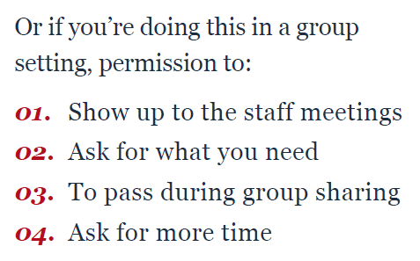
Permission Slips (Brown, 2020)
What do you need to give yourself permission to do, feel, or not do to show up for this read-along?
Permission slips are a great way to start building trust in your school community and to start container building. If you’re working on your own, it’s a helpful tool to identify what might get in your way of learning and practicing new ways of showing up.
Exercise Instructions:
- Go around the table at a quick but reasonable pace and let everyone share their permission slip(s).
- Everyone listens and holds comments until everyone has shared.
- The power in the round robin is finding commonalities. Sometimes that’s harder to recognize when people share entire worksheets instead of one set of answers going around the table, or when there’s cross talk in the middle of sharing.
- This is also a good check-in exercise if you want to start meetings with, “What new permission slips do we need today?”
When working in groups this is a helpful way of negotiating roles/responsibilities, building psychological safety & trust, whilst also recognizing what others in the group bring (ACER 1.1, 1.3, 2.2, 2.3). This enables other groups members to respond according to others (ACER 3.4).

Slide 5
Container Building (Brown, 2020)
Have each person in the group answer the following questions individually on sticky notes:
What do you need to show up and do the work?
What will get in the way of you showing up and doing the work?
What does support look like from your group?
This activity furthers assists with building psychological safety & trust, whilst also recognising others in the group (ACER 1.1, 1.3, 2.2, 2.3). This enables other groups members to respond according to others (ACER 3.4).
Notes:
Having made permission slips, now think about your role in the team and what is going to enable to do the work required today

Slide 6
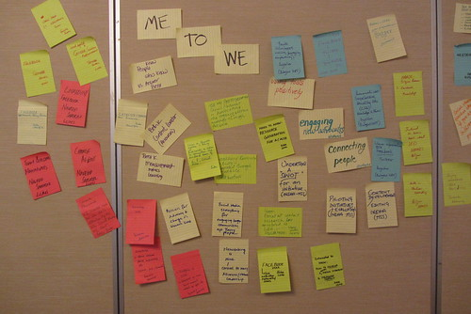
Group Norms
Have everyone share their answers.
Group into common themes.
Use these to develop 3 to 5 group ground rules/norms that you can use in your discussions throughout the workshop.

Slide 7
Competition Time- 5 minutes
As a Table..
Write down examples of collaboration/communications skills…
One sticky note per example
Be specific
What would you observe?
Don’t provide generalised examples
*GALLERY WALK
Image removed for copyright
Notes:
Common themes?
Anything that stood out?
Keep these for a later activity

Slide 8
ACER Collaboration: Skill Development Framework
This skill development framework has been developed to address the challenges associated with teaching and assessing collaboration.
While there are many definitions of the skill, few provide a means to operationalise collaboration in the classroom.
This framework is designed to synthesise and harmonise existing theory and research on collaboration to provide a holistic perspective. It outlines collaboration processes along prescribed strands and aspects that are informed by a sound evidentiary basis.
The aspects contained within the framework are designed to provide foci for teaching and the basis of assessment.
Image removed for copyright
https://research.acer.edu.au/cgi/viewcontent.cgi?article=1043&context=ar_misc

Slide 9
ACER Framework Jigsaw - Stage 1
Each person must read their section and write down 3 key points on their allocated section
Person 1: Strand 1 – Pg. 6-8
Person 2: Strand 2 – Pg. 8-9
Person 3: Strand 3 – Pg. 9-11
Person 4: Skill development levels – Bottom of Pg. 11, skim skill development table
This Photo by Unknown Author is licensed under CC BY-SA

Slide 10
ACER Framework Jigsaw - Stage 2
Campfire
Person 1 is the Firestarter and starts by sharing their key points
Person 2 paraphrases person 1 then adds their points,
Person 3 paraphrases person 2 then adds their points,
Person 4 paraphrases person 3 then adds their points,
Firestarter (Person 1) to bring it all together and propose how the ACER Framework could be applied in a Stage 2 PE setting?
Image removed for copyright
Notes:
See video to access the instructions for the activity.

Slide 11
Components of Collaboration (ACER)
Building Shared Understanding Learners build a shared understanding of the goal or problem presented to them. This involves establishing a group dynamic, applying effective communication strategies and combining the skills and knowledge of the group. | Collectively contributing Once a shared understanding of the group, task and roles has been established, each group member needs to contribute their agreed responsibilities to the group, and recognise the contributions of others, for sufficient collaboration to occur | Regulating This may require checking in or reporting back to other group members, ensuring differences are resolved, andadapting behaviour and contributions to support others’ roles, understanding or perspective for the greater good of the group.
1.1 Communication | 2.1 Participating in the group | 3.1 Constructive contributions
1.2 Pooling Resources and Information | 2.2 Recognising contributions of others | 3.2 Resolving differences
1.3 Negotiating Roles & Responsibilities | 2.3 Engaging in roles and responsibilities | 3.3 Maintaining Shared Understanding
https://research.acer.edu.au/cgi/viewcontent.cgi?article=1043&context=ar_misc |  | 3.4 Adapts Behaviour for Others

Slide 12
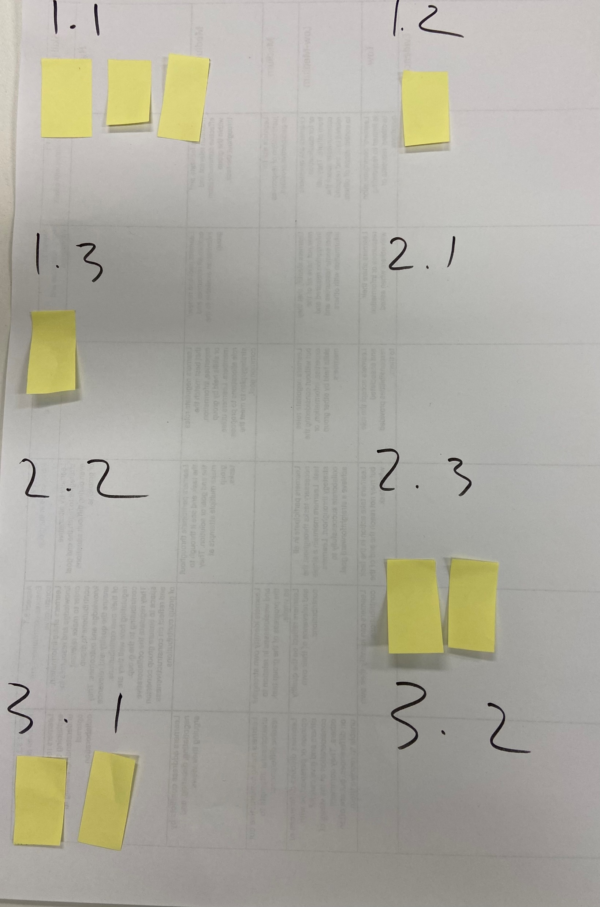
ACER Framework SORT
Take the examples of collaboration that your group came up with earlier and sort them under the 10 ‘ACER aspects’ (Write numbers on a giant post it)
Add new examples (post-its) to try and get at least one under each heading

Slide 13
Performance Standards Competition
Image removed for copyright
Jigsaw Challenge:
Step 1: Choose 1 member to be the observe. The Observer will get separate instructions to the rest of the group. See below for notes on their task.
Notes:
The observer will see the ACER progressions to assess the way in which the rest of the group perform during the Performance Standards competition. View the video for the way in which it was used.
The rest of the group will have specific features AC1 to 3, at the A, B and C standard cut up with the descriptors separate too the main specific feature description. These are all mixed together and the team have to try to match the descriptors to the appropriate feature, and the correct grade level in a specified period of time.
Questions that the Observer has to grade their team on after the activity has concluded.
ACER: 1.1, 1.2, 1.3, 2.1, 3.1, 3.2
How well did your group communicate with each other
How well did your group pool the information and resources on your table
Did you negotiate the roles and responsibilities of your members?
How well did you work in your group …. e.g. did you try alternate strategies?
How constructive were your groups contributions?
How well did your group resolve their differences?

Slide 14
AE3: Evaluation of implemented strategies.
A | Perceptive evaluation of implemented strategies.
B | Mostly perceptive evaluation of implemented strategies.
C | Some perceptive evaluation of implemented strategies.
D | Description of implemented strategies.
Notes:
Adjective/qualifier verb/action…. Separated from the context

Slide 15
Performance Standards Competition
Step 2: As a group you are going to apply collaboration and communication skills highly effectively to sort the performance standards into the correct order.
You will need to ensure that the qualifier (or adjectives) and verbs/actions are reattached to the correct feature (context).
No devices permitted.
The observer can not make any contributions and must only observe.
**The group who can collaborate most effectively will win a prize.
Notes:
Brad

Slide 16
Performance Standards Competition
Step 3: Observers report back to the group on the level their group achieved on the ACER Assessment rubric, as well as what evidence looks like for aspect 1.1, 1.2, 1.3, 2.1, 3.1, 3.2
Step 4: How could the ACER tool be useful for your students?
Step 5: A few tables to share
Notes:
Shane
Think about your school, context and cohort

Slide 17
ACER Framework in Action
In the following video what evidence can you see, for the following Specific Features?
Application and Communication
The specific features are as follows:
AC1 Contextual application of knowledge and understanding to movement concepts and strategies.
AC2 Application of communication and collaborative skills.
AC3 Application of feedback and implementation of strategies to improve participation and/or performance.
AC4 Communication using subject-specific terminology.
Analysis and Evaluation
The specific features are as follows:
AE1 Analysis and evaluation of evidence relating to physical activity.
AE2 Reflection on and evaluation of participation and/or performance improvement.
AE3 Evaluation of implemented strategies.
AE4 Proposal of recommendations for future directions.
Notes:
Shane

Slide 18
ACER Framework in Action
Please view this clip in the video captured on the day
Notes:
Shane
Speed a bit quick – what features cab you pick up on?

Slide 19
ACER Framework in action
Which specific features did you see evidence for?
What did this evidence look like?
Think, pair, share
Notes:
Shane
A few tables to share

Slide 20
Performance Zone vs Learning Zone
Performance zone and the learning zone as periods of time when we have different goals
Learning zone - aiming to improve, an objective which both promotes and stimulates a growth mindset
Performance zone we aim for flawless execution
Image removed – found at this link:
https://www.google.com/search?q=mindset+works+learning+zone+image&rlz=1C1GCEB_enAU821AU821&tbm=isch&source=iu&ictx=1&fir=3656IEAybHmIxM%252CHdDFgllJtXg1YM%252C_&vet=1&usg=AI4_-kTQ638TNDl07sZdxpooqyK2PCxG-A&sa=X&ved=2ahUKEwjX6cOxzs3xAhWDj-YKHQbqBJIQ9QF6BAgPEAE#imgrc=3656IEAybHmIxM
Notes:
Shane – talk to you about pedagogy over the next few slide – how do we go about creating opportunities for our students to evidence the SF – we’ve hopefully shown a few today
We need to shift our thinking and look at what we reward in our course
If students evidence the learning zone and map it along some kind of evidenced framework and speak to the specific features, they will get rewarded.
Taking the ACER framework, it provides a template for students to demonstrate thir application of collaborative skills, and how these can develop over time, but more so, they will be hitting other specific features along the way

Slide 21
What are we expecting of our students?
Image removed can be found at this link:
https://www.google.com/search?q=rigor%2Frelevance+framework+image&tbm=isch&ved=2ahUKEwiLopSzzs3xAhUPaysKHdnFBhkQ2-cCegQIABAA&oq=rigor%2Frelevance+framework+image&gs_lcp=CgNpbWcQAzoFCAAQsQM6CAgAELEDEIMBOgIIADoECAAQQzoECAAQHjoGCAAQCBAeOgQIABAYOgYIABAFEB5Q8swDWNaoBGC4rARoAXAAeACAAYgCiAGtK5IBBjAuMjguNJgBAKABAaoBC2d3cy13aXotaW1nwAEB&sclient=img&ei=s9zjYMv8Ko_WrQHZi5vIAQ&rlz=1C1GCEB_enAU821AU821#imgrc=2kqZaM7-9I54UM
Quad A - Students gather and store bits of knowledge and information. Students are primarily expected to remember or understand this knowledge.
Quad B - Students use acquired knowledge to solve problems, design solutions, and complete work. The highest level of application is to apply knowledge to new and unpredictable situations.
Quad C - Students extend and refine their acquired knowledge to be able to use that knowledge automatically and routinely to analyze and solve problems and create solutions.
Quad D - Students have the competence to think in complex ways and to apply their knowledge and skills they have acquired. Even when confronted with perplexing unknowns, students can use extensive knowledge and skill to create solutions and take action that further develops their skills and knowledge.
Rigor/Relevance Framework: Dr. Willard R. Daggett (2016)
Notes:
Shane
Below is a breakdown of the four quadrants: Quad A - Students gather and store bits of knowledge and information. Students are primarily expected to remember or understand this knowledge.
Quad B - Students use acquired knowledge to solve problems, design solutions, and complete work. The highest level of application is to apply knowledge to new and unpredictable situations.
Quad C - Students extend and refine their acquired knowledge to be able to use that knowledge automatically and routinely to analyze and solve problems and create solutions.
Quad D - Students have the competence to think in complex ways and to apply their knowledge and skills they have acquired. Even when confronted with perplexing unknowns, students are able to use extensive knowledge and skill to create solutions and take action that further develops their skills and knowledge.

Slide 22
What do we teach? - We need to shift our thinking around our pedagogy, and how we construct learning - We need to be purposeful in what we teach to enable our students with the tools needed to meet the requirements of the specific features
Image removed –can be found at the following link:
https://www.google.com/search?q=Tha+capable+country%3A+Cultivating+capabilities+in+Australian+education+image&tbm=isch&ved=2ahUKEwiD3rr1zs3xAhUFRysKHXiTDc8Q2-cCegQIABAA&oq=Tha+capable+country%3A+Cultivating+capabilities+in+Australian+education+image&gs_lcp=CgNpbWcQA1C9sAFY_aUCYLioAmgAcAB4AIAB-wGIAeNBkgEGMC40NS41mAEAoAEBqgELZ3dzLXdpei1pbWfAAQE&sclient=img&ei=Pt3jYIPHLYWOrQH4prb4DA&rlz=1C1GCEB_enAU821AU821#imgrc=zGrnI0EkfHwXEM
Lucas, B. & Smith, C. (2018). The Capable Country: Cultivating capabilities in Australian education, Mitchell Institute policy report No. 03/2018. Mitchell Institute, Melbourne. Available from: www.mitchellinstitute.org.au
Notes:
Shane
If we reward learning mode and we’re asking students to evaluate and create – whats the missing link? what do we teach?
Knowledge is absolutely important but it’s only one element to success
Capable country
Our new course is a lot meore sophisticated than the previous course and it demand not only more from the students, but also our teachers
This basis should make us think about not only how we are constructing the learning for each Ax piece but also structuring the year in general
How do we build on prior knowledge and provide the opportunity for students to take that learning into the next AX
Backwards by design – our stage 1 and our MS curriculum is in desperate need of attention

Slide 23
Metacognition The ways learners monitor and purposefully direct their learning
Image removed can be found at this link:
https://www.google.com/search?q=Metacognition+image+Alex+Quigley&rlz=1C1GCEB_enAU821AU821&tbm=isch&source=iu&ictx=1&fir=HXMK3lYPFYdVJM%252C9eXIthmYhcGgCM%252C_&vet=1&usg=AI4_-kTRNUyyHec3Uv2cXfHBgLTBWF5h6w&sa=X&ved=2ahUKEwjG09Kvz83xAhWdxjgGHfA6B-IQ9QF6BAgPEAE#imgrc=HXMK3lYPFYdVJM
Teachers should acquire the professional understanding and skills to develop their student's metacognitive knowledge
Provide a process and the resources needed by your students
If you can’t find them, develop the scaffolds yourself
Alex Quigley (Huntington School), Professor Daniel Muijs (previously University of Southampton, now at Ofsted) and Eleanor Stringer (Education Endowment Foundation).
Notes:
Shane
So if we know that our students require more than the knowledge and understanding of the content of our course, whats the missing link, quite oten its teaching the skills
One of the most important skills we can teach are metacognition skills - reflective process
We need to explicitly teach these skills
Provide rigor, grapple, struggle, reflective process
Reference article – link

Slide 24
Review and Application…
This Morning’s Learning:
Permission slips
Container building & Group Norms
Examples of communication & collaboration skills
ACER Tool
Performance standards Puzzle
Learning mode Vs Performance mode
The Mitchell Institute - The Capable Country
The Rigor/Relevance Framework
Metacognition & Self Regulated Learning
Questions to discuss as a table…
How could any/some of this morning’s learning be applied in your context?
How could your students produce evidence of these collaborative skills?
Notes:
Shane

Slide 25
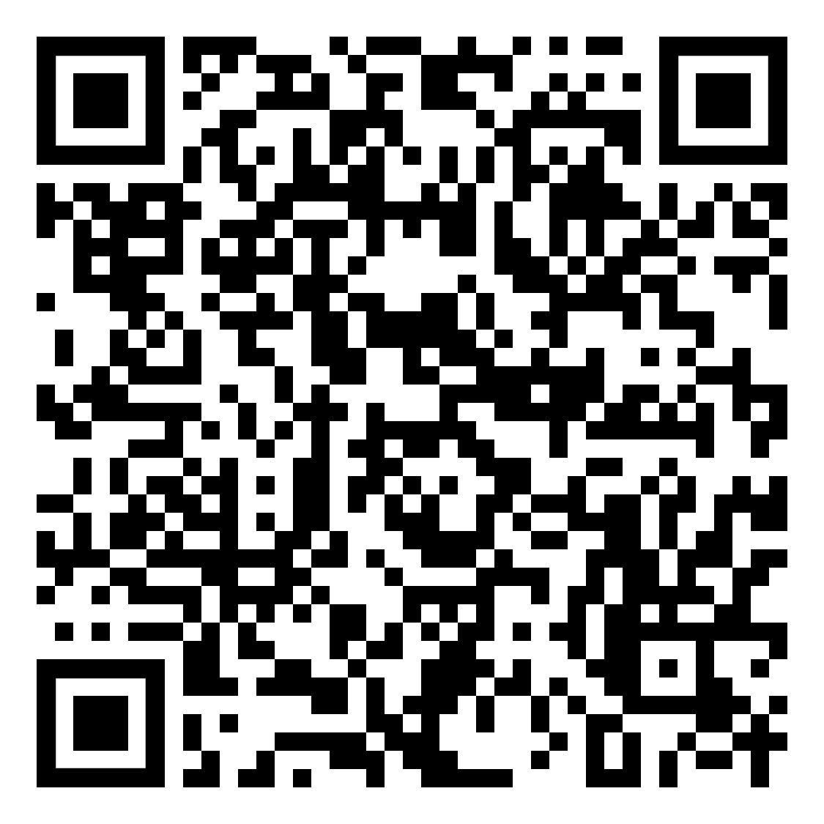
Receiver Awareness: Maintaining Shared Understanding (3.3))
Looking at the strategies in the following link, which tools could be useful for your students in their coaching?
Share one thought with your table .

Slide 26
Reflective Listening
Questioning: use open ended questions that encourage the athlete to continue speaking
Clarifying: make clear to the other person what has been heard
Encouraging: use a variety of verbal and non-verbal statements and or mannerisms to prompt athletes to keep talking
Paraphrasing: checks whether responder understands the message
Reflecting: let the person know you hear the content and feelings of what's being said
Empathetic understanding: use empathetic statements to keep the person you are dealing with focused on the task at hand
Summarising: pull together all the main ideas and feelings of what’s been said
Image removed can be found at this link:
https://www.google.com/search?q=%40letstalk.mentalhealth+are+you+listening+when+someone+speaks+or&tbm=isch&ved=2ahUKEwjDtYnh0M3xAhXUn0sFHWBfCKsQ2-cCegQIABAA&oq=%40letstalk.mentalhealth+are+you+listening+when+someone+speaks+or&gs_lcp=CgNpbWcQA1DKpQVYgPwFYNH-BWgAcAB4AIABvAGIAd40kgEEMC40MZgBAKABAaoBC2d3cy13aXotaW1nwAEB&sclient=img&ei=LN_jYMPvNNS_rtoP4L6h2Ao&rlz=1C1GCEB_enAU821AU821#imgrc=NmgUyUtvEht61M

Slide 27
1.1 Communication: Questioning
“The answer to any problem pre-exists…we need to ask the right question to reveal the answer”
Dr Jonas Salk
Notes:
Brad
How are we going for time? 26/27 slides – can be taken out

Slide 28
Types of questioning
Closed Questions
Open Questions
Probing Questions
Leading Questions
Loaded Questions
Funnel Questions
Recall and Process Questions
Rhetorical Questions
Activity:
Let the Text Be the Expert:
8 essential questioning techniques you need to know
Notes:
Brad

Slide 29
Funnel Method of Questioning (ACER 1.1)
View student response in video captured at workshop
Notes:
Brad

Slide 30
I used to think, but now I think
Based on AC2 – Application of Communication and Collaborative skills
Notes:
Brad

Slide 31
Gratitude
Today I am grateful for…
Notes:
Brad

Slide 32
AC2 – how do we support students to achieve ‘focussed’ application

Slide 33
Chris Adamson
Former Master Coach at the Australian institute of fitness
Current Australian Baseball Team Assistant Coach
Current Adelaide Giants Head Coach
Current Head Coach with the Philadelphia Phillies

Slide 34
Assessment Type 3 – Group Dynamics …. investigate the impact that team members, individually and collectively, have on the participation and performance of others.
AC2 - A Band
Highly effective and focussed application of communication and collaborative skills.

Slide 35
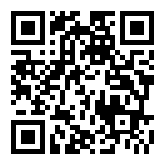
Introduction to Disc personality test
https://www.123test.com/disc-personality-test/

Slide 36
Communication tips for the: - High Dominance - High Influence - High Steadiness - High Compliance personality type.
For tips for the four communications types – view the video and access the full set of tips from the website link below
https://www.chartcourse.com/communicating-four-disc-styles/

Slide 37
Acer tool

Slide 38
Acer tool
Key Elaborations
Should be able to identify an appropriate style and level of complexity relevant to their group members and be able to adjust their communication
Unlikely to deliver the same information in the same manner
Referred to as receiver awareness
Aspect 3.4
Adapts behaviour and contributions for others

Slide 39
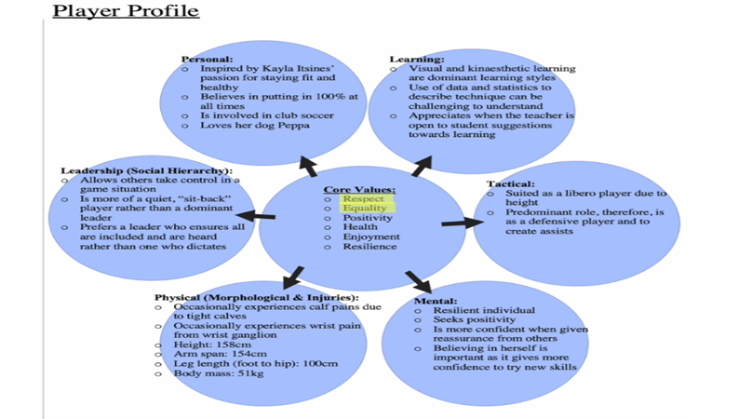
Ask students to create a player or group profile.
focussed application of communication and collaborative skills

Slide 40
Where can the player profile come from?
Surveys
Observations
Personality traits
Player/ Group profile is live

Slide 41
How the player/group profile could be introduced by a student
Access student response in video captured at workshop

Slide 42
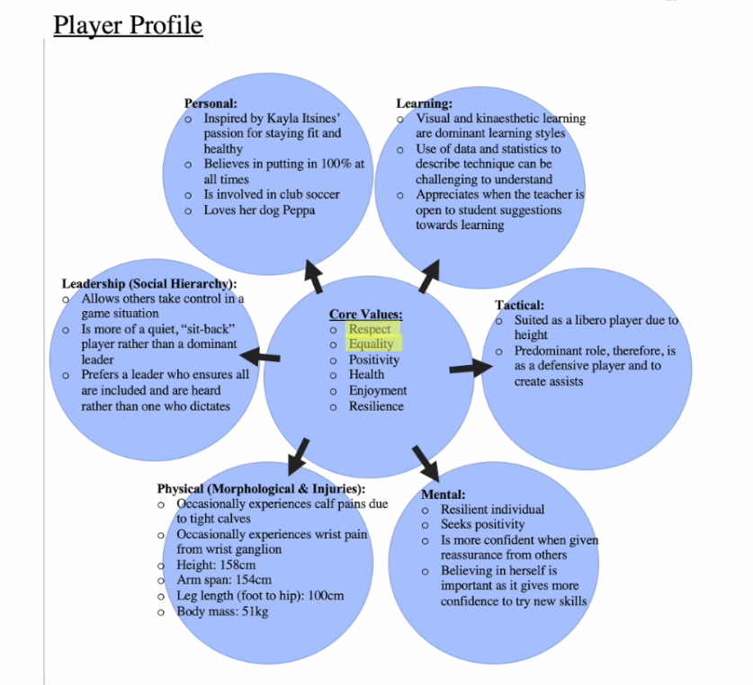
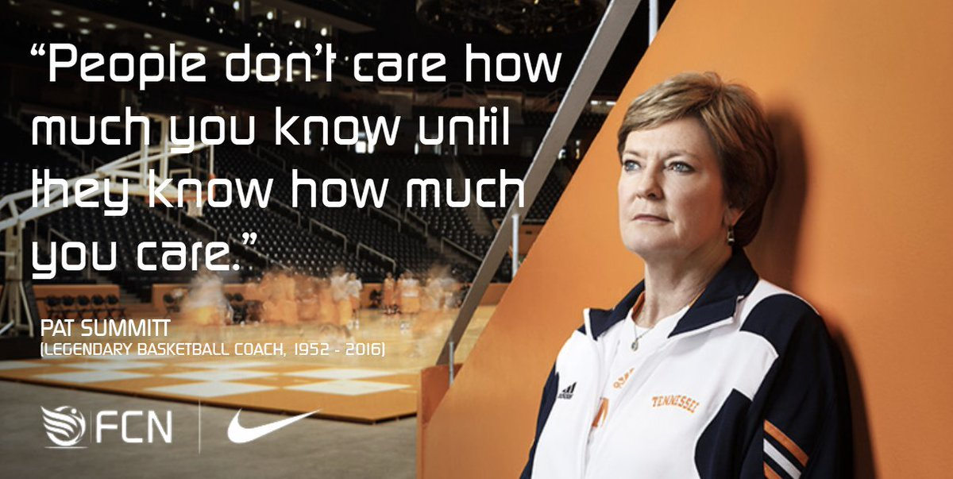
Core values and learning styles point toward what communication skills to apply. (focussed)
Personal (interests) are helpful with disengaged students.
BUILD RELATIONSHIP FIRST

Slide 43
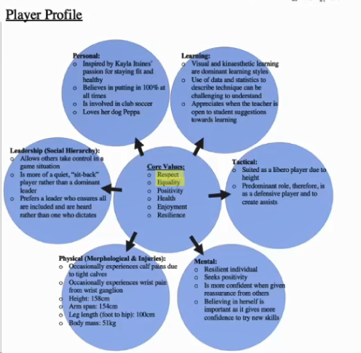
Using the Player Profile to support focussed application
Core values
Other aspects of the player profile identified the approach to coaching methods. Two core values include “respect” and “equality” which therefore suggested that my coaching leadership should be democratic, which involves being more open to training suggestions and guiding an individual rather than dictating to form an equal and respectful relationship.
Learning
The player profile also identified the trainees dominant learning styles of kinaesthetic and visual learning, which helped identify coaching strategies that were likely to be more effective for the player.
Mental
It also identified that the player seeks to feel positive and confident with their performance and often needs reassurance in order to do so, thus highlighting that I should give constructive feedback through a feedback sandwich.

Slide 44
Over-communication
The student coach should filter the information for the athlete. What information/ feedback /evidence should they not communicate based off their player/group personality traits?
When a student is aware that they have been giving too much information → this can be powerful

