Slide 1
Community Studies Implementation workshop
Integration of Australian Curriculum Capabilities
Community Studies B
Notes:
Welcome and introductions
Structure of workshop - 2 parts
To inform you about the changes for implementation:
the Integration of the Australian Curriculum Capabilities into Stage 1 and Stage 2 Community Studies
the introduction of the newly developed Stage 2 Community Studies B
and to encourage you to think about what this means for your students in 2016.
Why introduce an additional Community Studies subject?
Community Studies, first taught in 1986 as part of the senior secondary certificate, has been an important strategy in helping students to continue and complete their secondary education. The subject has continually evolved to meet the challenges voiced by schools in meeting the needs of students.
Programming Community Studies within the school timetable has always been a challenge and has often made it difficult for students to pursue this subject. The introduction of Stage 2 Community Studies B provides an additional programming option for schools.
Schools may plan for Community Studies B students to be taught simultaneously with students studying a related Stage 2 subject. For example, a school may plan that in some of their classes (e.g. Physical Education, Mathematical Applications and Psychology), students will be able to study a Community Studies B version of these subjects from the start of the year. Community Studies B is a more workable model of the current Using Materials from Another Subject often referred to as “conversions” that schools have been using to support students. This new subject also offers students who have enrolled in a subject but who are finding the subject difficult, a way of remaining in the original class but approaching their subject-related learning in an alternative way by withdrawing from the original subject and enrolling in Community Studies B during the year.
How we got to this point:
At the executive level the question was asked, ‘How can Community Studies better support schools to assist students to successfully complete their SACE?’ A working party was established and a consultation group of practising teachers across all sectors was used to develop this new subject. The subject outline went to the Board, and was approved at their August meeting for implementation in 2016.

Slide 2
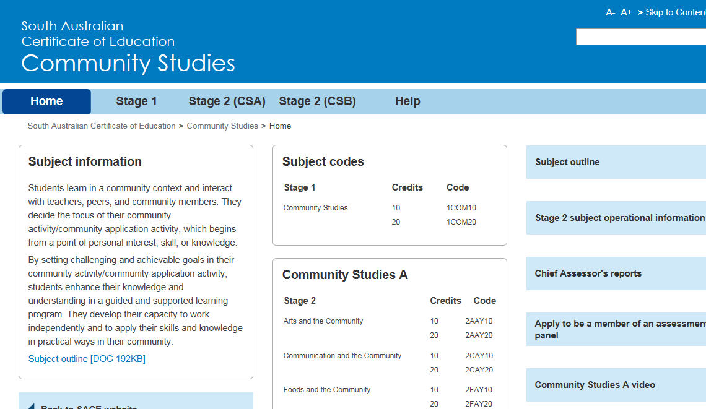
Community Studies
2016 Subject Offerings:
Stage 1 Community Studies
Stage 2 Community Studies A
Stage 2 Community Studies B
Notes:
From 2016 we will have an additional Community Studies offering, Stage 2 Community Studies B.
If you look at the Community Studies minisite home page as shown on the screen you will see a new section entitled ‘What’s New for 2016?’
Further materials under a heading ‘2016 Subject Changes’ will be added.

Slide 3
Capabilities
Integrated Australian Curriculum capabilities
Literacy
Numeracy
Information and communication technology capability
Critical and creative thinking
Personal and social capability
Ethical understanding
Intercultural understanding
Notes:
In the current Community Studies subjects at Stage 1 and Stage 2, students develop their existing literacy and numeracy skills and one or more capabilities. In 2016 with the integration of the Australian Curriculum capabilities, students will continue to develop the Literacy and Numeracy capabilities and at least one other capability.
Take a moment to have a look at the new capabilities in the subject outline (pages 1- 4 ). Think about your subject and think about what specific literacy and numeracy skills a student might develop and what other capability would be a natural fit. For example, critical and creative thinking in Art.

Slide 4
Stage 1 Community Studies
What has changed?
Capabilities
Flow on changes
Learning and Assessment Plan proforma
Learning and Assessment Plan checklist for teachers
Contract of Work template
Notes:
At Stage 1, the only change to the existing subject is the integration of the Australian Capabilities.
As a result, there are some minor flow on changes to some of the documents, like the Stage 1 Learning and Assessment Plan proforma and the Stage 1 Contract of Work template, as well as examples of developing capabilities.
We have provided these updated documents for 2016 in the booklet for your reference (pages 13-24).

Slide 5
Stage 2 Community Studies Options
Community Studies A
6 areas of study
School assessment; contract, folio & presentation
Reflection is the external assessment
9 Learning Requirements
4 Assessment Design Criteria
14 specific features contained in the Performance Standards
Community Studies B
3 fields of study
School assessment; Folio consists of tasks undertaken in a subject
Community Application Activity is the external assessment
6 Learning Requirements
3 Assessment Design Criteria
6 specific features contained in the Performance Standards
Notes:
This slide highlights the differences between the current Stage 2 Community Studies which has been renamed Stage 2 Community Studies A and the newly developed Stage 2 Community Studies B.
There are different areas/fields of study.
As you know, the school assessment for Community Studies A involves completing a Contract of Work, keeping a Record of Evidence and delivering a Presentation to an audience. Community Studies B requires students to put together a Folio of subject-related tasks.
Other differences are the External Assessment, the Learning Requirements, the Assessment Design Criteria and the specific features of the Performance Standards which we will discuss in detail later in the workshop.
Have a chat at your table about how your current students might feel about these two options.

Slide 6
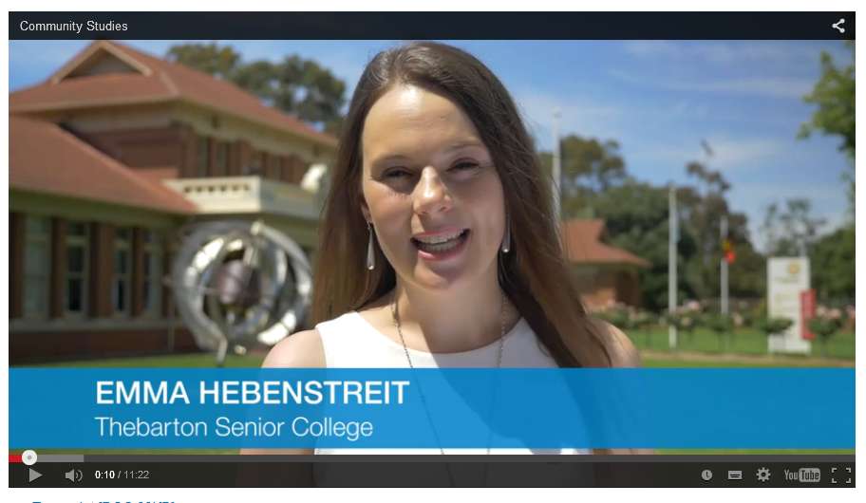
Stage 2 Community Studies A
https://www.sace.sa.edu.au/web/community-studies/stage-2/support-materials/subject-advice-strategies
Notes:
Let’s have a look at the Community Studies A video created last year to support teachers in schools. Essentially, Stage 2 Community Studies A has not changed except for the capabilities and its name. Who has had an opportunity to look at the video?
Play video. Stop video at 8.09 minutes and explain
The next section refers to the practice of using materials from another subject, previously know as conversions.
With the establishment of the newly developed Community Studies B, the practice of Using Materials From Another Subject (often referred to as conversions) may be better served by undertaking the new Community Studies B subject.

Slide 7
Stage 2 Community Studies A
What has changed?
Name
Capabilities
Flow on changes
Assessment Program Planner
Contract of Work template
Using Materials from Another Subject
Cover sheets (School & External Assessment)
Notes:
In summary, little has changed for Stage 2 Community Studies A, except the name, the capabilities and some documents as a flow on effect of these two changes. Please ensure that teachers in your school use the new documents for 2016. Refer to page 26-41 of the booklet for the updated documents for Community Studies A.
Provide time for them to look through documents.

Slide 8
Stage 2 Community Studies B
What is it?
An individual program of learning developing the knowledge, skills, and understanding described in a field of study in a Board-accredited SACE Stage 2 subject (e.g. Biology or History) by:
completing a Folio of work (School Assessment)
undertaking a Community Application Activity (External Assessment).
Notes:
What is it?
Students undertake learning associated with some of the Learning Requirements of a SACE Stage 2 Subject (e.g. Geography) by completing a Folio of work (School Assessment) and a Community Application Activity (External Assessment).

Slide 9
Folio of work
A student:
may submit for Community Studies B, subject tasks that are:
identified in the learning and assessment plan of the related SACE Stage 2 Subject
and/ or
newly developed tasks that relate to the SACE Stage 2 subject learning requirements
may include formative or summative assessment tasks.
All tasks are assessed against the Community Studies B Assessment Design Criteria.
Notes:
A student may submit SACE Stage 2 subject tasks that are identified in the learning and assessment plan of the related subject e.g. Biology and/ or newly developed tasks that relate to the SACE Stage 2 subject learning requirements. A student may include formative or summative assessment tasks as evidence of their learning from their previous subject. The task may be the same but may be done under different assessment conditions. For example, a skills and applications task in Chemistry may be done as an open book test or a take home assignment. This is differentiation of the curriculum where the student is the focus and evidence of learning is shown in other ways.
All tasks are assessed against the Stage 2 Community Studies B Assessment Design Criteria and Performance Standards. This could mean that some tasks have originally been marked against the original subject Assessment Design Criteria so will need to be re-assessed against Stage 2 Community Studies B Assessment Design Criteria.

Slide 10
Community Application Activity
A student :
designs a Community Application Activity by applying their knowledge, skills, and understanding of an aspect of a Stage 2 subject to a community context
documents the processes used, capabilities selected and reflects on the activity
is assessed against the Community Studies B Assessment Design Criteria and Performance Standards through a report and reflection.
Notes:
This task is designed by the student. The student takes an area of interest from the SACE Stage 2 selected subject, and applies the knowledge, skills, and understanding of an area of interest to a community context.
The student documents the processes used, capabilities selected and reflects on the activity.
The student’s work is assessed against the Community Studies B Assessment Design Criteria and Performance Standards through a report and reflection.

Slide 11
Stage 2 Community Studies B
Fields of Study:
UBY Humanities and the Community
SBY Science, Technology, Engineering, and Mathematics (STEM) and the Community
IBY Interdisciplinary Learning and the Community.
Notes:
On the screen you can see the three Fields of Study for Community Studies B. If you have a look at the subject outline on page 41/42 you can see that some subjects can reasonably be placed in more that one field of study. For example, Economics could be placed in Interdisciplinary Learning and the Community or Humanities and the Community. This provides more options for students as they may wish to study Art within the Interdisciplinary Learning and History within Humanities and the Community or vice versa. Remember students can study more than one Community Studies subject from both Community Studies A and Community Studies B as long as they are different codes.

Slide 12
Stage 2 Community Studies B
Who is it for?
Students who:
wish to remain in their Stage 2 class
would benefit from a subject being framed in a real-life community context
would benefit from a different assessment model
Notes:
Students who, from the beginning or during the year, wish to be in a particular Stage 2 subject but would benefit from this subject being framed in a real-life community context with a different assessment model.
This new subject also offers students who have enrolled in a subject but who are finding the subject difficult, a way of remaining in the original class but approaching their subject-related learning in a different way by withdrawing from the original subject and enrolling in Stage 2 Community Studies B during the year.

Slide 13
Implementation: Student considerations
Before enrolling a student in Stage 2 Community Studies B consider:
the benefits to the student
career pathway
Community Studies A or B will not contribute to an ATAR
SACE completion
the assessment requirements and timelines
Field of Study and student’s program of learning.
Notes:
Before enrolling a student in Stage 2 Community Studies B consider:
the benefits to the student in undertaking Community Studies B
the student’s career path and need for an ATAR (Community Studies A or B will not contribute to an ATAR)
SACE completion
the assessment requirements and timelines for Community Studies B
the Community Studies B field of study that best suits the student’s program of learning.

Slide 14
Implementation: Programming considerations
Start of the year
or
During the year
Assessment Type 1: Folio (70%) Plan 5 assessment tasks developing the knowledge, skills and understand described in a SACE Stage 2 subject
Assessment Type 2: Community Application Activity (30%) Plan for this external assessment task
Each assessment task is assessed according to Community Studies B Performance Standards.
Assessment Type 1: Folio (70%) Use 5 assessment tasks (existing and/or newly developed tasks) developing the knowledge, skills and understanding described in a SACE Stage 2 subject
Assessment Type 2: Community Application Activity (30%) Plan for this external assessment task
Ensure existing assessment tasks and any newly developed tasks are assessed according to Community Studies B Performance Standards
Notes:
“Approaches to Planning” is outlined in the Subject Outline on page 43.
Also refer to ‘Advice for Teachers’ in your booklet on page 43 .
Please note that the information displayed above is for a 20-credit Community studies B subject. For a 10-credit Community Studies subject the number of tasks is 2 and one Community Application Activity.

Slide 15
Stage 2 Community Studies B
School Assessment (70%)
Assessment Type 1: Folio
10 credits - 2 tasks or 20 credits - 5 tasks
Tasks derived from a Board-accredited SACE Stage 2 subject LAP or newly developed
All tasks assessed with Community Studies B Performance Standards
At least one 1 task annotated
Notes:
I would like you to open to page 50 of your booklet. We will exemplify a student moving from Australian History to Humanities and the Community. I will walk you through the different documents quickly so you can see the logical progression. We will then look at each document separately in more detail.
On page 50 in your booklet there is an example of a Stage 2 Australian History Learning and Assessment Plan. Take a moment to look at the assessment overview (second page of the assessment overview). Then look at the first assignment ‘Individual Research Assignment Report’ detailed in the Assessment Details section of the learning and assessment plan on the next page. Read this out loud. Now look at the performance standards rubric on the next page that shows a student who has struggled to successfully complete this assignment. After discussion with the student, parents and counselling team it has been decided to withdraw the student from Stage 2 Australian History and enroll in Stage 2 Community Studies B.
The teacher has now completed the Assessment Group Planner (page 56 & 57) for this student and others. The student will remain in the class with the teacher and complete a 20-credit Stage 2 Community Studies B in the Field of Study, Humanities and the Community. This means the student needs to have five tasks for the folio.
Have a look at the Community Studies B School Assessment cover sheet and you can see that it has been decided that the student will undertake 2 existing tasks from the Australian History Learning and Assessment Plan. They have then negotiated three new tasks designed around the Australian History learning requirements. These tasks have been developed to build on the student’s interests.
Take a look at the remarking of task 1 using the Community Studies B Performance Standards. From the performance standards (AR1), you can see that the student has looked back at this assignment, reflected on their development of knowledge, skills and understanding through highlighting sections and annotated comments. It is clear from the shading of the Community Studies B performance standards rubric that the student was successful in demonstrating some basic knowledge, skills and understanding and basic understanding of one or more concepts related to Australian History ( KU1 & KU2). The student was also successful in demonstrating appropriate planning and exploration, and development of a small number of strategies to complete this task. If you look at the Performance Standards rubrics for task 2 you can also see that the student was successful in demonstrating learning at the B/C standard.
You may now wish to look at possible alternative tasks, that a student who is undertaking Community Studies B could complete rather than those on the related subject learning and assessment plan. These are described on page 62 & 63 of the booklet.

Slide 16
Stage 2 Community Studies B
School Assessment (70%)
Assessment Type 1: Folio
Assessment Design Criteria:
Knowledge and Understanding KU1, KU2
Planning and Organisation PO1
Application and Reflection AR1
Notes:
Knowledge and Understanding
The specific features are as follows:
KU1 Development of some specific knowledge, skills,
and understanding related to the selected SACE Stage 2 subject.
KU2 Demonstration of one or more concepts of the selected subject.
Planning and Organisation
The specific features are as follows:
PO1 Planning, exploration, and development of strategies to
complete tasks.
Application and Reflection
The specific features are as follows:
AR1 Reflection on the development of some specific knowledge,
skills, and understanding related to the selected SACE Stage 2 subject.

Slide 17
Stage 2 Community Studies B
External Assessment (30%)
Assessment Type 2: Community Application Activity
Designed by student
Related to subject
Community context
Programmed time (20 hours)
Completion of one Community Application Activity
Notes:
As previously explained the external assessment is the Community Application Activity.
This task is designed by the student. The student takes an aspect or area of interest from the SACE Stage 2 selected subject, and applies the knowledge, skills, and understandings of the aspect or area of interest to a community context.
As a guide, the student undertakes this Community Application Activity in approximately 20 hours of programmed time for a 20-credit subject, and approximately 10 hours of programmed time for a 10-credit subject.
In the Subject Outline on page 41-43 there are suggested ideas for a Community Application Activity for each field of study. Give time to read.
What could a student undertaking Community Studies B do in your subject?
In pairs come up with possible Community Application Activities for a subject. Record these on the sheet provided. We would like to add these to the list of possible ideas for future resources.

Slide 18
Stage 2 Community Studies B
External Assessment (30%)
Assessment Type 2: Community Application Activity
Evidence of learning: Report and Reflection
10-credit subject, max 500 words or 3 minutes
20-credit subject, max 1000 words or 6 minutes
Assessment Design Criteria
Planning and Organisation PO1
Application and Reflection AR2, AR3
Notes:
Evidence of learning is shown through a task that has two components: a Report & Reflection.
Students report on their chosen Community Application Activity and processes used. They provide evidence of their planning, organising, and decision-making processes in conducting their activity. In doing so, they consider the role of one or more capabilities in their activity. They document the conduct of their Community Application Activity.
Students then reflect on the success of the Community Application Activity, e.g. highlights, learnings, strengths, areas for improvement, how the activity might be used in or by the community.
Read the subject specifications outlined on the slide. Please refer to the subject outline for more details regarding this assessment type.
Lets have a look at the Assessment Design Criteria. You might like to refer to these on page 46 of subject outline.
PO1- Planning, exploration, and development of strategies to complete tasks
AR2 Application of knowledge and skills, including the selected capability or capabilities, to the community application activity.
AR3 - Report and reflection on the application of knowledge and skills to the community application activity.
In your booklet on pages 64 and 65 there is an example of a Community Application Activity report and reflection for Humanities and the Community Field of Study. I would like you to spend time reading this example and identify the evidence the student has provided for PO1, AR2 & AR3 then determine a grade for this piece of work. There is a Community Studies B Performance Standards sheet on page 66 for you to use or make reference. Some people like to put notes in the columns or underline sections using colours to identify this information.

Slide 19
Group Discussion Questions
What ‘big’ questions do you have?
How might these subjects be programmed into the timetable?
What opportunities do you see for renewing your teaching programs?
What is challenging about these subjects? How might these challenges be addressed?
Notes:
We would like to give you some processing time and ask that in pairs or individually that you write down on the sheet provided any questions or main points or comments for these questions.
Allow 10 to15 minutes for discussion and seek feedback.

Slide 20
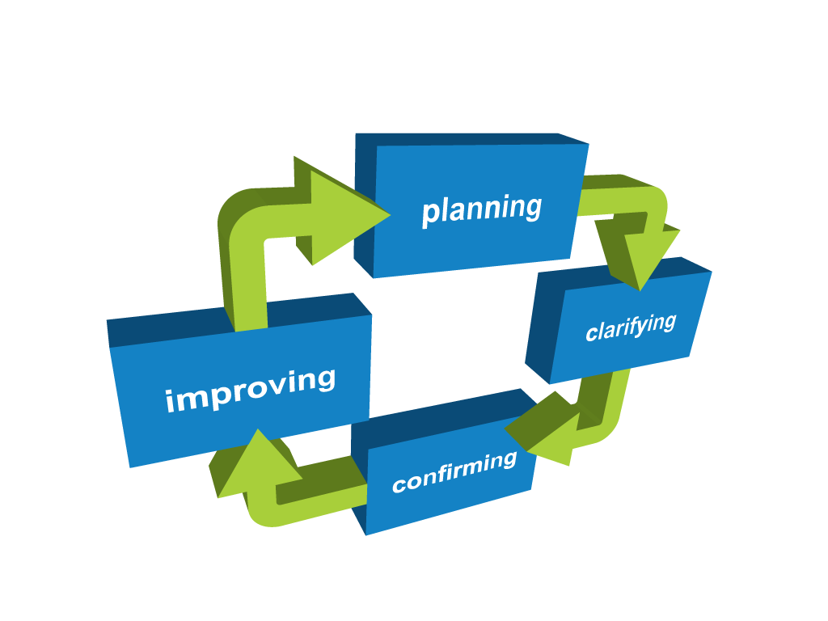
4 Phases of Quality Assurance
Notes:
Schools and the SACE Board use a range of quality assurance processes to assure the community that students’ results are fair, valid, and reliable. The SACE Board’s four-phase quality assurance cycle of planning, clarifying, confirming and improving, will continue to support schools and teachers to transition to the redeveloped Community Studies subjects.
We will look at each of these phases and see what it means in the context of the new Community Studies Subject Outlines for 2016.

Slide 21
Quality Assurance
Notes:
Your school will continue to use a range of processes to support teachers to plan quality teaching and learning programs. In Term 1 2016 the SACE Board will re-run these implementation workshops to provide additional support for schools who have not had a representative attend this a workshop in Term 4 this year.

Slide 22
Planning requirements
Stage 1 | Stage 2
Community Studies | Community Studies A | Community Studies B
Learning and Assessment Plan required | Assessment Program Planner (only required at Moderation) | Assessment Program Planner (only required at Moderation)
Notes:
The purpose of this phase is to understand the learning intentions of the subject and to develop a program for student success.
At Stage 1 a Learning and Assessment Plan is required. Refer to booklet page 14 & 15. You will note that the LAP now only consists of 2 pages. Teachers will complete the context/content description section which, for Stage 1 Community Studies, requires student ID/ name, Area of Study, student learning needs. An addendum section is now on the front page, and will be used to indicate any changes ( for Community Studies it would be additional students identified.) The second page shows the Assessment Overview, with assessment type, name and details of assessment, Assessment Design Criteria and the assessment conditions. For Stage 1 Community Studies, these are the tasks/requirements a students needs to complete. A teacher would prepare a program of learning that support students to undertake this process.
No LAP is required at Stage 2. At Stage 2 for both Community Studies A (page 27 & 28 booklet) & Community Studies B (page 44 &45 Booklet) an Assessment Program Planner is required. This is not sent to the SACE board for approval but is required for moderation. I will give you a moment to read through these documents.

Slide 23
Quality Assurance
Notes:
The SACE Board understands that you will want to ensure that your school’s interpretation and application of the performance standards is consistent with the state - wide interpretation in the new Stage 2 Community Studies B subject. The SACE Board will make available clarifying support materials. The clarifying support will include a range of student samples, at a task level, that teachers can mark or discuss with colleagues.

Slide 24
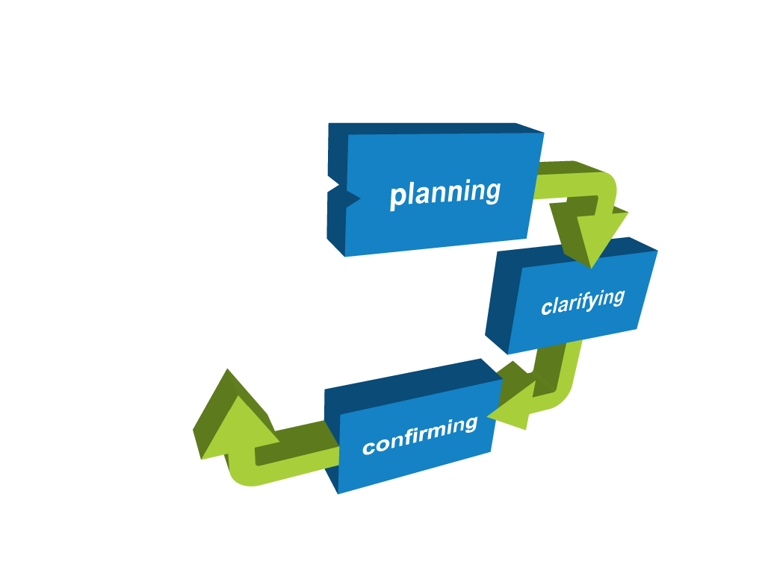
Quality Assurance
Notes:
Confirming has two key parts:
ensuring that the performance standards in a subject are interpreted and applied consistently within schools
a state-wide moderation process for Stage 2 subjects is then used to assure student results are comparable between schools.

Slide 25
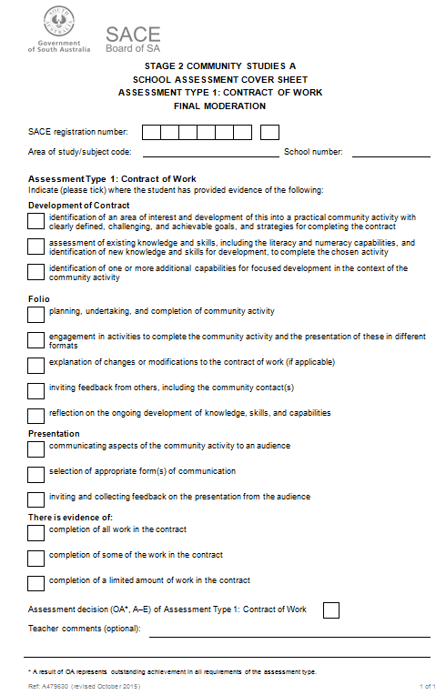
Moderation (School Assessment)
Stage 2 Community Studies A
All student materials submitted
Cover sheet
Notes:
Firstly, all student materials for Community Studies A are submitted for moderation.
I would like you to now look at page 37 of your booklet for a copy of the coversheet required for Community Studies A School Assessment at moderation. You will identify that the AT1: Contract of Work has 3 components: contract, folio and presentation. A cover sheet identifies the specific student’s evidence packaged in the clear plastic bag and the overall assessment of the work. Please note a grade of OA, A-E is used and this matches the result recorded on Schools Online for School Assessment of this subject.

Slide 26
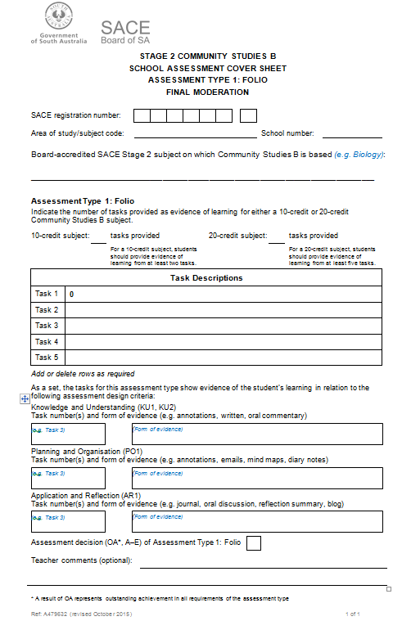
Moderation (School Assessment)
Stage 2 Community Studies B
All student materials submitted
Cover sheet
Notes:
For Community Studies B, all student materials are submitted for moderation.
On page 46 of your booklet is a Community Studies B School Assessment cover sheet. You have been shown earlier in the Humanities and the Community subject a completed example.
A cover sheet identifies the student’s evidence provided i.e. individual tasks and a description of these and where annotation/evidence exist to identify specific features in at least one task. It is envisaged that the student and/or the teacher complete the first section of the sheet before the teacher indicates the overall assessment decision.
The student work is packaged in the clear plastic bag and the overall assessment of the work indicated on the cover sheet. Please note a grade of OA, A-E is used and this matches the result recorded on Schools Online for School Assessment of this subject.

Slide 27
Marking (External Assessment)
Community Studies A | Community Studies B
Teacher marks Records results on school’s online All student work submitted (summary and reflection) with no grade or teacher comments and a cover sheet attached SACE board appoints second marker and third or fourth maker if required. Final result derived from outcome | Teacher marks Records results on school’s online All student work submitted (report and reflection on the Community Application Activity) with no grade or teacher comments and a cover sheet attached SACE board appoints second marker and third or fourth maker if required. Final result derived from outcome
Notes:
Most people are aware of the process for marking external assessment materials. The process is the same for both Community Studies A and Community Studies B except for the specific assessment type requirements for each subject.
Please remind teachers no grade or teacher comments are to be on the student work that is submitted.
An External Assessment cover sheet needs to be attached to each student work. There is a copy of this on page 38 for Community Studies A and page 47 for Community Studies B of the booklet.

Slide 28
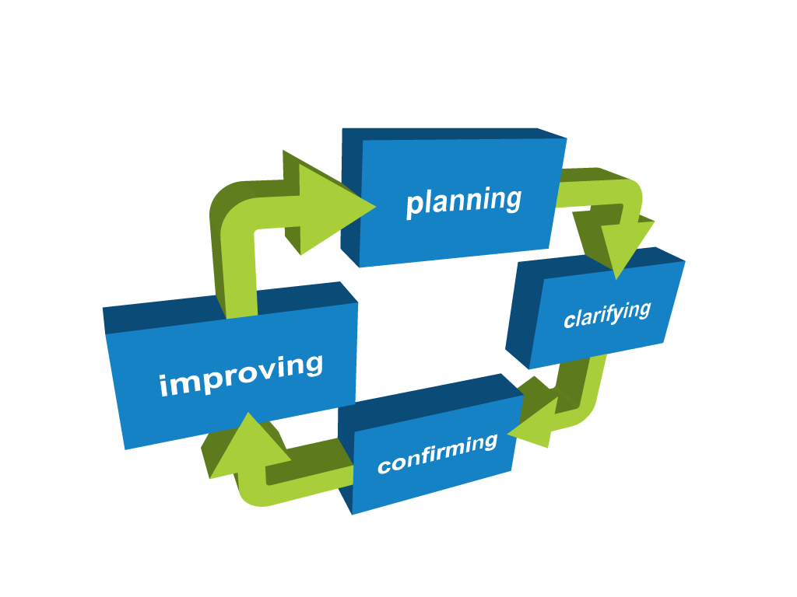
Quality Assurance
Notes:
Improving
The SACE Board provides schools with data and advice that allows schools and teachers, as well as the Board itself, to monitor and improve their quality assurance processes.
Schools receive the moderation feedback and data or results that can be used to continue to improve student outcomes.

Slide 29
FAQs
ATAR
LAPs
Marking Guides
Moderation
Packaging
Preclusions
Resulting
Notes:
Please refer to the FAQs on the last 4 pages of your booklet (67-70). This document may assist with discussions with staff at your school. The FAQs are organised under the following headings:
Enrolment, Results and Reporting
Teaching and Learning
Assessment Design Criteria
Assessment Decisions.
Preparing materials for packaging. I would like to draw your attention to a reference in your booklet on page 41 for Community Studies A & page 49 for Community Studies B that shows a flow chart to assist teacher with the requirements of packaging.
Allow time to look at FAQs and ask clarifying questions.

Slide 30
Key Resources
Community Studies minisite
2016 Subject Outline
Stage 2 Subject Operational Information
Stage 1 Information and Guidelines
Schools Online Teacher Instructional Booklet
Notes:
Key resources a staff member will need if they are undertaking any Community Studies subject at Stage 1 and Stage 2 are: the Community Studies minisite, 2016 Community Studies Subject Outline, Stage 2 Community Studies Subject Operational Information for 2016, Stage 1 Information and Guidelines and the Schools Online Teacher Instructional Booklet.

Slide 31
What’s next?
School planning – subjects
Teacher planning
familiarise yourself with the Subject Outline
teaching program
Assessment Program Planner
Tasks
Assessment requirements
Notes:
You have come to this workshop to gain information about the changes to Community Studies and learn about the new Stage 2 Community Studies B subject and to share this information with your colleagues. Consider how and when you will present this information to all your teachers, in particular all Stage 2 subject teachers, for awareness and action if required. However there may be bigger picture issues like, which Community Studies subjects you will offer at your school and the counselling process for students.
For the teacher, planning is crucial. They need to:
become familiar with the learning requirements of the Subject Outline
develop a teaching program
complete an assessment group planner if at Stage 2 Community Studies A or Stage 2 Community Studies B and a Learning and Assessment Plan for Stage 1
consider the tasks and if necessary begin modifying current tasks ensuring they meet the assessment requirements.
We will continue to place further materials on the website to support planning.
We hope you now understand the changes that have occurred in Community Studies and the new opportunity that Stage 2 Community Studies B will have for student’s success at your school.

