Slide 1
Assessment Type 3: Group Dynamics
Support for collating task responses and assessment decisions
PHYSICAL EDUCATION
TERM 3 2021
Notes:
DEANNA

Slide 2
Session Outline
Welcome
AT3 Group Dynamics Task Responses
Using the Performance Standard Elaborations
Q&A
  Post questions in discussion board throughout Zoom
Notes:
DEANNA
Focus will be predominantly on Part 2 as this will also support part 1

Slide 3
Welcome
Purpose of this Session:
Enhance capacity to support your students through their process of consolidating their final AT3: Group Dynamics task response
Develop understanding of the Performance Standards to support assessment decisions for AT3: Group Dynamics
Provide space to seek clarification of aspects and assessment of the AT3: Group Dynamics task.
Notes:
DEANNA

Slide 4
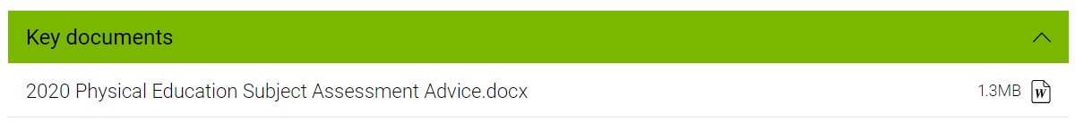
Welcome
Lead Practitioners supporting the meeting
Locating support resources:
https://www.sace.sa.edu.au/web/physical-education/overview
> Advice and Strategies
Notes:
DEANNA
Mention other resources available in Advice & Strategies specifically:
Examining AE1, AE2 and AE3
C&C session

Slide 5
Assessment Type 3:
Group Dynamics
Task Responses
Notes:
JESS

Slide 6
Tips for Supporting Students
Refer students to the Subject Assessment Advice & PS Elaborations
Focus deep, not broad
Clear evidence of each Specific Feature being assessed
Evaluate, evaluate, evaluate
Support with effective evidence – analysed, relevant, intentional
Application of collaboration and communication strategies evidenced throughout – not a ‘tack on’
Notes:
JESS

Slide 7
Check the Requirements
Coaching Role – MUST be one of the four: Fitness, Motivational, Technical or Tactical
Focus of task – solely about impact on performance/participation of others. DO NOT discuss personal improvement in playing the sport.
DO NOT EXCEED Time Limit or Word Count – refer to policies & advice.
  ALL evidence must be included within the task response and allowed limit. NO external links.
  Be aware of PowerPoints with text + video tasks where markers are expected to read + watch/listen (see next slide for calculating word count).
Notes:
BRAD
Many students in 2020 were disadvantaged for not getting these right.

Slide 8
Quantifying Different Modes of Presentation
MODE | HOW TO QUANTIFY
Written | Word count (up to maximum of 2000 words) – see support document on Unpacking the word count policy for what to include on word count
Oral or screen cast or video | Record the time (up to maximum of 12 minutes)
PowerPoint – with text + video | Convert all video or sound recordings to a word count: 1 minute recorded oral/video = approx 167 words. Do a word count for all sections that must be read by the marker (as per ‘written’ note above). This may require a ‘screen dump’ of text into a word document. Add the totals together to ensure total count is less than 2000.
Notes:
BRAD

Slide 9
Using the Performance Standard Elaborations
Support giving feedback on student draft responses
Clarify assessment decisions
In this session we are only examining the PS relevant to the SF assessed in AT3
Notes:
SHANE

Slide 10
Prioritising SF for AT3
AE2, AE3, AC2 form the foundation of the task response
AE1, AC1 and AC4 provide the supporting evidence that informs the evaluation of improvement and strategies and application of C&C skills
Notes:
SHANE

Slide 11
Performance Standards Elaborations
Elaborations are a guide only.
Recommendation: use this PowerPoint in conjunction with the documents “Stage 2 Physical Education – Assessment Support”
A1022547, Stage 2 Physical Education
© SACE Board of South Australia 2021
Notes:
SHANE

Slide 12
AE2: Reflection on and evaluation of participation and/or performance improvement.
AE2 | Performance Standard | Some examples of how students may demonstrate this.
A | Insightful reflection on and evaluation | Student examines parts or components of the performance or participation improvement (or lack of) from different perspectives or with consideration given to various factors influencing the improvement outcomes. The reflection on improvement demonstrates an appreciation for the complex, multidimensional nature of performance or participation improvement. Judgments made about the value or level of improvement are supported with multiple forms of evidence.
B | Considered reflection on and evaluation with some insights | Student examines parts or components of the performance or participation improvement (or lack of). There may be consideration given to different perspectives or other factors influencing the improvement outcomes. There are clear judgments about the value or level of improvement supported with evidence. Some judgments may be supported with multiple forms of evidence.
C | Some reflection on and evaluation | Student identifies whether there was improvement or not with some exploration into different parts or components of the participation or performance. There is some judgment about the value or level of improvement which is supported with some evidence. The judgment/s may be general in nature and the evidence used may be broad and superficial.
D | Some reflection on and description | Student identifies whether there was improvement or not in performance or participation. The performance or participation experience is explained. There may be information given about how the player felt about the experience or their general strengths and weaknesses rather than on the improvement (or lack of) that was attained.
E | Attempted reflection on and description | Student outlines the performance or participation experience with minimal reference to whether there was improvement or not.
Notes:
SHANE
(From C level up) Parts or components of improvement could look like examining aspects of performance or participation (e.g. appreciation for the complex nature of skilful performance and the factors influencing it) or it could look like stages or levels of improvement.
What differentiates a C from a D:
If a student solely describes or explains that there was improvement without any value or evidence, it is a D.
C has to demonstrate some evaluation, which means there is a judgment about the level of improvement with some evidence.
What differentiates an A from a B:
B level = well evidenced but not as much depth exploring different factors or perspectives to the improvement or why there was or was not improvement. Judgements may be more holistic in nature
A level = examines parts or components of improvement + consideration of different factors and perspectives + multiple forms of evidence. For example, student clearly identifies and justifies “this part of performance improved in this way, whereas this part did not improve for these reasons”

Slide 13
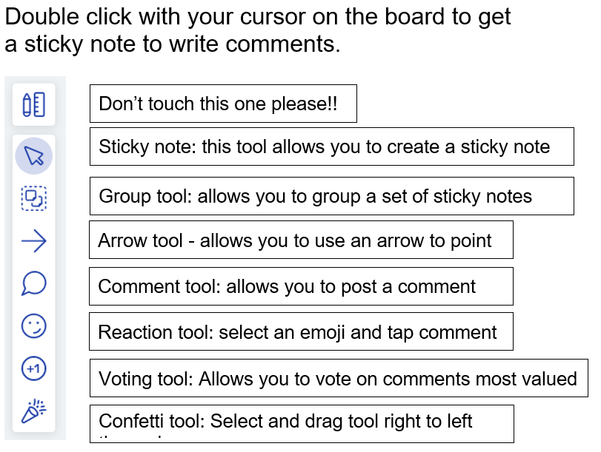
METRO RETRO BOARD
How might your students demonstrate evidence of AE2 in their task?

Slide 14
AE3: Evaluation of implemented strategies.
AE3 | Performance Standard | Some examples of how students may demonstrate this.
A | Perceptive evaluation | Evaluates deeper than the obvious, judgment is nuanced and entirely founded on evidence (criteria). Student uses evidence to inform a judgment that considers different perspectives on why or how any particular strategy was effective and/or ineffective and whether the strategy achieved its intended outcomes. These perspectives may include (but are not limited to) comparing different sources of evidence (examples include evidence collected from training/practice or performance situation or post-training fitness or skills testing), different viewpoints or applying different concepts from K&U to determine a level of value for the strategy. Students may use evidence of transfer from training/practice to the performance situation to support justification for the effective or ineffective aspects of the strategy.
B | Some perceptive evaluation | Evaluation of strategies, for the most part, is informed by evidence (criteria), and beyond the superficial. Student uses evidence to support the reasons for why a strategy was effective or ineffective and whether the strategy achieved its intended outcomes. Student is able to give a judgment about the value of particular aspects of strategies, perhaps identifying parts that were effective and parts that were ineffective. Evidence may include evidence collected from training/practice or performance situation or post-training fitness or skills testing.
C | Description, with some evaluation | There needs to be clear evidence of some evaluation of at least one strategy. There may be some description. The differentiating factor from a D level is that there is some evaluation – meaning the student provides a judgement of the value of the strategy based on one or more criteria. Evaluation may be superficial. For example, student provides a holistic judgment about the value of a strategy/ies. This may look like the student identifying that a training session was good/bad and giving some reasons why. Reasons may be general in nature.
D | Description | The experiences of implementing strategies are recounted. Student outlines, sometimes in great detail, their strategies (journey/training/practice) without providing a judgement of their value. For example, Student talks about how they felt when undertaking practice/training. Information about how the strategies looked and what happened is provided without a judgment given for how valuable these strategies were.
E | Attempted description | Student has attempted to outline the strategies that they implemented but it is relatively unclear
Notes:
JESS
What differentiates a C from a D:
D level = student just describes what they did. It’s a narrative.
C is more accessible than in 2020 – student may still describe predominantly their strategies, but as long as they are able to provide some evaluation of at least one strategy there is evidence for a C. Was the strategy effective or not with at least one reason as to why.
What differentiates an A from a B:
B level = evidence is clearly used to support justifying a strategy being effective or not. Beyond the superficial that is a C level.
A level is being able to use evidence to identify how a strategy can be more or less effective in different situations or times or with different people, etc. The aspects of the strategy are unpacked to go into the depth as to what exactly about the strategy was effective or not and being able to use evidence to support the judgements being made

Slide 15
METRO RETRO BOARD
How might your students demonstrate evidence of AE3 in their task?

Slide 16
AC2: Application of communication and collaborative skills.
AC2 | Performance Standard | Some examples of how students may demonstrate this
A | Highly effective and focused application | Student tailors the use of specific and identified communication and collaboration skill/s toward achieving an intended purpose for the physical activity context and the participant/s involved. The student adapts the use of the skill/s according to the context of the person/s they are collaborating with and the context of the situation. There may be multiple communication and collaboration skills used according to the needs of the situation and/or there is evidence of the skill/s being used and modified across multiple situations in order to achieve the intended outcomes related to the physical activity and participant/s.
B | Mostly effective application | Student identifies the communication and collaboration skill/s they are using and how they are intended to impact the outcomes for the physical activity and/or participant/s. There may be multiple communication and collaboration skill/s used. The student may adapt the skill/s used according to the person/s they are collaborating with and the situation.
C | Generally effective application | Student uses communication and collaboration skill/s within a physical activity context. The communication and collaboration skill/s may be broad or general in nature, but their use by the student achieves an outcome for the participant/s and/or physical activity.
D | Some application | Student generalises their use of communication and collaboration skill/s. The skill/s are used within a physical activity context.
E | Attempted application | Student references communication and collaboration skill/s. There is minimal evidence of how the skill/s were used within a physical activity context.
Notes:
BRAD
Examples
D = photos/video of group meetings, emails/messages, etc. ‘plonked’ on screen
C = some form of additional information (e.g. annotation, verbal explanation, in the task response) identifying how this is evidence of C&C for or within a physical activity context
B = identifies specific C&C skill/s being used in that group meeting or message, etc. For example they identify how pooling resources has helped the coaching team or the coach + player to improve the player’s performance.
A = more than one example of that C&C skill being used with evidence of how it is being adapted or tailored to the context. For example using specific collaborative skills that suit the player you are coaching or using collaborative skills that best allow 2 or more coaches to work together to achieve what they need to. For example the student is able to recognise how they contribute to pooling resources, how they receive and use the resources shared by others, how they invite further contribution of resources, how they build on or further develop resources through the sharing process with a thread throughout as to how this is achieving an outcome.
**to achieve at an A or B level it is most likely that the student has given evidence throughout their task response and not just a tack on at the end. Although they may still draw together a summary of their C&C skills at the end in addition to evidence throughout.

Slide 17
METRO RETRO BOARD
How might your students demonstrate evidence of AC2 in their task?

Slide 18
AE1: Analysis and evaluation of evidence relating to physical activity.
AE1 | Performance Standard | Some examples of how students may demonstrate this.
A | Critical analysis and perceptive evaluation | Student examines parts of evidence and draws out relationships (trends, connections, comparisons, contrasts, causation, correlation) between different types or parts of evidence. Evidence is synthesised and, where possible, contrasted to determine different perspectives on how evidence could be interpreted and what this says about the participation or performance. Evidence used to support other points being made is consistently highly relevant. There is nuanced appreciation for the validity and reliability when using the evidence, which may look like a student demonstrating possible shortcomings when using the evidence. (At an upper A level, there may be intentional, targeted selection of evidence to support the point i.e. not an abundance of all evidence that has been collected being included within the response).
B | Thoughtful analysis and evaluation | Student breaks down evidence into parts and identifies relationships (trends, connections, comparisons, contrasts) between different types or parts of evidence to examine what it says about participation or performance. There may be different perspectives given on how evidence could be interpreted and what this says about the participation or performance. Evidence used to support other points being made is relevant.
C | Some analysis and evaluation | There is some break down of evidence into parts and some relationships (trends, connections, comparisons, contrasts) between types or parts of evidence are identified with links made to participation or performance. Evidence used to support other points being made is mostly relevant.
D | Basic analysis and description | The evidence is explained, recounted or stated as presented. There is a basic attempt to breakdown evidence and/or identify a relationship between pieces of evidence. The process of collecting evidence may be outlined.
E | Attempted description | Student identifies or outlines what evidence they have. There may be some reference to parts of the evidence in isolation from other parts. The process of collecting evidence may be outlined.
Notes:
JESS
Examples:
D level = Data is put into basic table or graph or there are some simple annotations on a photo/video
C = as above with additional break down and relationship of evidence identified and there is a clear link of the evidence being used to support other points e.g. evaluation of improvement or strategies
B = rich or multiple forms of data collected throughout the performance journey. Relevant evidence used to support other points.
A = rich & multiple form of data synthesised throughout. Targeted/focused selection of evidence for drawing out information to support evaluation of improvement or strategies.
You don’t ‘get lost’ in the data, it tells a clear story

Slide 19
METRO RETRO BOARD
How might your students demonstrate evidence of AE1 in their task?

Slide 20
AC1: Contextual application of knowledge and understanding to movement concepts and strategies.
AC1 | Performance Standard | Some examples of how students may demonstrate this
A | Insightful and highly effective contextual application | Deep, refined and consistently accurate use of relevant KU. Focused use of KU to make sense of movement concepts and/or strategies specific to the context of the physical activity and the participant/s. This is demonstrated when using KU to inform: the analysis and evaluation of evidence; the evaluation of participation or performance improvement; and the implementation and evaluation of strategies.
B | Considered and mostly effective contextual application | Relevant and accurate KU is used to make sense of movement concepts and/or strategies. It can be clearly identified how KU has been used (considered) to inform analysis and evaluation of evidence, evaluation of improvement and the implementation and evaluation of strategies. This use of KU is specific to the physical activity and the participant/s.
C | Contextual application | KU is accurate and there are links showing how KU has been used to inform other components of the task, including analysis and evaluation of evidence, evaluation of improvement and/or the implementation and evaluation of strategies. KU may be generalised but is relevant to the physical activity, the participant/s or both.
D | Some contextual application | KU is generalised and mostly relevant to the physical activity or participant/s. There may be some errors in KU and how it is used to inform other components of the task.
E | Attempted application | KU is stated. There may be some attempted links to the physical activity or participant/s.
Notes:
SHANE
What differentiates a C from a D:
D level = student has some understanding, perhaps there are some definitions
C level = accurate and contextual (i.e. relevant) but probably quite general
What differentiates an A from a B:
B level = relevant and accurate and used to inform the other components of the task. Clear links to AE2, AE3
A level = highly specific and tailored to the context of the physical activity and the participant. i.e. selected and used appropriately. Not an information dump, allowing for focus and depth.

Slide 21
AC4: Communication using subject-specific terminology.
AC4 | Performance Standard | Some examples of how students may demonstrate this
A | Highly effective and accurate | Student uses terminology from the Focus Areas that is consistently correct and relevant for the context in which it is used. Where there is opportunity to use terminology, the student does so. Terminology is accurate according to the specific Key Idea being applied. The use of terminology is sophisticated in relation to its subject-specificity, by adding depth to the meaning/understanding/application/evaluation of participation/performance within physical activity that the student is communicating.
B | Effective and accurate | Student uses terminology from the Focus Areas that is consistently correct and relevant for the context in which it is used. Where there is opportunity to use terminology, the student does so the majority of the time. The use of terminology contributes to the meaning/understanding/application/evaluation of participation/performance within physical activity that the student is communicating.
C | Generally effective with some accuracy | Student uses terminology from the Focus Areas that is mostly correct and relevant for the context in which it is used to communicate about the physical activity participation/performance. There may be a few errors in the way terminology is used or there may be times where general language is used when subject-specific terminology would have been appropriate.
D | Some communication | Student uses some correct terminology from the Focus Areas to communicate about the physical activity participation/performance, however, there is a tendency toward using general language when subject-specific terminology would have been appropriate.
E | Attempted communication | Student uses terminology from the Focus Areas sporadically and sometimes correctly, to communicate something about physical activity.
Notes:
BRAD

Slide 22
METRO RETRO BOARD
How might your students demonstrate evidence of AC1 & AC4 in their task?

Slide 23
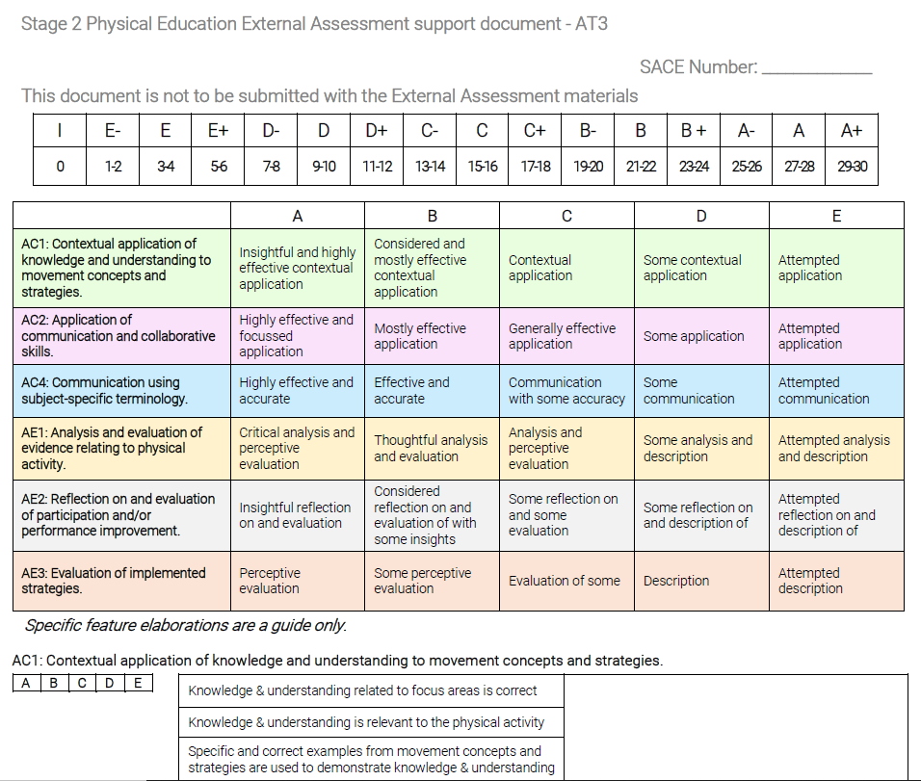
External Assessment support document
In Advice and Strategies on PE minisite
Notes:
DEANNA

Slide 24
Q & A
Questions related to AT3
If time – questions related to other aspects of the course
Notes:
SHARED

Slide 25
Thank You
Follow up | Feedback | Questions or Concerns
Deanna Isles
Deanna.Isles@sa.gov.au
Notes:
DEANNA

Slide 26


